Slide 1
COE211: Digital Logic Design
Introduction

Slide 2
* Introduction to Digital Logic Design
One of the characteristics that separates an engineer or computer scientist from a layperson (not professional) is a systematic approach to managing complexity.
Modern digital systems are built from millions or billions of transistors.
No human being could understand these systems by writing equations describing the movement of electrons in each transistor and solving all of the equations simultaneously.
You will need to learn to manage complexity to understand how to build a microprocessor by easily manner.

Slide 3
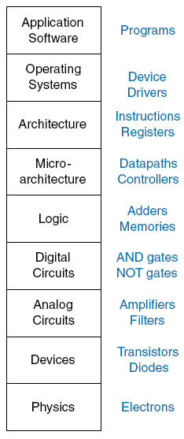
* Levels of abstraction for electronic computing system

Slide 4
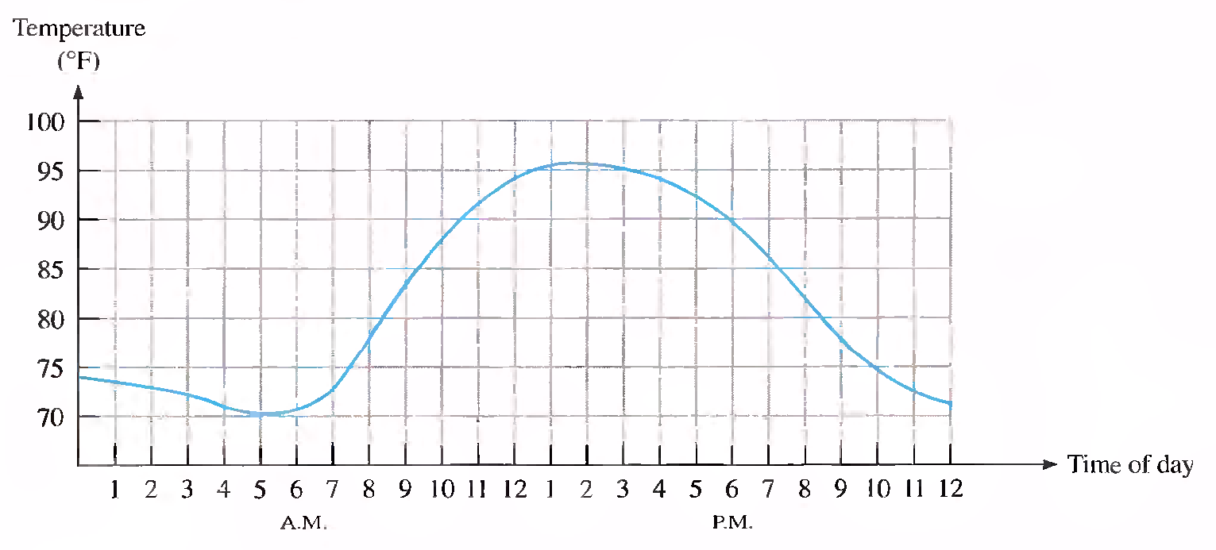
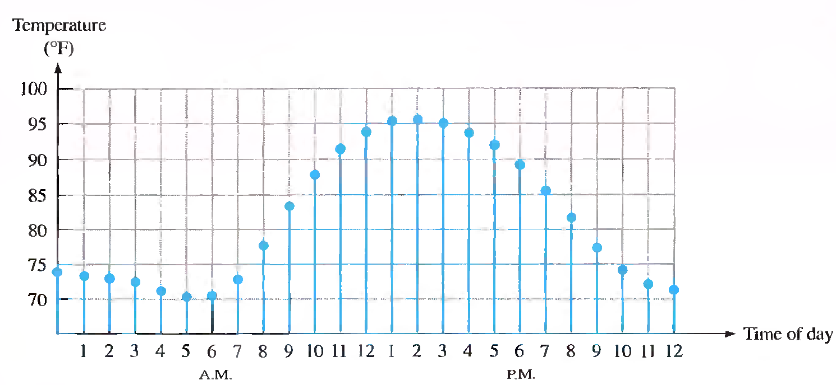
* Digital and Analog Quantities
An analog quantity is one having continuous values
A digital quantity is one having a discrete set of values

Slide 5
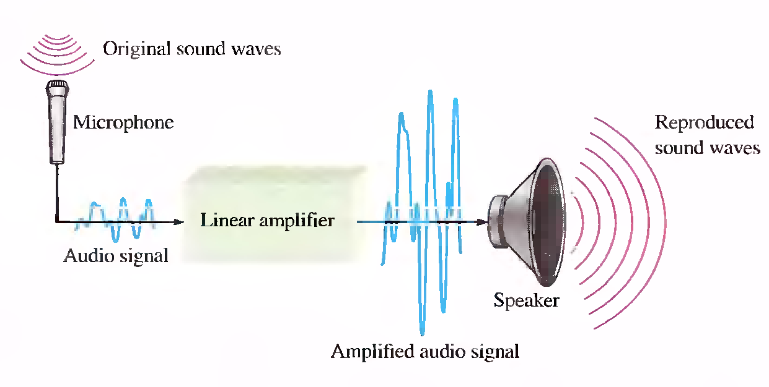
* An Analog Electronic System

Slide 6
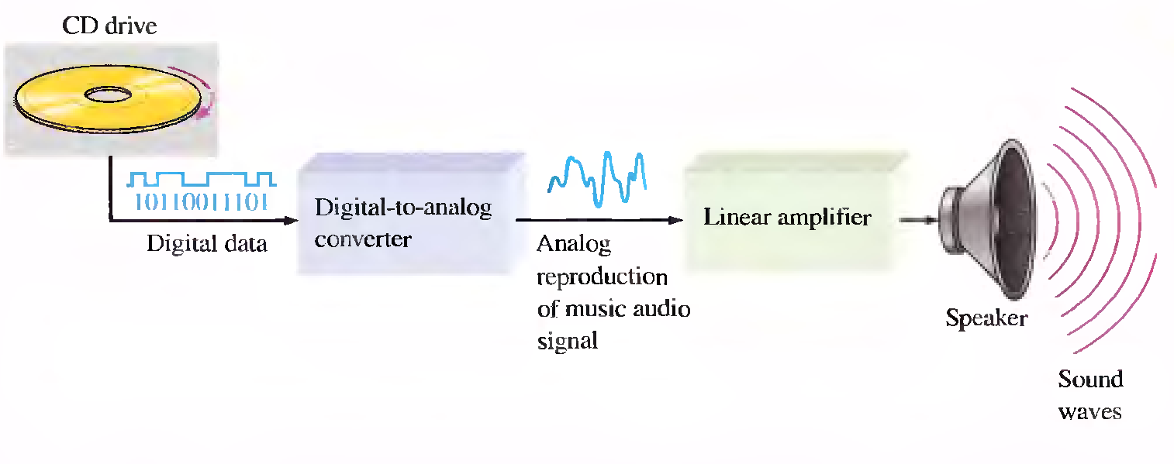
* A System Using Digital and Analog Methods

Slide 7
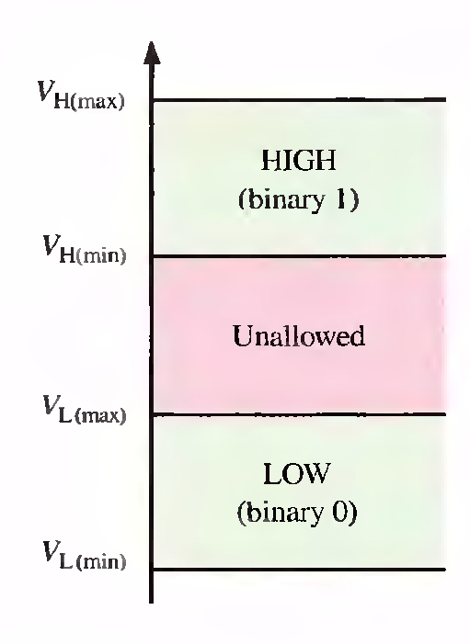
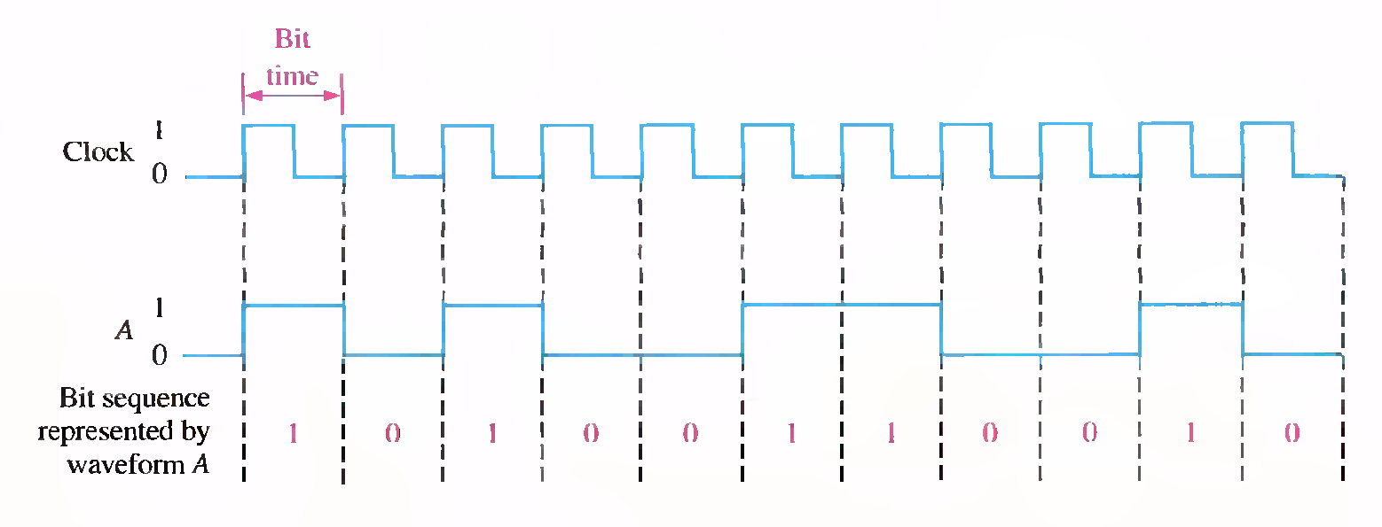
* Basic Logic States

Slide 8
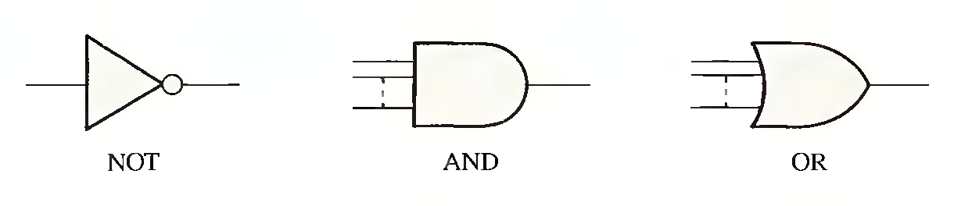
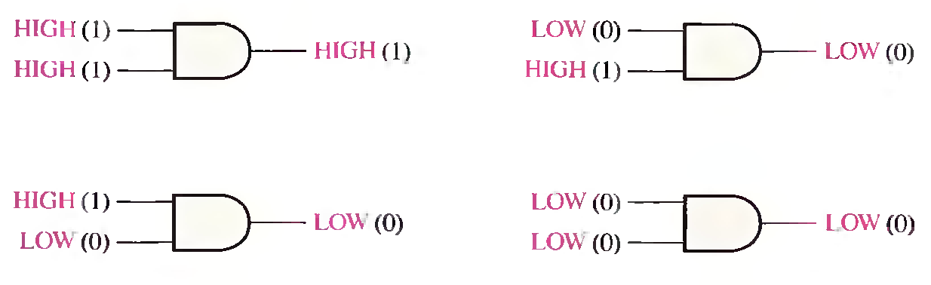
* Basic Logic Operations

Slide 9
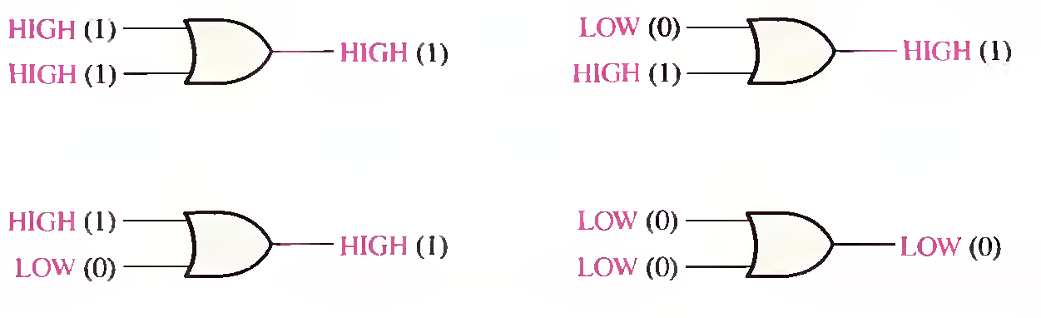

* Basic Logic Operations

Slide 10
Digital Computer Systems
Digital systems consider discrete amounts of data
Examples
26 letters in the alphabet
10 decimal digits
Larger quantities can be built from discrete values:
Words made of letters
Numbers made of decimal digits (e.g. 239875.32)
Computers operate on binary values (0 and 1)
Easy to represent binary values electrically
Voltages and currents
Can be implemented using circuits
Create the building blocks of modern computers

Slide 11
Number Systems
Decimal Numbers
Binary Numbers
Octal Numbers
Hexadecimal Numbers
Number System Conversion
Signed Number Representation

Slide 12
Understanding Decimal Numbers
Decimal numbers are made of decimal digits: (0,1,2,3,4,5,6,7,8,9) ⇒ Base = 10
But how many items does a decimal number represent?
8653 = 8 x10³ + 6 x10² + 5 x10¹ + 3 x10⁰
Number = d₃ x B³ + d₂ x B² + d₁ x B¹ + d₀ x B⁰ = Value
What about fractions?
97654.35 = 9x10⁴ + 7x10³ + 6x10² + 5x10¹ + 4x10⁰ + 3x10⁻¹ + 5x10⁻²
In formal notation → (97654.35)₁₀

Slide 13
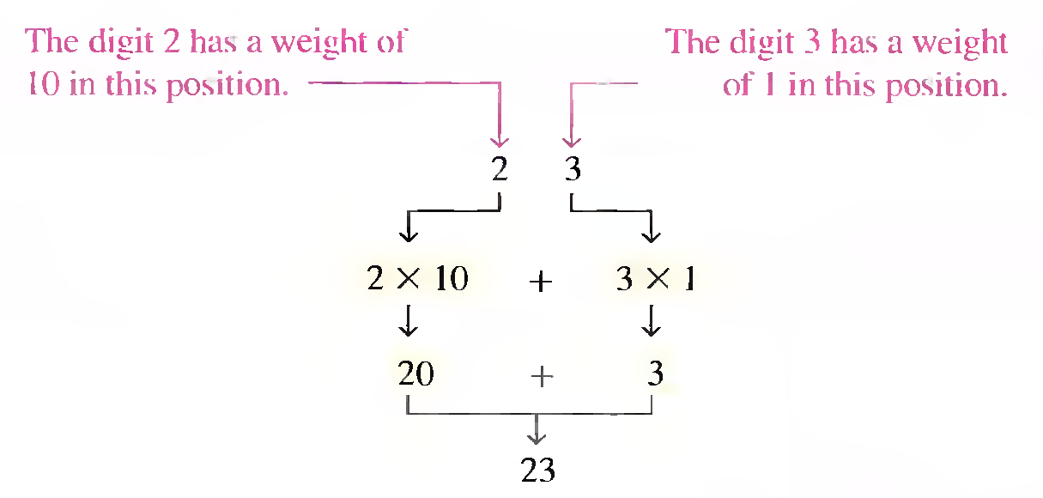
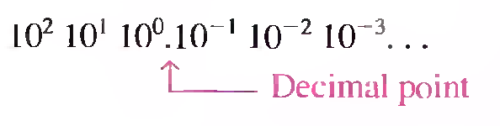
* Understanding Decimal Numbers
Example

Slide 14
Understanding Binary Numbers
Binary numbers are made of binary digits (bits):
0 and 1
How many items does a binary number represent?
8 4 2 1 = Weights
(1011)₂ = 1x2³ + 0x2² + 1x2¹ + 1x2⁰ = (11)₁₀
What about fractions?
(110.10)₂ = 1x2² + 1x2¹ + 0x2⁰ + 1x2⁻¹ + 0x2⁻²
Groups of eight bits are called a byte
(11001001)₂
Groups of four bits are called a nibble
(1101)₂

Slide 15
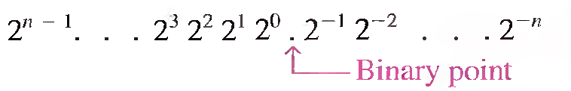
* Understanding Binary Numbers
POSITIVE POWERS OF TWO (WHOLE NUMBERS) |  |  |  |  |  |  |  |  | NEGATIVE POWERS OF TWO (FRACTIONAL NUMBER)
2⁸ | 2⁷ | 2⁶ | 2⁵ | 2⁴ | 2³ | 2² | 2¹ | 2⁰ | 2⁻¹ | 2⁻² | 2⁻³ | 2⁻⁴ | 2⁻⁵ | 2⁻⁶
256 | 128 | 64 | 32 | 16 | 8 | 4 | 2 | 1 | 1/2 | 1/4 | 1/8 | 1/16 | 1/32 | 1/64
 |  |  |  |  |  |  |  |  | 0.5 | 0.25 | 0.125 | 0.0625 | 0.03125 | 0.015625

Slide 16
Understanding Octal Numbers
Octal numbers are made of octal digits: (0,1,2,3,4,5,6,7)
How many items does an octal number represent?
512 64 8 1 = Weights
(4536)₈ = 4x8³ + 5x8² + 3x8¹ + 6x8⁰ = (2398)₁₀
What about fractions?
(465.27)₈ = 4x8² + 6x8¹ + 5x8⁰ + 2x8⁻¹ + 7x8⁻²
Octal numbers don’t use digits 8 or 9

Slide 17
Understanding Hexadecimal Numbers
Hexadecimal numbers are made of 16 digits:
(0,1,2,3,4,5,6,7,8,9,A, B, C, D, E, F)
How many items does a hex number represent?
4096 256 16 1 = Weights
(3A9F)₁₆ = 3x16³ + 10x16² + 9x16¹ + 15x16⁰ = 15007₁₀
What about fractions?
(2D3.5)₁₆ = 2x16² + 13x16¹ + 3x16⁰ + 5x16⁻¹ = 723.3125₁₀
Note that each hexadecimal digit can be represented with four bits
(1110)₂ = (E)₁₆

Slide 18
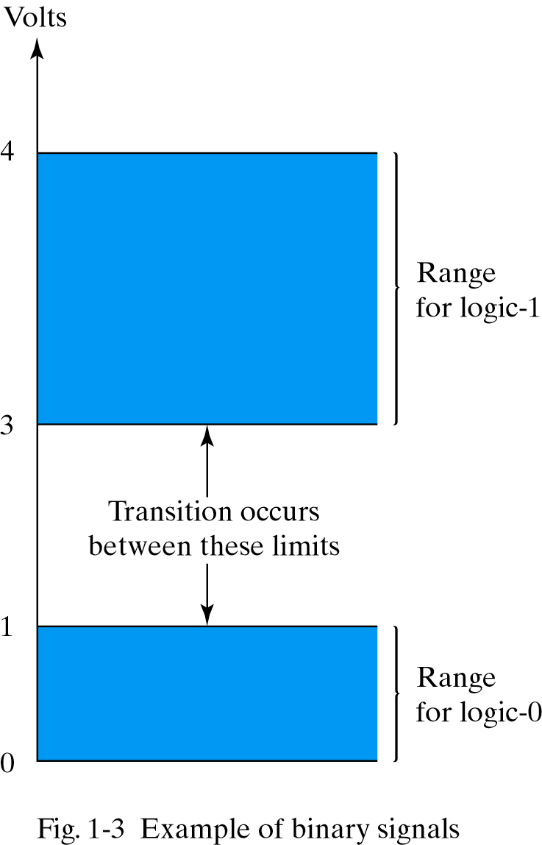
Why Use Binary Numbers?
Easy to represent 0 and 1 using electrical values
Possible to tolerate noise
Easy to transmit data
Easy to build binary circuits
1
AND Gate
0
0

Slide 19
Convert an Integer from Decimal to Another Base
For each digit position:
Divide decimal number by the base (e.g. 2)
The remainder is the lowest-order digit
Repeat first two steps until no divisor remains
Example for (13)₁₀:
Quotient
Remainder
Coefficient
13/2 = 6 , 1 a₀ = 1
6/2 = 3 , 0 a₁ = 0
3/2 = 1 , 1 a₂ = 1
1/2 = 0 , 1 a₃ = 1
Answer (13)₁₀ = (a₃ a₂ a₁ a₀)₂ = (1101)₂
MSB LSB

Slide 20
* Convert an Integer from Decimal to Binary
÷
2
2
2
2
2
2
2
95
47
23
11
5
2
1
0
1
1
1
1
1
0
1
LSB
MSB
LSB
= 1 0 1 1 1 1 1
MSB
* Convert from Binary to Decimal
×
64 | 32 | 16 | 8 | 4 | 2 | 1
1 | 0 | 1 | 1 | 1 | 1 | 1
64 | 0 | 16 | 8 | 4 | 2 | 1
= 95

Slide 21
Convert a Fraction from Decimal to Another Base
For each digit position:
Multiply decimal number by the base (e.g. 2)
The integer is the highest-order digit
Repeat first two steps until fraction becomes zero
Example for (0.625)₁₀:
Integer
Fraction
Coefficient
0.625 x 2 = 1 + 0.250 a₋₁ = 1
0.250 x 2 = 0 + 0.500 a₋₂ = 0
0.500 x 2 = 1 + 0 a₋₃ = 1
Answer (0.625)₁₀ = (0.a₋₁ a₋₂ a₋₃ )₂ = (0.101)₂
MSB LSB

Slide 22
* Convert an Integer from Decimal to Binary
×
2
2
2
2
2
2
2
2
MSB
0.33203125.
0.6640625
0.328125
0.65625
0.3125
0.625
0.25
0.5
0
0
1
0
1
0
1
0
1
MSB
LSB
= 0.01010101
LSB
* Convert from Binary to Decimal
×
0.5 | 0.25 | 0.125 | 0.0625 | 0.03125 | 0.015625 | 0.0078125
0 | 1 | 0 | 1 | 0 | 1 | 0
0 | 0.25 | 0 | 0.0626 | 0 | 0.015625 | 0
0.00390625
1
0.00390625
= 0.3320303125

Slide 23
* Conversion Between Base 16 and Base 2
Hexadecimal Number
0
1
2
3
4
5
6
7
8
9
A
B
C
D
E
F
Decimal Number | Binary Number
0 | 0 | 0 | 0 | 0
1 | 0 | 0 | 0 | 1
2 | 0 | 0 | 1 | 0
3 | 0 | 0 | 1 | 1
4 | 0 | 1 | 0 | 0
5 | 0 | 1 | 0 | 1
6 | 0 | 1 | 1 | 0
7 | 0 | 1 | 1 | 1
8 | 1 | 0 | 0 | 0
9 | 1 | 0 | 0 | 1
10 | 1 | 0 | 1 | 0
11 | 1 | 0 | 1 | 1
12 | 1 | 1 | 0 | 0
13 | 1 | 1 | 0 | 1
14 | 1 | 1 | 1 | 0
15 | 1 | 1 | 1 | 1

Slide 24
Conversion Between Base 16 and Base 2
Conversion is easy!
Determine the 4-bit value for each hex digit
Note that there are 16 different values of four bits
Easier to read and write in hexadecimal
Representations are equivalent!
3A9F₁₆ = 0011 1010 1001 1111₂
3
A
9
F

Slide 25
* Example
Convert the following binary numbers to hexadecimal:
(a) 1100101001010111
(b) 111111000101101001
Solution.
1100 _ 1010 _ 0101 _ 0111 = CA57)₁₆
0011 _ 1111 _ 0001 _ 0110 _ 1001 = 3F169)₁₆

Slide 26
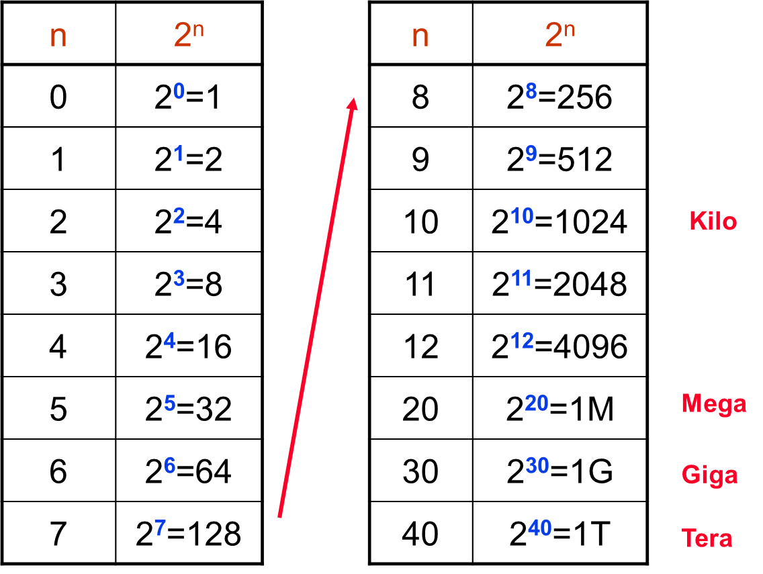
The Growth of Binary Numbers

Slide 27
* Hexadecimal-to-Decimal Conversion
16³ 16² 16¹ 16⁰
4096 256 16 1
Convert the following hexadecimal numbers to decimal:
(a) E5)₁₆ (b) B2F8)₁₆
Solution.
(a) E5)₁₆ = (E×16) + (5×1) = (14×16) + (5×1) = 224 + 5 = 229)₁₀
(b) B2F8)₁₆ = (B×4096) + (2×256) + (F×16) + (8×1) = (11×4096) + (2×256) + (15×16) + (8×1) = 45,056 + 512 + 240 + 8 = 45,81610

Slide 28
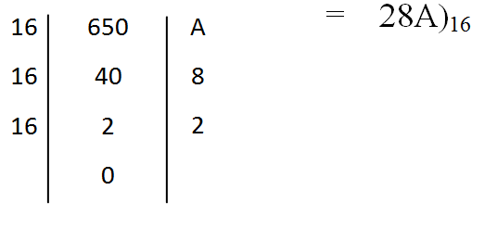
* Decimal-to-Hexadecimal Conversion
Convert the decimal number 650 to hexadecimal by repeated division by 16.
Solution.

Slide 29
* Octal Numbers
Decimal | Binary |  |  | Octal
0 | 0 | 0 | 0 | 0
1 | 0 | 0 | 1 | 1
2 | 0 | 1 | 0 | 2
3 | 0 | 1 | 1 | 3
4 | 1 | 0 | 0 | 4
5 | 1 | 0 | 1 | 5
6 | 1 | 1 | 0 | 6
7 | 1 | 1 | 1 | 7

Slide 30
* Octal-to-Decimal Conversion
Convert 2374)₈ to Decimal
Weight: 8³ 8² 8¹ 8⁰
Octal number: 2 3 7 4
2374)₈ = (2 × 8³) + (3 × 8² ) + (7 × 8¹ ) + (4 × 8⁰)
= (2×512) + (3 × 64) + (7 × 8) + (4 × 1)
= 1024 + 192 + 56 + 4 =1276)₁₀

Slide 31
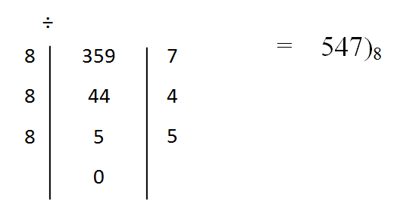
* Decimal-to-Octal Conversion
Convert 359)₁₀ to Octal

Slide 32
* Octal-to-Binary Conversion
Convert each of the following octal numbers to binary: (a) 13)₈ (b) 25)₈ (c) 140)₈ (d) 7526)₈
Solution.
13 = 001 _ 011 = 1011
25 = 010 _ 101 = 10101
140 = 001_100_000 = 1100000
7526 =111_101_010_110 = 111101010110

Slide 33
* Hexadecimal-to-Octal Conversion
Convert each of the following numbers:
(a) 7526)₈ to Hexadecimal (b) 5AC2)₁₆ to Octal
Solution.
7526)₈ =111_101_010_110 = 111101010110
1111_0101_0110 = F56)₁₆
5AC2)₁₆ =0101_1010_1100_0010 = 101101011000010
101_101_011_000_010 = 55302)₈

Slide 34
Understanding Binary Coded Decimal
Binary Coded Decimal (BCD) represents each decimal digit with four bits
Ex. 0011 0010 1001
This is NOT the same as 001100101001₂ = 809₁₀
= 329_{BCD}
3
2
9
Digit | BCD Code
0 | 0000
1 | 0001
2 | 0010
3 | 0011
4 | 0100
5 | 0101
6 | 0110
7 | 0111
8 | 1000
9 | 1001

Slide 35
Putting It All Together
Decimal | Binary | Octal | Hexadecimal | BCD
0 | 0000 | 0 | 0 | 000
1 | 0001 | 1 | 1 | 0001
2 | 0010 | 2 | 2 | 0010
3 | 0011 | 3 | 3 | 0011
4 | 0100 | 4 | 4 | 0100
5 | 0101 | 5 | 5 | 0101
6 | 0110 | 6 | 6 | 0110
7 | 0111 | 7 | 7 | 0111
8 | 1000 | 10 | 8 | 1000
9 | 1001 | 11 | 9 | 1001
10 | 1010 | 12 | A | 0001 0000
11 | 1011 | 13 | B | 0001 0001
12 | 1100 | 14 | C | 0001 0010
13 | 1101 | 15 | D | 0001 0011
14 | 1110 | 16 | E | 0001 0100
15 | 1111 | 17 | F | 0001 0101

Slide 36
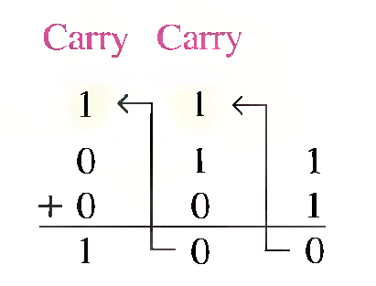
* Binary Addition
Carry-in | A | B | Sum | Carry-out
0 | 0 | 0 | 0 | 0
0 | 0 | 1 | 1 | 0
0 | 1 | 0 | 1 | 0
0 | 1 | 1 | 0 | 1
1 | 0 | 0 | 1 | 0
1 | 0 | 1 | 0 | 1
1 | 1 | 0 | 0 | 1
1 | 1 | 1 | 1 | 1

Slide 37
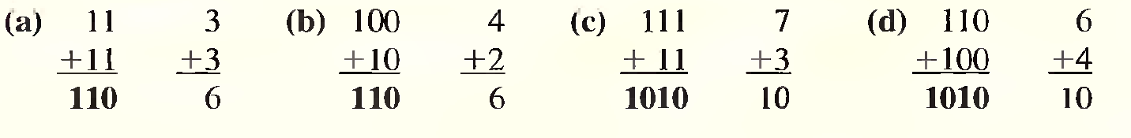
* Binary Addition
1111111
00111011 1+2+8+16+32 = 59
01010111+ 1+2+4+16+64 = 87
------------ = 146
10010010 2+16+128 = 146

Slide 38
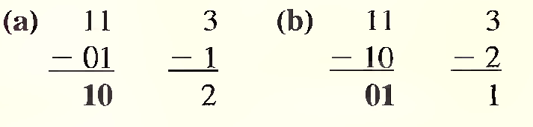
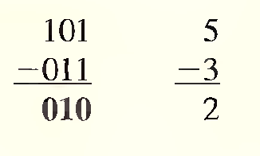
* Binary Subtraction
0 - 0 = 0
1 - 1 = 0
1 - 0 = 1
10 - 1 = 1
0 - 1 with a borrow of (1)

Slide 39
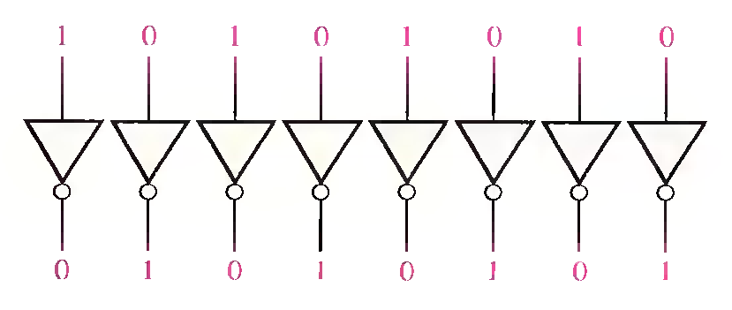
* 1's and 2's Complements of Binary Numbers
Finding the 1's Complement
Finding the 2's Complement
2's complement = (l's complement) + 1

Slide 40
* Subtracting two unsigned numbers
1's Complement
 | 01010111
 | 00111011 | -
 | 01010111
 | 11000100 | +
1 | 00011011
 | 1
 | 11100

Slide 41
* Subtracting two unsigned numbers
2's Complement
 | 01010111
 | 00111011 | -
 | 01010111
 | 11000101 | +
1 | 00011100

Slide 42
How To Represent Signed Numbers
Plus and minus signs are used for decimal numbers:
25 (or +25), −16, etc
In computers, everything is represented as bits
Three types of signed binary number representations:
signed magnitude
1’s complement
2’s complement
In each case: left-most bit indicates the sign: ‘0’ for positive and ‘1’ for negative

Slide 43
Signed Magnitude Representation
The left most bit is designated as the sign bit while the remaining bits form the magnitude
00001100₂ = 12₁₀
Sign bit
Magnitude
10001100₂ = −12₁₀
Sign bit
Magnitude

Slide 44
One’s Complement Representation
The one’s complement of a binary number is done by complementing (i.e. inverting) all bits
1’s comp of 00110011 is 11001100
1’s comp of 10101010 is 01010101
For a n-bit number N the 1’s complement is (2^{n} − 1) − N
Called “diminished radix complement” by Mano
To find the negative of a 1’s complement number take its 1’s complement
00001100₂ = 12₁₀
11110011₂ = −12₁₀
Sign bit
Magnitude
Sign bit
Code

Slide 45
One’s Complement Representation
7
0111
4 bits
⇓ 16 combinations
6
0110
.
.
.
.
1
0001
0
0000
− 0
1111
− 1
1110
.
.
.
.
− 6
1001
− 7
1000

Slide 46
Two’s Complement Representation
The two’s complement of a binary number is done by complementing (inverting) all bits then adding 1
2’s comp of 00110011 is 11001101
2’s comp of 10101010 is 01010110
For an n-bit number N the 2’s complement is (2^{n}−1) − N + 1
Called “radix complement” by Mano
To find the negative of a 2’s complement number take its 2’s complement
00001100₂ = 12₁₀
11110100₂ = −12₁₀
Sign bit
Magnitude
Sign bit
Code

Slide 47
Two’s Complement Shortcuts
Algorithm 1: Complement each bit then add 1 to the result
N = 01100101
10011010
+ 1
10011011
Algorithm 2: Starting with the least significant bit, copy all of the bits up to and including the first ‘1’ bit, then complement the remaining bits
N = 0 1 1 0 0 1 1 0
[N] = 1 0 0 1 1 0 1 0
[N] = 10011011
01100100
+ 1
01100101

Slide 48
Two’s Complement Representation
7
0111
4 bits
⇓ 16 combinations
6
0110
.
.
2
0010
1
0001
0
0000
− 1
1111
− 2
1110
.
.
.
.
− 7
1001
− 8
1000

Slide 49
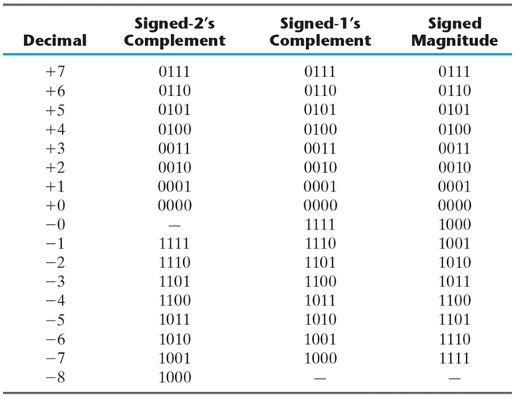
Putting All Together

Slide 50
Finite-Precision Number Representation
Machines that use 2’s complement arithmetic can represent integers in the range
− 2^{n-1} ≤ N ≤ 2^{n-1} − 1
n is the number of bits used for representing N
Note that 2^{n-1} − 1 = (011..11)₂ and − 2^{n-1} = (100..00)₂
2’s complement code has more negative numbers than positive
1’s complement code has 2 representations for zero
For an n-bit number in base (i.e. radix) z there are z^{n} different unsigned values (combinations)
(0, 1, …z^{n-1})

Slide 51
2’s Complement Addition
Using 2’s complement representation, adding numbers is easy
Step 1: Add binary numbers
Step 2: Ignore the resulting carry bit
For example: (12)₁₀ + (1)₁₀
(12)₁₀ = +(1100)₂
= 01100₂ in 2’s comp.
(1)₁₀ = +(0001)₂
= 00001₂ in 2’s comp.
0 1 1 0 0
+ 0 0 0 0 1
--------------
0 0 1 1 0 1
Add
Final
Result
Ignore

Slide 52
2’s Complement Subtraction
Using 2’s complement representation, subtracting numbers is also easy
Step 1: Take 2’s complement of 2nd operand
Step 2: Add binary numbers
Step 3: Ignore the resulting carry bit
For example: (12)₁₀ − (1)₁₀
(12)₁₀ = +(1100)₂
= 01100₂ in 2’s comp.
(−1)₁₀ = −(0001)₂
= 11111₂ in 2’s comp.
0 1 1 0 0
- 0 0 0 0 1
0 1 1 0 0
+ 1 1 1 1 1
--------------
1 0 1 0 1 1
2’s comp
Add
Final
Result
Ignore
Carry

Slide 53
2’s Complement Subtraction (Cont’d)
Example 2: (13)₁₀ − (5)₁₀
(13)₁₀ = +(1101)₂ = (01101)₂
(−5)₁₀ = −(0101)₂ = (11011)₂
Adding these two 5-bit codes:
0 1 1 0 1
+ 1 1 0 1 1
1 0 1 0 0 0
Discarding the carry bit, the sign bit is seen to be zero, indicating a positive result
Indeed: (01000)₂ = +(8)₁₀
Carry

Slide 54
2’s Complement Subtraction (Cont’d)
Example 3: (5)₁₀ − (12)₁₀
(5)₁₀ = +(0101)₂ = (00101)₂
(−12)₁₀ = −(1100)₂ = (10100)₂
Adding these two 5-bit codes:
0 0 1 0 1
+ 1 0 1 0 0
0 1 1 0 0 1
Here, there is no carry bit and the sign bit is 1. This indicates a negative result, which is what we expect: (11001)₂ = – (7)₁₀
Carry

Slide 55
* Example 1
Add the signed numbers: 01000100, 00011011, 00001110, and 000 10010.
68 01000100
+ 27 + 00011011 ­Add 1st two numbers
------ -------------
95 01011111 1st sum
+ 14 + 00001110 Add 3rd number
----- -------------
109 01101101 2nd sum
+ 18 + 00010010 Add 4th number
----- -------------
127 01111111 Final sum

Slide 56
* Example 2
Perform each of the following subtractions of the signed numbers:
(a) 00001000 - 00000011 (c) 11100111 - 00010011
(b) 00001100 - 11110111 (d) 10001000 - 11100010
(a) In this case, 8 - 3 = 8 + (-3) = 5.
00001000 Minuend (+ 8)
+ 11111101 2's comp. of subtrahend (- 3)
--------------
Discard carry 1 00000101 Difference ( + 5)

Slide 57
* Example 2 (Cont’d)
(b) In this case, 12 - (-9) = 12 + 9 = 21.
00001100 Minuend (+ 12)
+ 00001001 2's comp. of subtrahend (+9)
--------------
00010101 Difference ( + 21)
(c) In this case, -25 - (+ 19) = -25 + (-19) = -44.
11100111 Minuend (-25)
+ 11101101 2's comp. of subtrahend (-19)
--------------
Discard carry 1 11010100 Difference ( -44)

Slide 58
* Example 2 (Cont’d)
(d) In this case, -120 - (-30) = -120 + 30 = -90.
10001000 Minuend (-120)
+ 00011110 2's comp. of subtrahend (+30)
--------------
10100110 Difference (-90)

Slide 59
Gray Code
Gray code is not a number system
It is an alternate way to represent four bit data
Only one bit changes from one decimal digit to the next
Useful for reducing errors in communication
Can be scaled to larger numbers
Digit | Binary | Gray Code
0 | 0000 | 0000
1 | 0001 | 0001
2 | 0010 | 0011
3 | 0011 | 0010
4 | 0100 | 0110
5 | 0101 | 0111
6 | 0110 | 0101
7 | 0111 | 0100
8 | 1000 | 1100
9 | 1001 | 1101
10 | 1010 | 1111
11 | 1011 | 1110
12 | 1100 | 1010
13 | 1101 | 1011
14 | 1110 | 1001
15 | 1111 | 1000

Slide 60
Text: ASCII Characters
ASCII: Maps 128 characters to 7-bit code.
both printable and non-printable (ESC, DEL, …) characters http://www.asciitable.com/
00 | nul | 10 | dle | 20 | sp | 30 | 0 | 40 | @ | 50 | P | 60 | ` | 70 | p
01 | soh | 11 | dc1 | 21 | ! | 31 | 1 | 41 | A | 51 | Q | 61 | a | 71 | q
02 | stx | 12 | dc2 | 22 | " | 32 | 2 | 42 | B | 52 | R | 62 | b | 72 | r
03 | etx | 13 | dc3 | 23 | # | 33 | 3 | 43 | C | 53 | S | 63 | c | 73 | s
04 | eot | 14 | dc4 | 24 | $ | 34 | 4 | 44 | D | 54 | T | 64 | d | 74 | t
05 | enq | 15 | nak | 25 | % | 35 | 5 | 45 | E | 55 | U | 65 | e | 75 | u
06 | ack | 16 | syn | 26 | & | 36 | 6 | 46 | F | 56 | V | 66 | f | 76 | v
07 | bel | 17 | etb | 27 | ' | 37 | 7 | 47 | G | 57 | W | 67 | g | 77 | w
08 | bs | 18 | can | 28 | ( | 38 | 8 | 48 | H | 58 | X | 68 | h | 78 | x
09 | ht | 19 | em | 29 | ) | 39 | 9 | 49 | I | 59 | Y | 69 | i | 79 | y
0a | nl | 1a | sub | 2a | * | 3a | : | 4a | J | 5a | Z | 6a | j | 7a | z
0b | vt | 1b | esc | 2b | + | 3b | ; | 4b | K | 5b | [ | 6b | k | 7b | {
0c | np | 1c | fs | 2c | , | 3c | < | 4c | L | 5c | \ | 6c | l | 7c | |
0d | cr | 1d | gs | 2d | - | 3d | = | 4d | M | 5d | ] | 6d | m | 7d | }
0e | so | 1e | rs | 2e | . | 3e | > | 4e | N | 5e | ^ | 6e | n | 7e | ~
0f | si | 1f | us | 2f | / | 3f | ? | 4f | O | 5f | _ | 6f | o | 7f | del

