Slide 1
COE211: Digital Logic Design
Simplification of Boolean Functions

Slide 2
Overview
Introduction to Karnaugh Maps
Karnaugh Maps Rules and Methods
Two and Three-Variable K-Maps
Four-Variable K-Maps
Simplification Techniques
Don’t Cares Conditions

Slide 3
Karnaugh Maps
Alternate way of representing Boolean functions
Each row in the truth table is represented by a square
Each square represents a minterm
Easy to convert between truth table, K-map, and SOP
Un-optimized form: number of 1’s in K-map equals number of minterms (products) in SOP
Optimized form: reduced number of minterms
F = Σ(m₀,m₁) = x’y’ + x’y
y
x y F
0 0 1
0 1 1
1 0 0
1 1 0
y
y
x
0
1
x
0
1
x’y’
x’y
1
1
0
0
x
1
1
xy’
xy
0
0

Slide 4
Karnaugh Maps (cont’d)
A Karnaugh map is a graphical tool for assisting in the general simplification procedure
Two variable maps
Three variable maps
B
B
0
1
0
1
A
A
0
0
1
0
0
1
F=AB +AB +AB
F=AB+AB
1
1
0
1
1
1
A
B
C
F
0
0
0
0
BC
0
0
1
1
00
01
11
10
0
1
0
1
A
0
1
1
0
0
0
1
0
1
1
0
0
1
1
0
1
1
1
1
1
1
1
1
1
0
1
1
1
1
1
+
F=ABC +ABC +ABC + ABC + ABC + ABC

Slide 5
Rules for K-Maps
We can reduce functions by circling 1’s in the K-map
Each circle represents minterm reduction
After circling, deduce a minimized AND-OR form
Rules to consider
Every cell containing a 1 must be included at least once
The largest possible “power of 2 rectangle” should be used
Use the smallest possible number of rectangles

Slide 6
Karnaugh Maps Examples
Two variable maps
Three variable maps
B
B
0
1
0
1
A
A
0
0
1
0
0
1
F=AB +AB +AB
F=AB+AB
1
1
0
1
1
1
F=A+B
BC
A
00
01
11
10
0
0
1
0
1
1
1
1
1
1
F=A+BC +BC
F=ABC +ABC +ABC + ABC + ABC + ABC

Slide 7
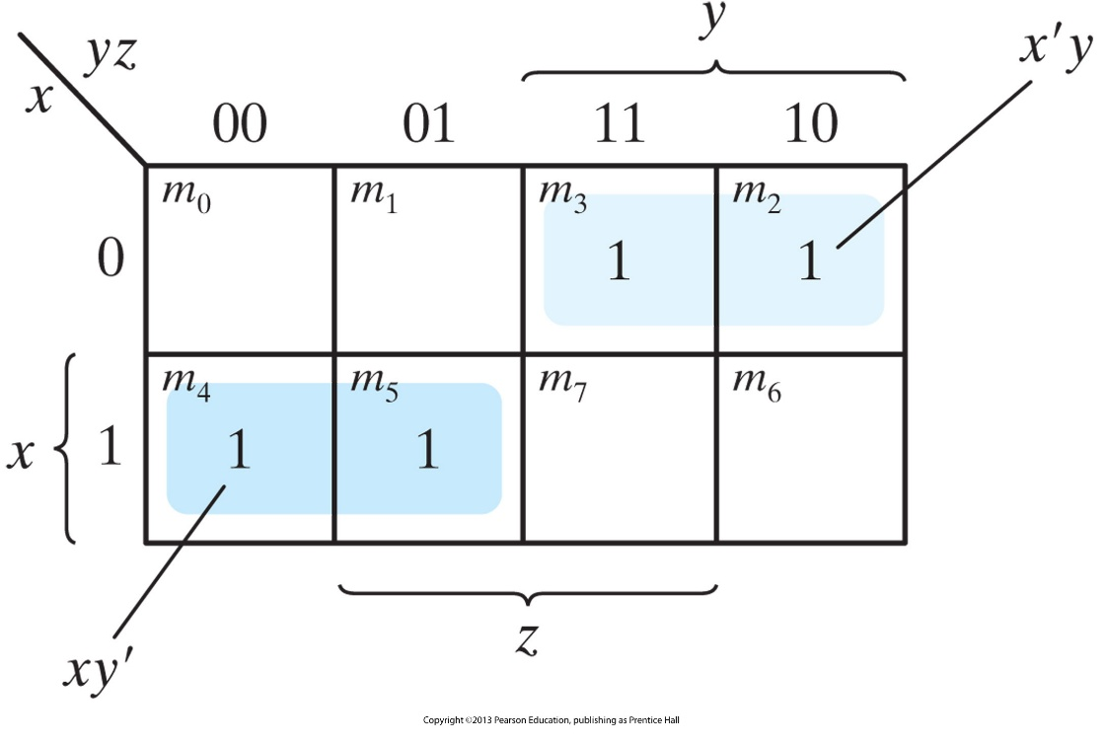
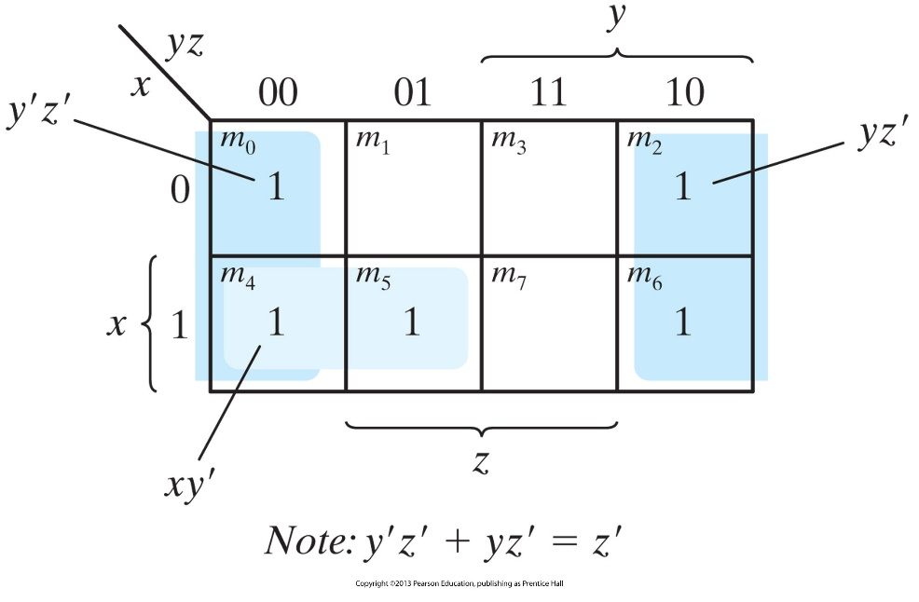
Karnaugh Maps Examples (cont’d)
FIGURE 3.6 Map for Example 3.3, F(x, y, z) = Σ(0, 2, 4, 5, 6) = z’ + xy’
FIGURE 3.4 Map for Example 3.1, F(x, y, z) = Σ(2, 3, 4, 5) = x’y + xy’

Slide 8
Karnaugh Maps Examples (cont’d)
b
b
a
0
1
a
0
1
0
0
1
0
1
1
1
0
1
1
0
0
f = b
g = a'
bc
bc
a
00
01
11
10
a
00
01
11
10
0
0
0
1
0
0
0
0
1
1
1
0
1
1
1
1
0
0
1
1
cout = bc + ac + ab
f = b
1. Circle the largest groups possible
2. Group dimensions must be a power of 2
3. Remember what circling means!

Slide 9
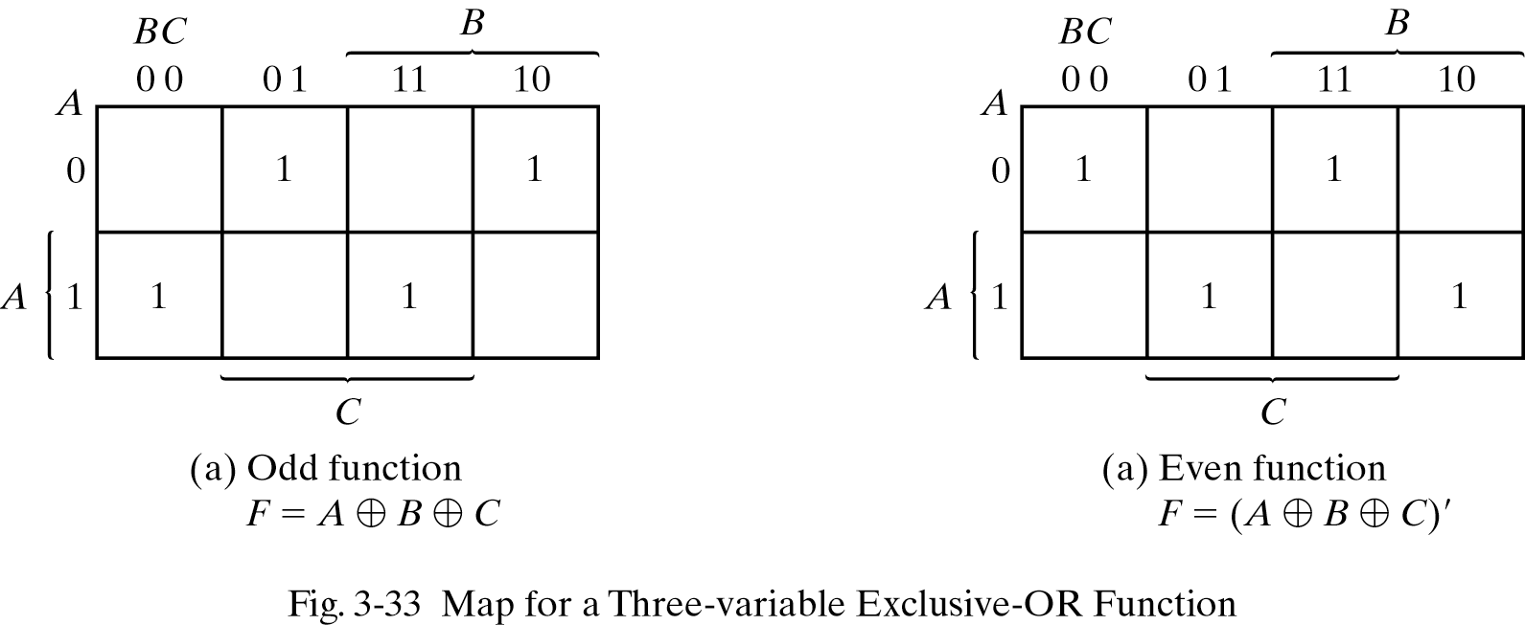
K-Maps of 3-variable XOR Function
Odd function – odd number of inputs are 1
Even function – even number of inputs are 1

Slide 10
Example using 1-bit Adder
Cin
A
B
Cin
S
Cout
0
0
0
0
0
Adder
0
0
1
1
0
A
0
1
0
1
0
How to use a Karnaugh
Map instead of the
Algebraic simplification?
S
0
1
1
0
1
B
1
0
0
1
0
1
0
1
0
1
1
1
0
0
1
1
1
1
1
1
Cout
+
S = A’B’Cin + A’BCin’ + A’BCin + ABCin
Cout = A’BCin + A B’Cin + ABCin’ + ABCin
= A’BCin + ABCin + AB’Cin + ABCin + ABCin’ + ABCin
= (A’ + A)BCin + (B’ + B)ACin + (Cin’ + Cin)AB
= 1·BCin + 1· ACin + 1· AB
= BCin + ACin + AB

Slide 11
Example using 1-bit Adder (cont’d)
Cin
Adder
A
S
B
Cout
B
0
0
1
0
Now we have to cover all the 1s in the
Karnaugh Map using the largest
rectangles and as few rectangles
as we can.
A
0
1
1
1
Cin
Karnaugh Map for Cout

Slide 12
Example using 1-bit Adder (cont’d)
Cin
A
Adder
S
B
Cout
B
Now we have to cover all the 1s in the
Karnaugh Map using the largest
rectangles and as few rectangles
as we can.
0
0
1
0
A
0
1
1
1
Cin
Cout =
BCin
+ AB
+ ACin
Karnaugh Map for Cout

Slide 13
Example using 1-bit Adder (cont’d)
Cin
Can you draw the circuit diagrams?
A
Adder
S
B
Cout
B
0
1
0
1
S =
A’ B’ Cin
+ A’BC’in
+ A B’ C’in
+ ABCin
A
1
0
1
0
Cin
No Possible Reduction!

Slide 14
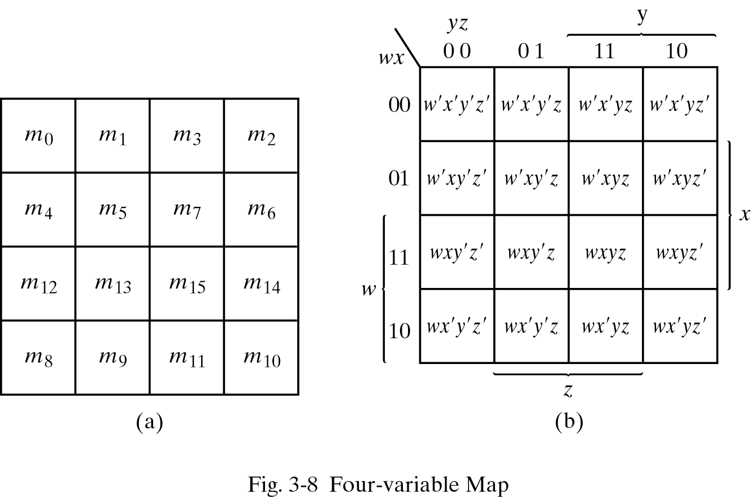
Karnaugh Maps for 4-Input Functions
Represent functions of 4 inputs with 16 minterms
Use same rules developed for 3-input functions

Slide 15
Karnaugh Map: 4-Variable Example
F(A,B,C,D) = Σm(0, 2, 3, 5, 6, 7, 8, 10, 11, 14, 15)
C
1
0
1
1
0
1
1
1
0
0
1
1
B
A
1
0
1
1
D
C
+ B’D’
F =
+ A’BD

Slide 16


Design Examples
C
C
C
0 1
0 0
1 1
1 1
1 0
0 1
0 0
0 0
0 0
1 0
0 0
0 0
B
B
B
0 0
0 0
0 0
1 0
0 0
0 0
1 0
0 1
1 1
1 1
0 1
0 0
A
A
A
D
D
D
K-map for LT
K-map for EQ
K-map for GT
LT =
EQ =
GT =
A' C + A' B' D + B' C D
A'B'C'D' + A'BC'D + ABCD + AB'CD’
A C' + B C' D' + A B D'
Can you draw the truth table for these examples?

Slide 17
Physical Implementation
Step 1: Truth table
Step 2: K-map
Step 3: Minimized sum-of-products
Step 4: Physical implementation with gates
A B C D
EQ
C
1 0
0 1
0 0
0 0
B
0 0
0 0
1 0
0 1
A
D
K-map for EQ

Slide 18
Karnaugh Maps: Don’t Cares
In some cases, outputs are undefined
We “don’t care” if the circuit produces a ‘0’ or a ‘1’
This knowledge can be used to simplify functions
AB
A
CD
00
01
11
10
00
0 0
1 1
X 0
X 1
- Treat X’s like either 1’s or 0’s
Very useful
OK to leave some X’s uncovered
01
D
11
1 1
0 X
0 0
0 0
C
10
B

Slide 19
Don’t Care Conditions
In some situations, we don’t care about the value of a function for certain combinations of the variables.
these combinations may be impossible in certain contexts
or the value of the function may not matter when the combinations occur
In such situations we say the function is incompletely specified and there are multiple (completely specified) logic functions that can be used in the design.
so we can select a function that gives the simplest circuit
When constructing the terms in the simplification procedure, we can choose to either cover or not cover the don’t care conditions.

Slide 20
Don’t Cares Examples
CD
AB
00
01
11
10
00
0
1
0
0
01
x
x
x
1
F=A′C′D+B+AC
11
1
1
1
x
10
x
0
1
1
Alternative covering:
CD
AB
00
01
11
10
00
0
1
0
0
01
x
x
x
1
F=A′B′C′D+ABC′+BC+AC
11
1
1
1
x
10
x
0
1
1

Slide 21
Don’t Cares Examples (cont’d)
f(A,B,C,D) = Σ m(1,3,5,7,9) + d(6,12,13)
f = A'D + B'C'D without don't cares
f = with don't cares
A‘ D
+ C‘ D
C
0 1
0 1
1 0
1 X
don't cares can be treated as 1s or 0s depending on which is more advantageous
B
X X
0 1
0 0
0 0
A
D

Slide 22
Definition of Terms
Implicant
Single product term of the ON-set (terms that create a logic 1)
Prime implicant
Implicant that can't be combined with another to form an implicant with fewer literals
Essential prime implicant
Prime implicant is essential if it alone covers a minterm in the K-map
Remember that all squares marked with 1 must be covered
Objective:
Group implicants into prime implicants (minimize literals per term)
Cover the K-map with as few prime implicants as possible (minimize number of product terms)

Slide 23
Examples to Illustrate Terms
C
6 prime implicants: ABD', A'D, AC, A‘BC', CD, BC'D'
0 X
1 1
1 0
1 0
B
essential
1 0
0 0
1 1
1 1
A
minimum cover: AC + A‘D + BC'D'
D
C
5 prime implicants: BD, ABC, AC'D, A'BC', A'CD
0 0
1 1
1 0
1 0
B
essential
0 1
0 1
1 1
0 0
A
minimum cover: 4 essential implicants
D

Slide 24
Prime Implicants
Any single 1 or group of 1s in the Karnaugh map of a function F is an implicant of F.
A product term is called a prime implicant of F if it cannot be combined with another term to eliminate a variable.
If a function F is represented by
this Karnaugh Map. Which of the
following terms are implicants of
F, and which ones are prime
implicants of F?
C
1
1
1
Example:
1
1
B
(a) A’B’C
(b) BD
(c) A’B’C’D’
(d) A’C
(e) A’B’D’
Implicants:
(a),(c),(d),(e)
1
A
1
1
Prime Implicants:
(d),(e)
D

Slide 25
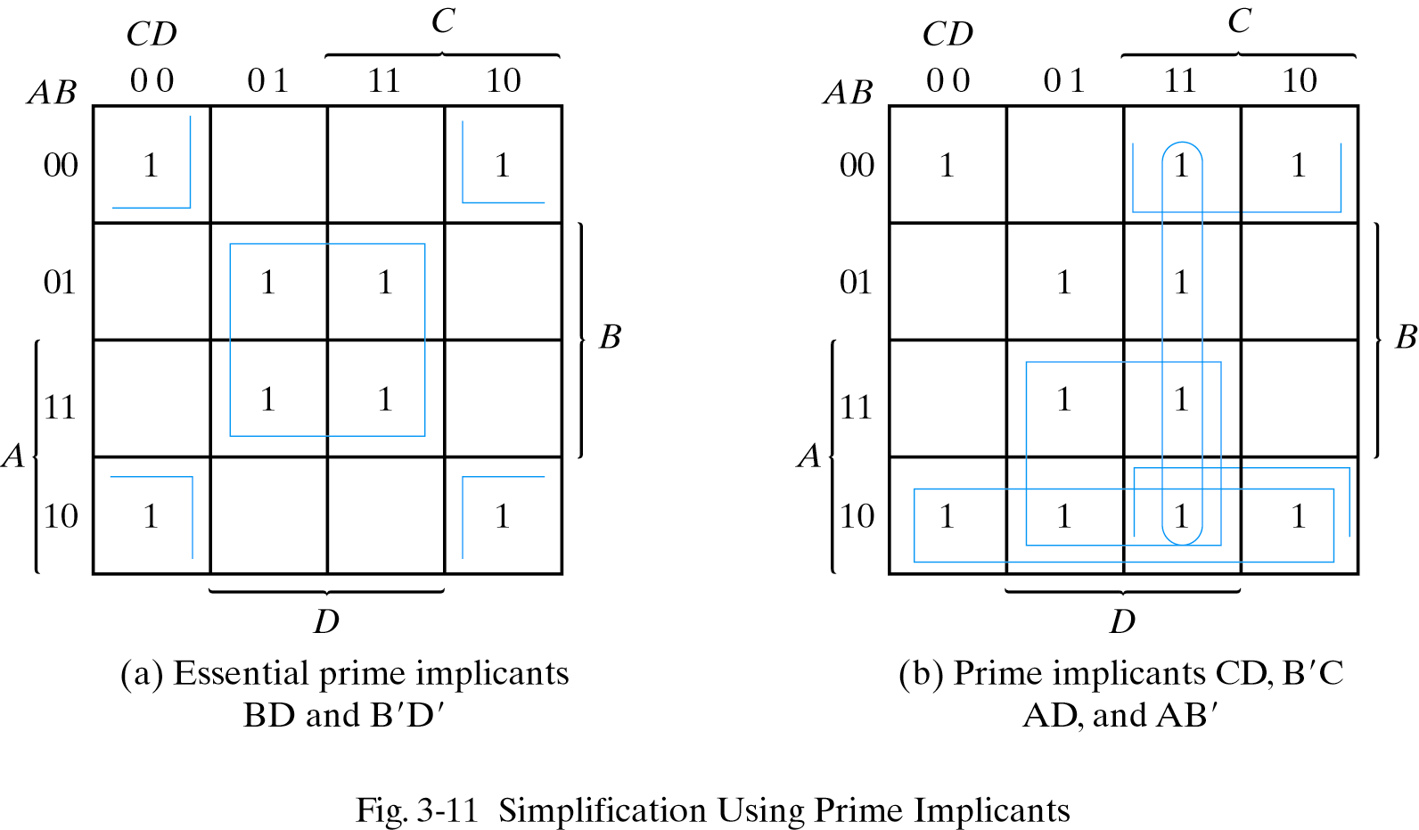
Essential Prime Implicants
A product term is an essential prime implicant if there is a minterm that is only covered by that prime implicant
The minimal sum-of-products form of F must include
all the essential prime implicants of F

Slide 26
Summary
Karnaugh map allows us to represent functions with new notation
Representation allows for logic reduction
Implement same function with less logic
Each square represents one minterm
Each circle leads to one product term
Not all functions can be reduced
K-maps of four literals were considered (Larger examples exist)
Don’t care conditions help minimize functions
Result of minimization is a minimal sum-of-products
Result contains prime implicants
Essential prime implicants are required in the implementation

