Slide 1
COE211: Digital Logic Design
Synchronous Sequential Logic
Part 2:
Sequential Circuits Analysis and Design

Slide 2
Analysis of Sequential Circuits
Behavior of clocked sequential circuit determined by
Inputs
Outputs
State of flip-flops
Analysis process
Consider all combinations of
Inputs
Flip-flop states
Determine next state and output of circuit
Concept of a Finite State Machine (FSM)
Methods
State equations
State table
State diagram

Slide 3
Example Circuit
Sequential circuit
Input: x
Output: y
Flip-flops:
2 D-type FFs
A and B
When is y=1?
Very difficult to answer
Systematic analysis
necessary

Slide 4
State and Output Equations
Circuit view FSM view

Slide 5
State and Output Equations
State equation specifies next state
Function of current state and inputs
State equation for flip-flops:
A(t+1) = A(t) x(t) + B(t) x(t)
B(t+1) = A’(t) x(t)
Output expression:
y(t) = (A(t) + B(t)) x’(t)
Simplified notation:
A(t+1) = A x + B x
B(t+1) = A’ x
y = (A+B) x’
How to derive these Eqs?

Slide 6
Flip-flop Input Equations
Similar to state equations
Specifies type of flip-flop used
In case of D-FFs
they are the
same as state equations.
This circuit:
D_{A} = A x + B x
D_{B} = A’ x
y = (A + B) x’

Slide 7
State Table
What needs to be considered in table?
Inputs
State of flip-flops
Next state of flip-flops
Outputs
How many entries in state table?
n inputs
m number of flip-flops
Total of 2^{m+n} entries
For every entry
Determine flip-flop change by input and current state
State equation
Determine the output (Output equation)

Slide 8
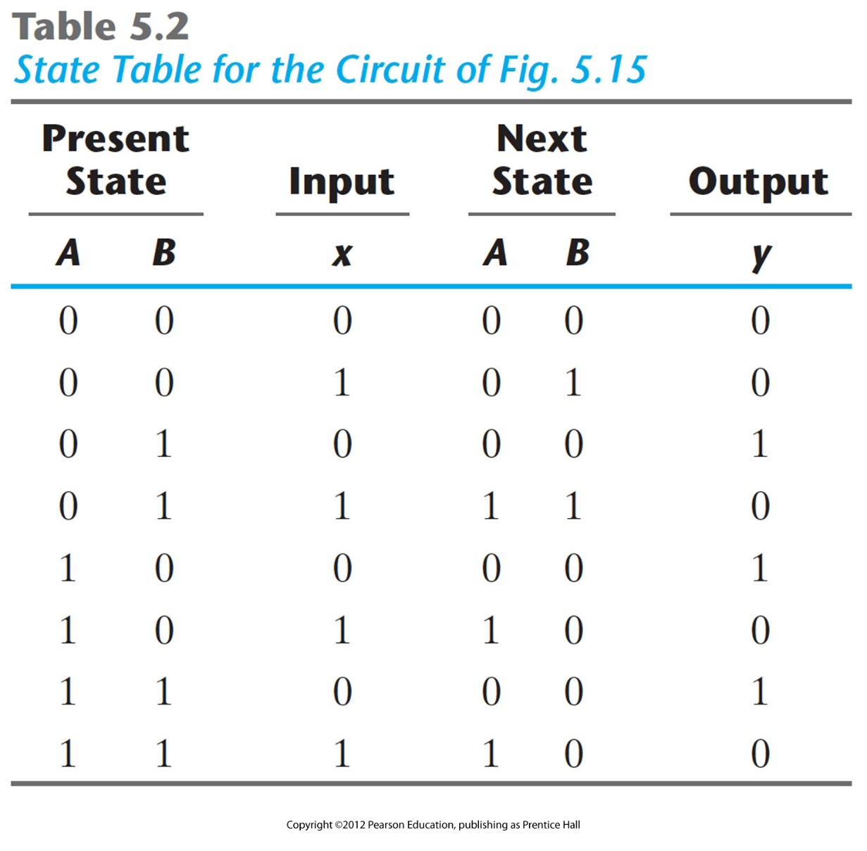
State Table
A(t+1) = A x + B x
B(t+1) = A’ x
y = (A+B) x’

Slide 9
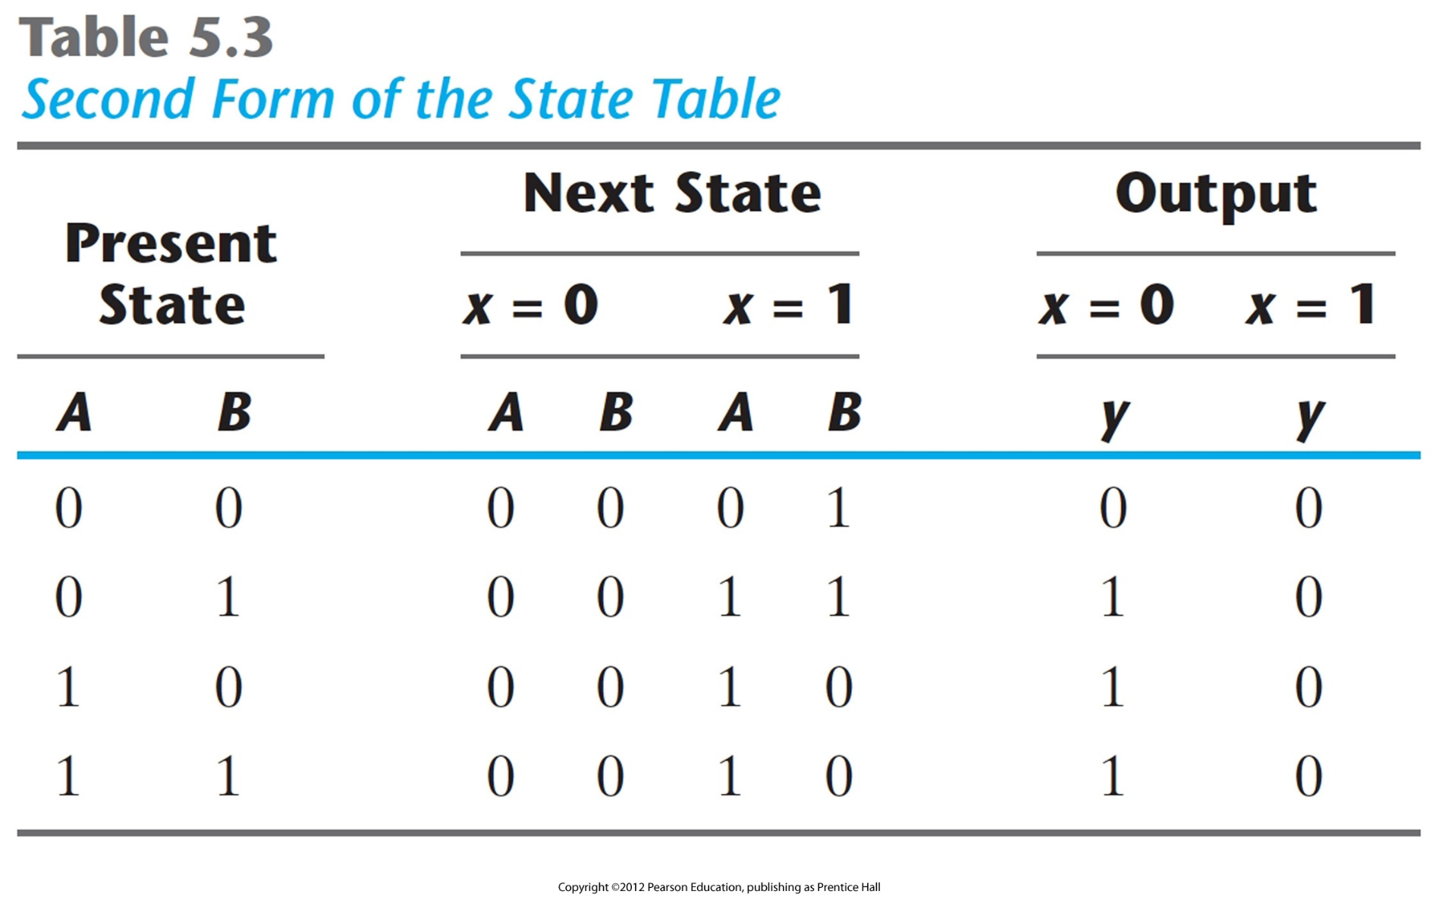
State Table

Slide 10
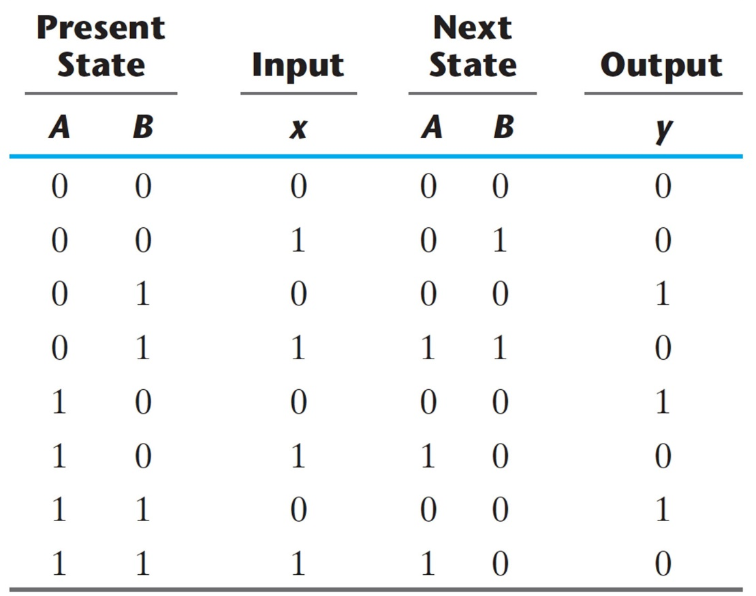
State Diagram
State transitions represented as graph
Vertices indicate states
Edges represent transitions
Edge annotation: “x/y” meaning input is x and output is y

Slide 11
Analysis Example 2
Equation:
(state equation)
(flip-flop equation)
State table:
State diagram:
Note: no outputs

Slide 12
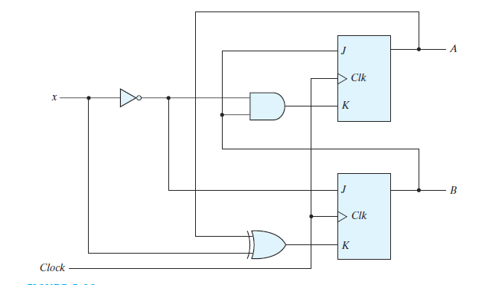

Analysis with JK FF
Flip-flop Input Equations

Slide 13


Analysis with JK FF
State Equations

Slide 14
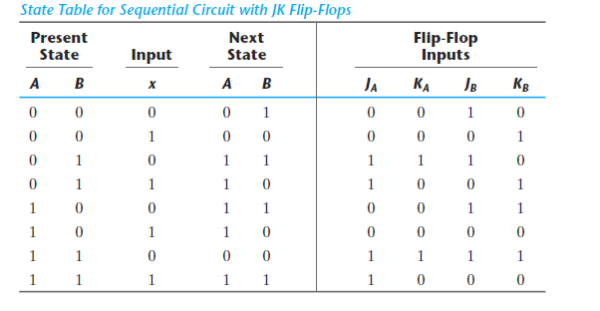
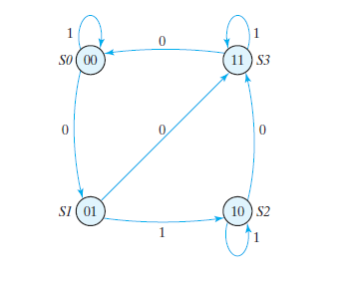
Analysis with JK FF
State Equations
State table:
State Diagram:

Slide 15
Finite State Machines
State diagrams are representations of Finite State Machines (FSM)
Two flavors of FSMs:
Mealy FSM
Moore FSM
Difference:
How output is determined
Mealy FSM
Output depends on input and state
Output is not synchronized with clock
can have temporarily unstable output
Moore FSM
Output depends only on state

Slide 16
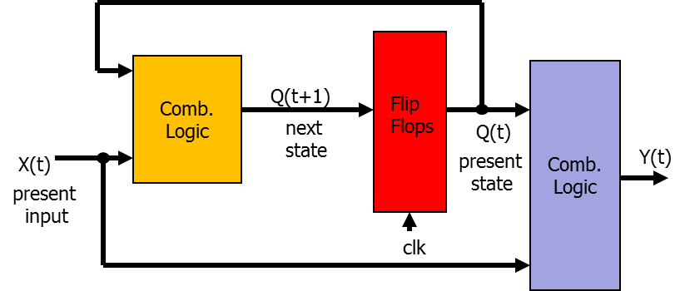
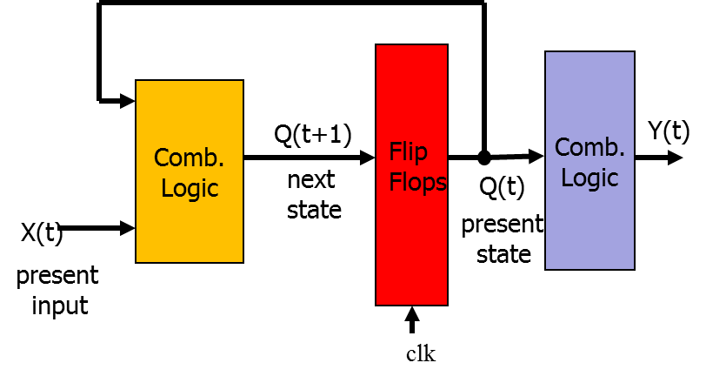
Mealy vs Moore Machine
Mealy Machine
Output is a function of
current state and present input
Moore Machine
Output is a function of
current state only

Slide 17
Design of Sequential Circuits

Slide 18
Design of Sequential Circuits
Derive state diagram from description
Reduce number of states if necessary (will NOT be covered)
Assign binary values to states
Obtain binary coded state table (transition table)
Choose type of flip-flops
Derive flip-flop input equations and output equations
Draw logic diagram

Slide 19
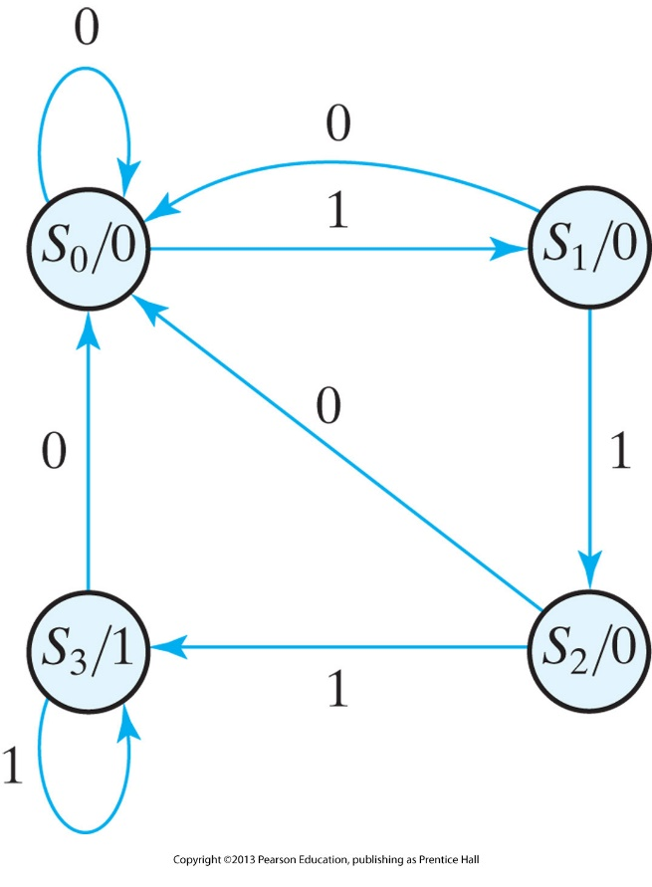
Example 1: Sequence Detector
Circuit specification:
Design a circuit that outputs a 1 when three consecutive 1s have been applied to input, and 0 otherwise.”
Step 1: derive state diagram
What should a state represent?
E.g., “number of 1’s seen so far”
Moore or Mealy FSM?
Both possible
Chose Moore to simplify diagram
State diagram:
State S0: zero 1s detected
State S1: one 1 detected
State S2: two 1s detected
State S3: three 1s detected

Slide 20
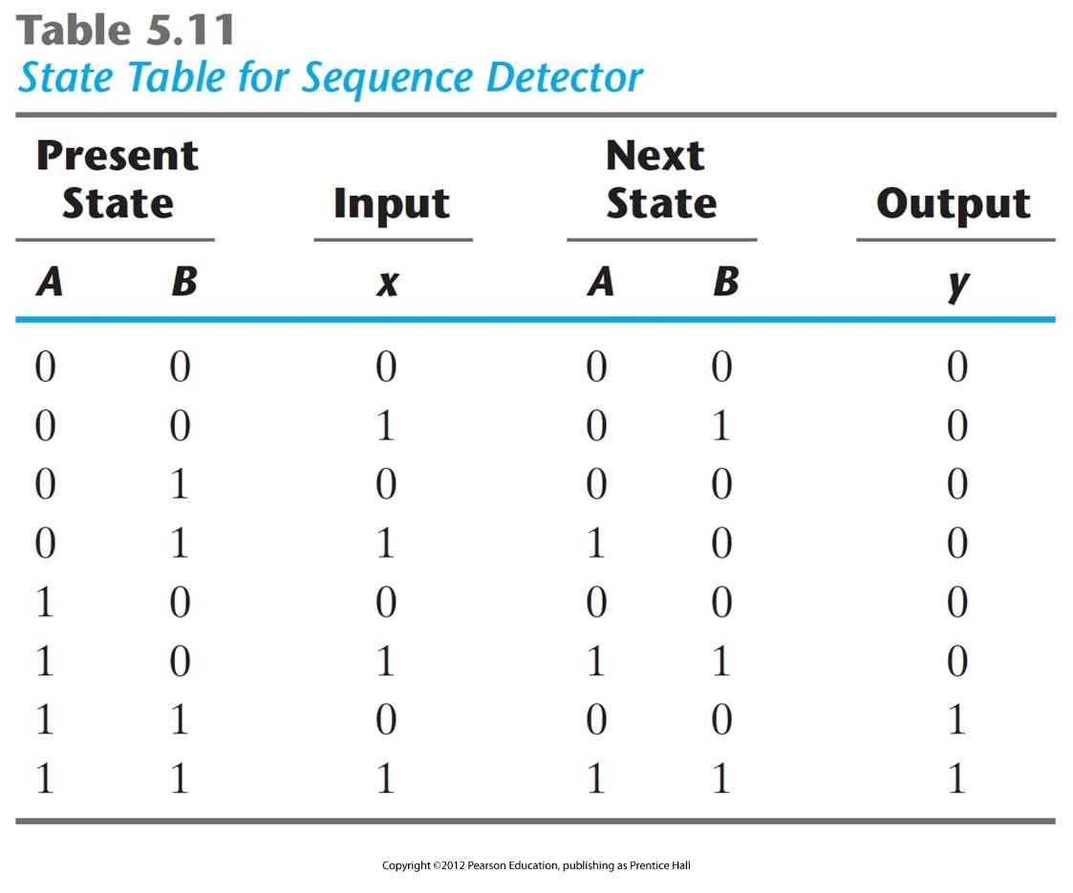
Example 1: Sequence Detector
Step 2: state assignment
Two flip-flops
Binary state coding
Step 3: Binary coded
state table
Name flip-flops A and B
Step 4: Choose type of
flip-flops
E.g., D flip-flop
Characteristic equation: Q(t+1)=DQ

Slide 21
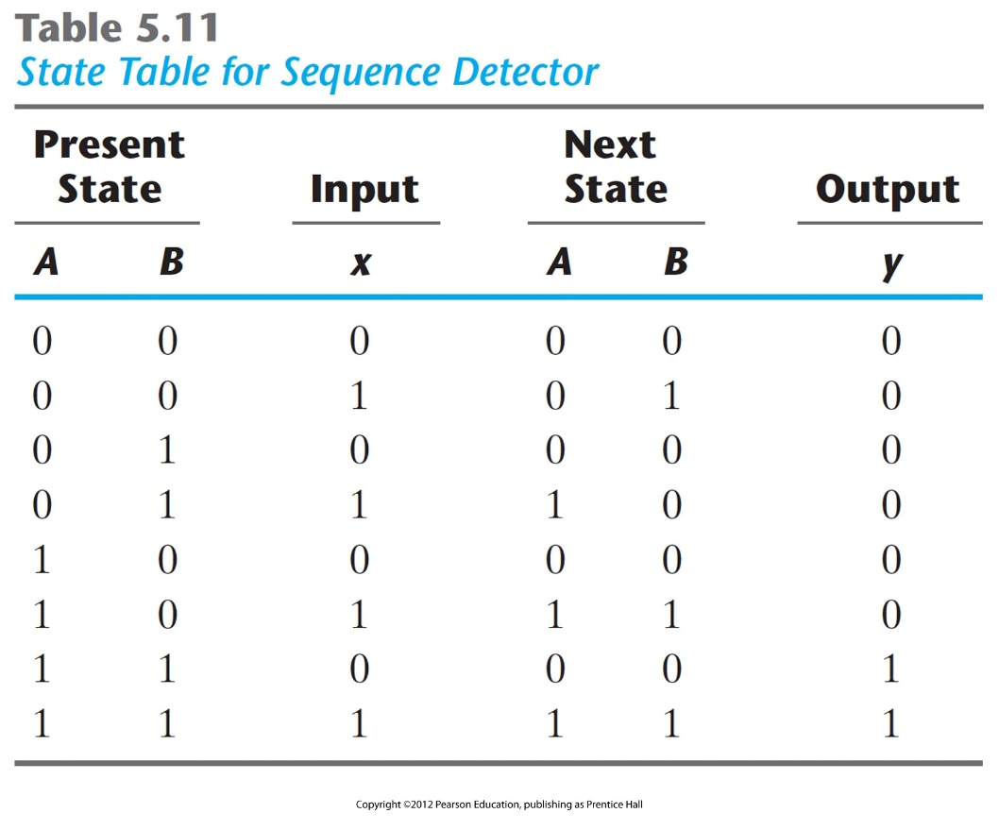
Example 1: Sequence Detector
Step 6: derive flip-flop input equations and output equation
Use state table

Slide 22
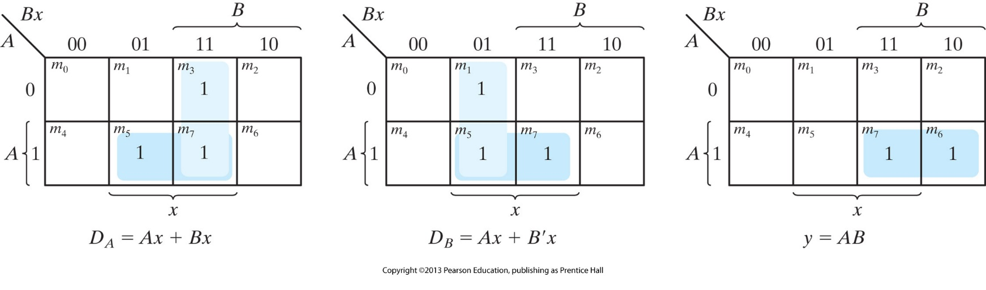
Example 1: Sequence Detector
Step 6b: minimize equations

Slide 23
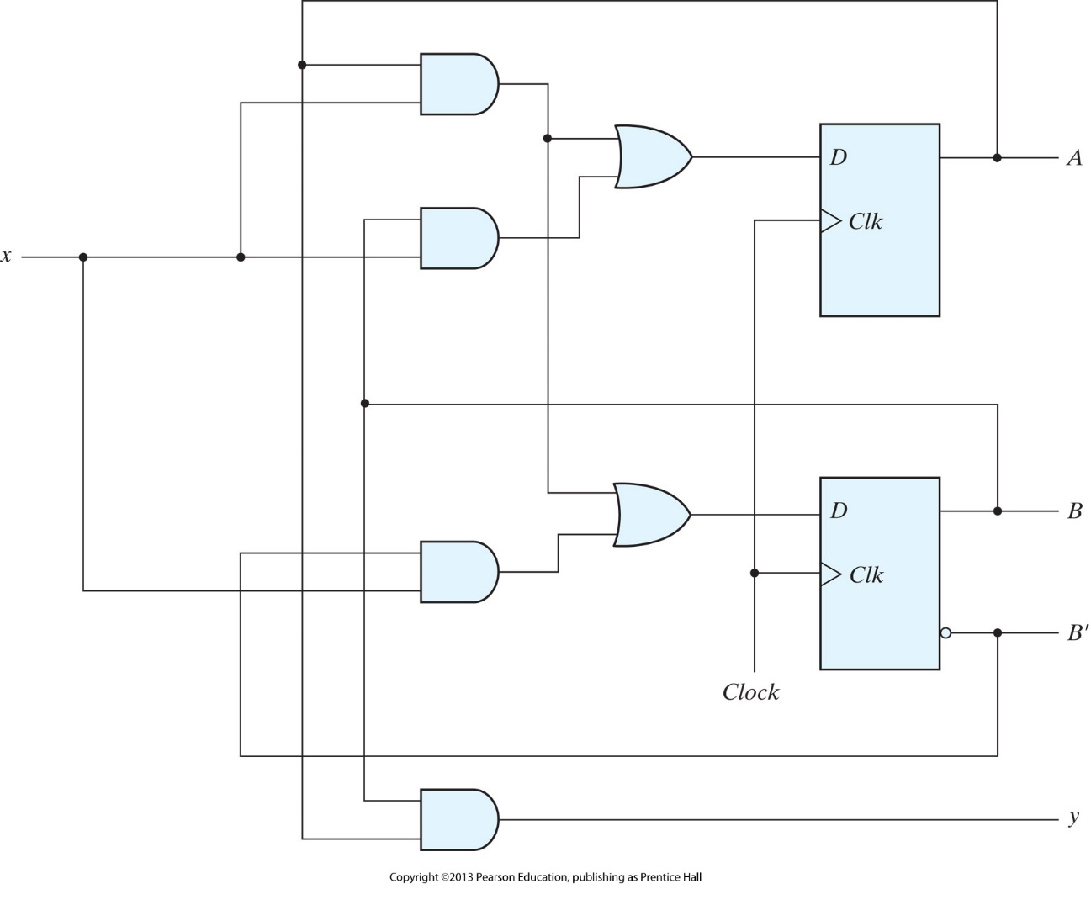
Example 1: Sequence Detector

Slide 24
Summary
Flip flops contain state information
State can be represented in several forms:
State equations
State table
State diagram
Possible to convert between these forms
Circuits with states can take on a finite set of values
Finite state machine
Two types of “machines”
Mealy machine
Moore machine

