Slide 1
COE211: Digital Logic Design
Registers and Counters

Slide 2
Outline
Registers
Parallel load register
Shift register
Serial adder
Universal shift register
Binary counters
Ripple counters (asynchronous)
Synchronous counters (driven by common clock)
Special counters
Ring counters
Johnson counter

Slide 3
Registers
Computer systems use n-bit numbers
Too complex to worry about individual bits
Data is stored in “registers”
What functions should a register support?
Storing data (and states)
Getting data in parallel or in serial

Slide 4

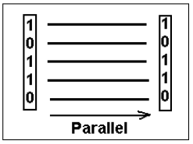
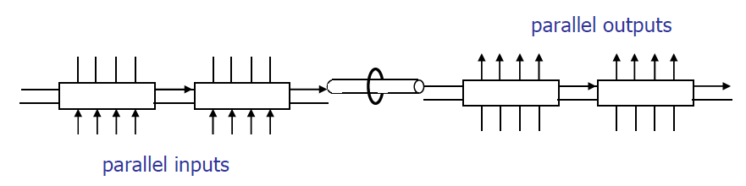
Parallel vs Serial Transfer
Serial communications
Provide a binary number as a sequence of binary digits, one after another, through one data line.
Parallel communications
Provide a binary number through multiple data lines at the same time.
Mixed: serial/parallel communications

Slide 5
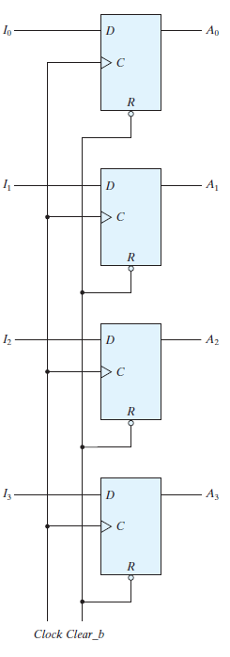
Simple Parallel Load Register
Parallel load:
All n bits can be stored at the same time
Straightforward circuit:
n D flip-flops
Shared clock
Shared clear
What is the problem with this register?
How long is data stored?
D flip-flops are set on each clock cycle
Undesired if we want to store data
Undesired if input requires time to stabilize
Suggested improvement?

Slide 6
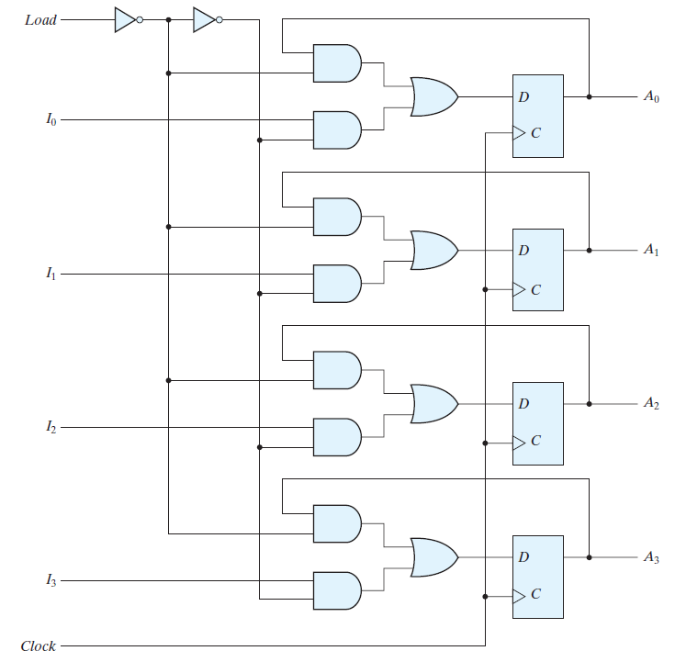
Parallel Load Register
Load | Q(t+1)
0 | Q(t)
1 | I_{x}
Register should only load when specified
Design choices:
Intercept clock signal
Not desirable, because of added clock delay
Feedback flip-flop value
Circuit:
When loading, input is fed to flip-flop
When not loading, current state is “recycled”

Slide 7
Serial Data Transfer
What are the limitations of a parallel load register?
Requires n data lines
Can be expensive for 32-bit or 64-bit registers
Serial data transfer common in digital systems
Transfer of information one bit at a time
Examples:
Serial port on PC
USB (Universal Serial Bus)
Ethernet (and many other) network devices
Trade-offs between serial vs. parallel?
Serial requires only single wire
Serial requires higher data rate to achieve same throughput

Slide 8
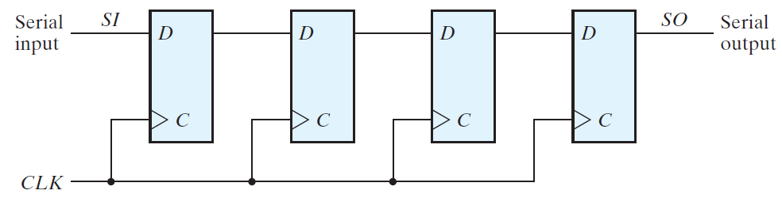
Shift Registers
A register capable of shifting the binary information held in each cell to its neighboring cell, in a selected direction, is called a shift register.
The shown shift register is unidirectional (left‐to‐right).
Each clock pulse shifts the contents of the register one bit position to the right.
Right to left?

Slide 9
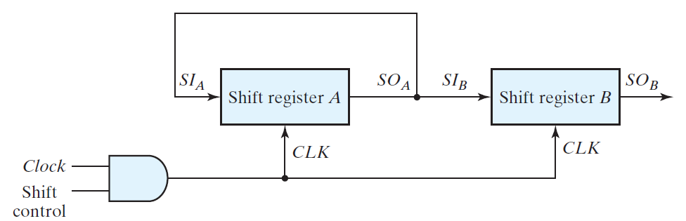
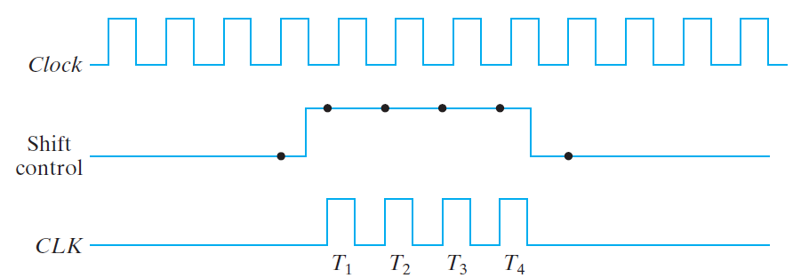
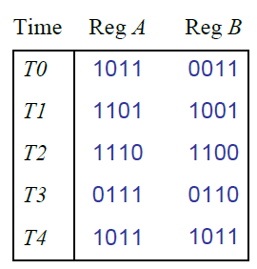
Serial Transfer - Example
Serial transfer from register A to register B:
Example:
Assume A= 1011 and B = 0011
What are the register values at T1 –T4 ?

Slide 10
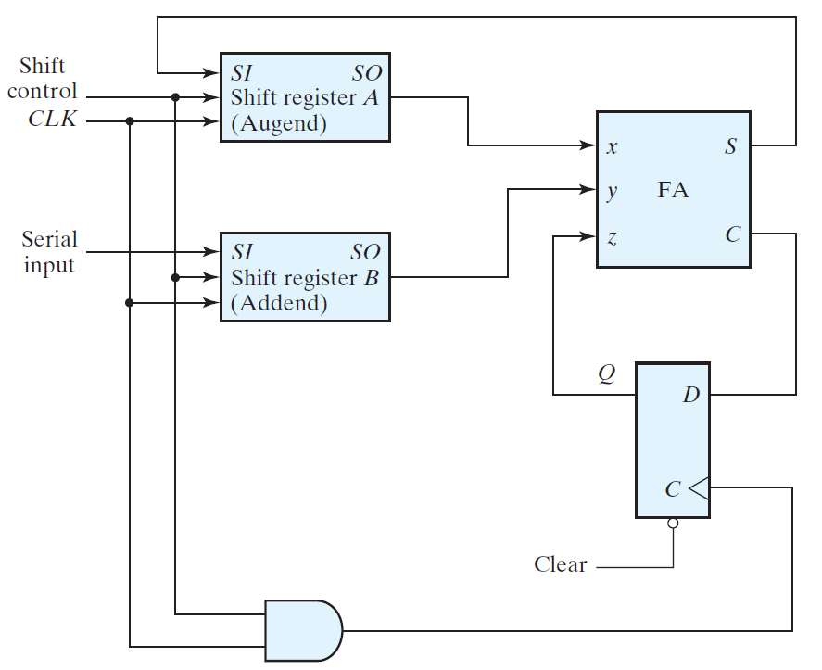
Serial Addition
Addition is a “serial” process
Need to determine carry before next significant bit is added
We can use shift registers to add bits one-by-one
Only one-bit adder needed
Initial state:
Augend and addend in A and B
Shift control
Controls (stops) addition
How can we handle carry?
Feedback via D FF
Carry is saved in D FF
Where is the result?
Register A after n shifts

Slide 11
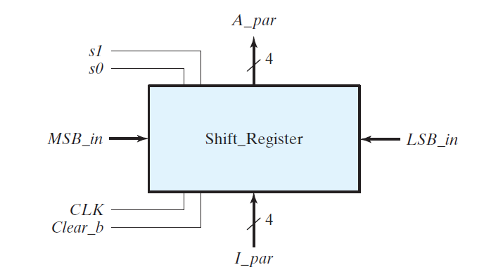
Universal Shift Register
Universal Shift Register has the following control functions:
CLEAR: reset register to 0
CLOCK: synchronizes operation
SHIFT-RIGHT: shifts right (incl. serial I/O)
SHIFT-LEFT: shifts left (incl. serial I/O)
PARALLEL-LOAD: parallel transfer of register value
PARALLEL OUTPUT: n data lines
NO OPERATION: state remains unchanged

Slide 12
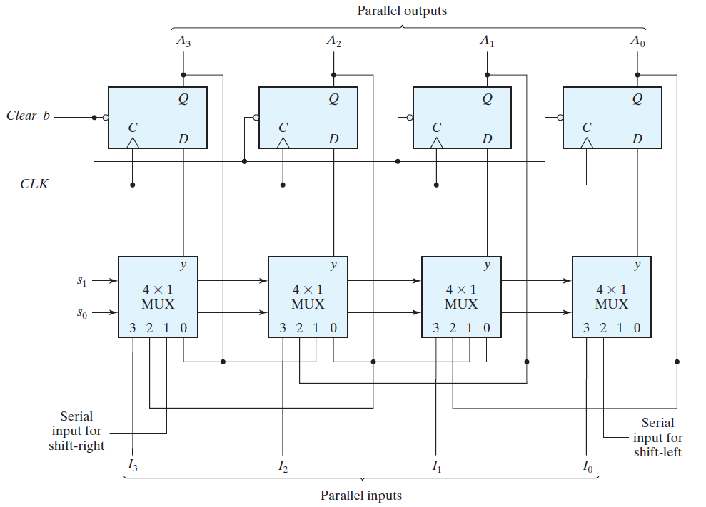
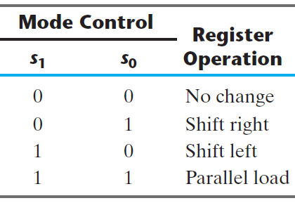
Universal Shift Register (Cont’d)

Slide 13
Counters
A counter is a register that goes through a predetermined sequence of states upon application of input pulses (clock)
Example: n-bit binary counter
Counts from 0 through 2^{n}-1
Two flavors:
Ripple counters (asynchronous)
Synchronous counters
Difference:
How flip-flops are triggered when propagating updates
Who drives the Clk input to FF
Counters can count up or down.

Slide 14
Binary Counter
4-bit binary sequence
0000
0001
0010
0011
0100
0101
0110
0111
1000
1001
1010
1011
1100
1101
1110
1111
The count starts with binary 0 and increments by 1 with each count pulse input.
After the count of 15, the counter goes back to 0.
The least significant bit, A₀, is complemented with each count pulse input.
Every time that A₀ goes from 1 to 0, it complements A₁.
Every time that A₁ goes from 1 to 0, it complements A₂.
Every time that A₂ goes from 1 to 0, it complements A₃.

Slide 15
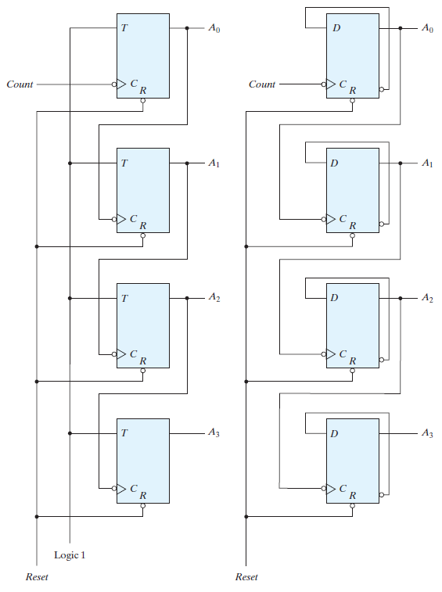
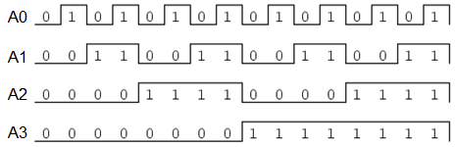
Binary Ripple Counter
“Reset” signal sets all outputs to 0
“Count” signal toggles output of low-order flip flop
Low-order flip flop provides trigger for next flip flop
Not all flip flops change values simultaneously (Lower-order FF change first)

Slide 16
Asynchronous Counters
Each FF output drives the CLK input of the next FF
FFs do not change states in exact synchronism with the applied clock pulses
There is a delay between the responses of successive FFs
Ripple wave in the way the FFs respond one after another

Slide 17
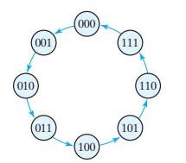
3-bit Synchronous Binary Counter
All of the FFs are triggered simultaneously by the clock pulse
All FFs change at the same time
Most counters in computer systems are synchronous

Slide 18
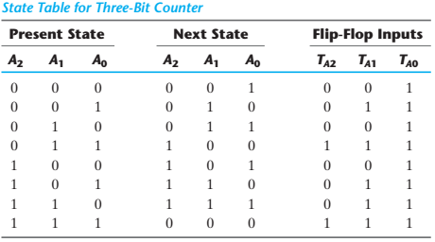
3-bit Synchronous Binary Counter

Slide 19
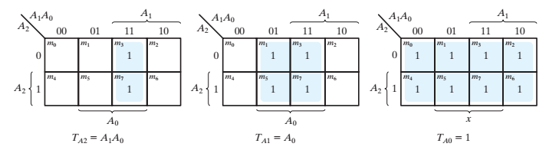
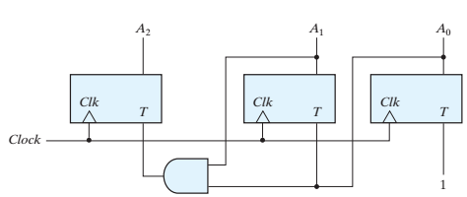
3-bit Synchronous Binary Counter

Slide 20
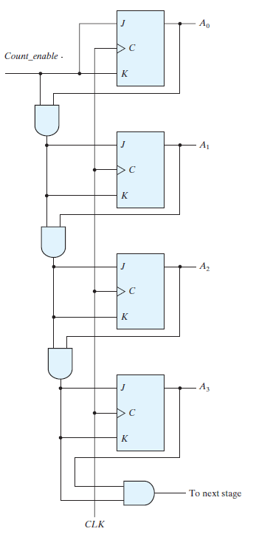
4-bit Synchronous Binary Counter
TGL
All of the FFs are triggered simultaneously by the clock pulse
All FFs change at the same time
Most counters in computer systems are synchronous
Can also be made from D flip flops
The JK inputs in the MSB FF has a long AND chain delay
NC/TGL
NC/TGL
NC/TGL

Slide 21
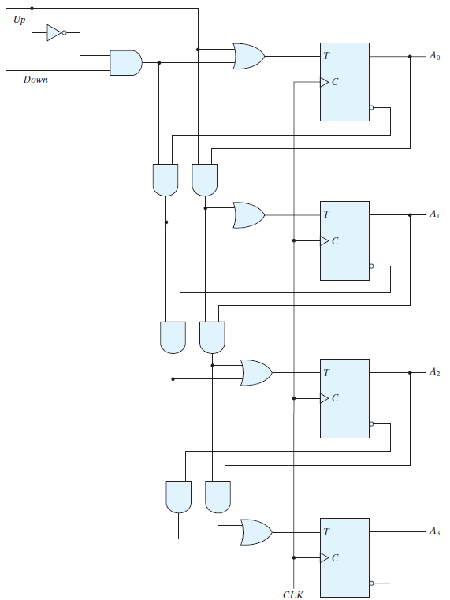
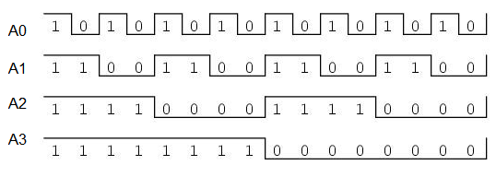
Synchronous UP/Down Counter
Up/Down Counter can either count up or down on each clock cycle
Up: counts from 0000 to 1111 and then changes back to 0000
Down: counts from 1111 to 0000 and then back to 1111 as shown in the figure below:

Slide 22
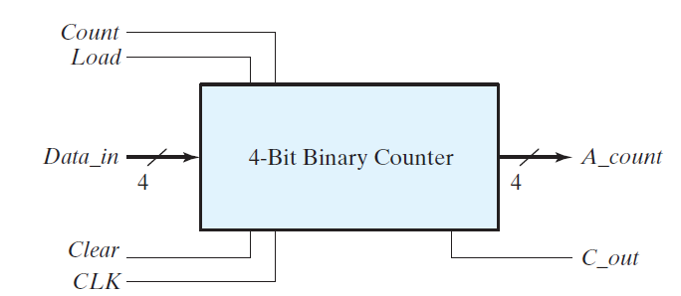
Counter with Parallel Load
It is a counter with a parallel load capability
When Load equal to 1, the input load control disables the count operation and causes a transfer of data from the four data inputs into the four flip‐flops.
If both control inputs (Load and Count) are 0, clock pulses do not change the state of the register.
Clear resets counter to zero
Carry-output can be used for higher order bits

Slide 23
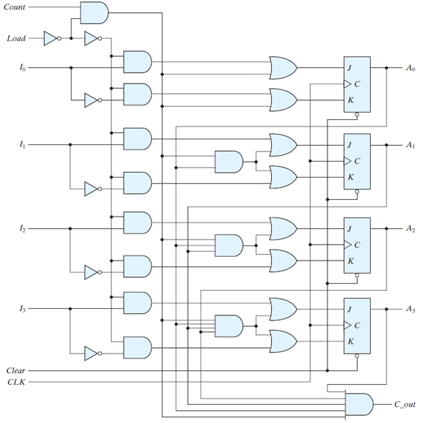
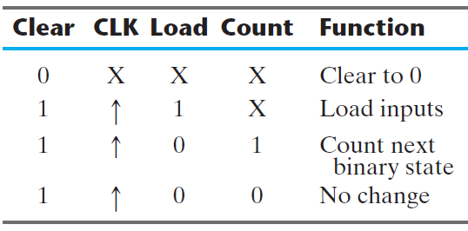
Counter with Parallel Load (cont’d)

Slide 24
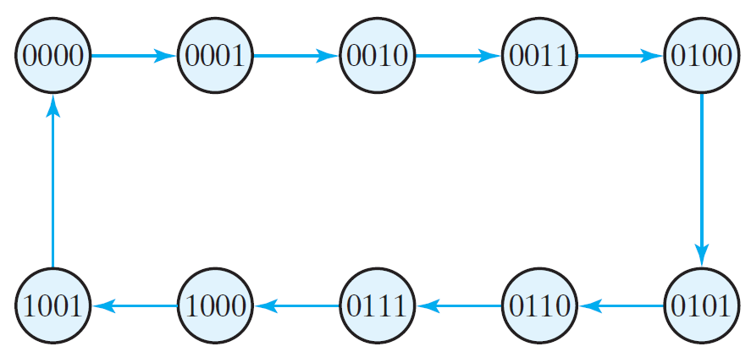
BCD Counter
A decimal counter follows a sequence of 10 states and returns to 0 after the count of 9.
Such a counter must have at least four flip‐flops to represent each decimal digit.
The sequence of states of the BCD counter is shown in the following state diagram.
A decimal counter is similar to a binary counter, except that the state after 1001 (the code for decimal digit 9) is 0000 (the code for decimal digit 0).

Slide 25
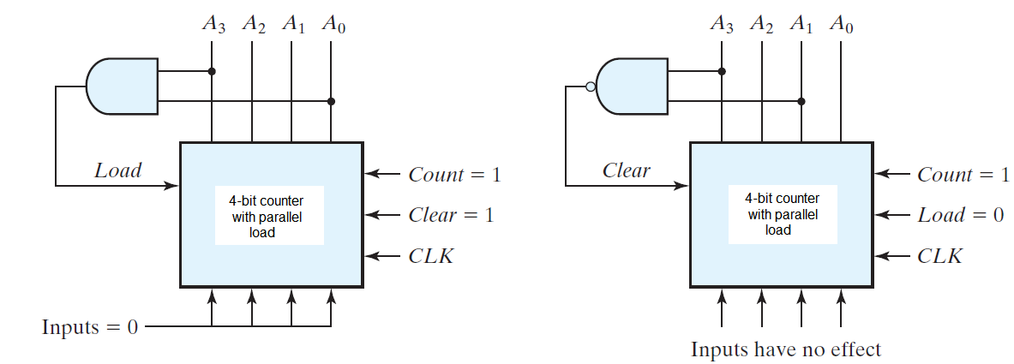
BCD counter using a counter with parallel load
There are two ways in which a counter with a parallel load is used to generate the BCD count.
The first way uses an AND gate to detect the occurrence of state 1001, which activates the Load input; therefore, on the next clock edge the register does not count, but is loaded from its four inputs with zeros.
The second way uses a NAND gate to detect the count of 1010, but as soon as this count occurs, the register is cleared. The count 1010 has no chance of staying on for any appreciable time, because the register goes immediately to 0.

Slide 26
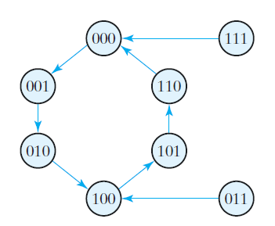
Counter with Unused States
JK Flip-flop transition table
A circuit with n flip‐flops has 2^{n} binary states.
There are occasions when a sequential circuit uses fewer than this maximum possible number of states.
The following is an example and it is designed with JK FFs.
The count has a repeated sequence of six states, with flip‐flops B and C repeating the binary count 00, 01, 10, and flip‐flop A alternating between 0 and 1 every three counts.

Slide 27
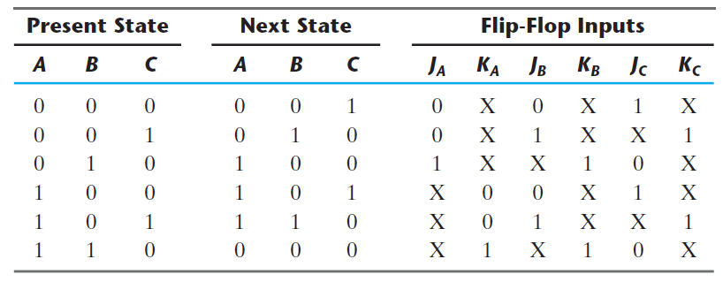
Counter with Unused States

Slide 28
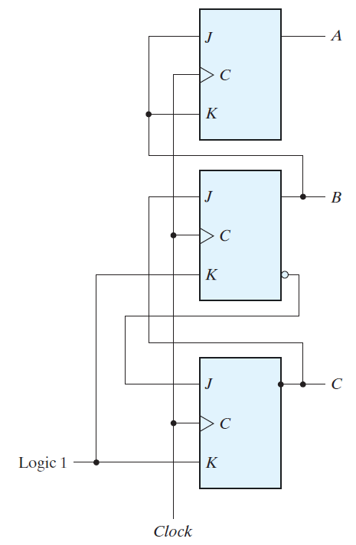
Counter with Unused States (cont’d)

Slide 29
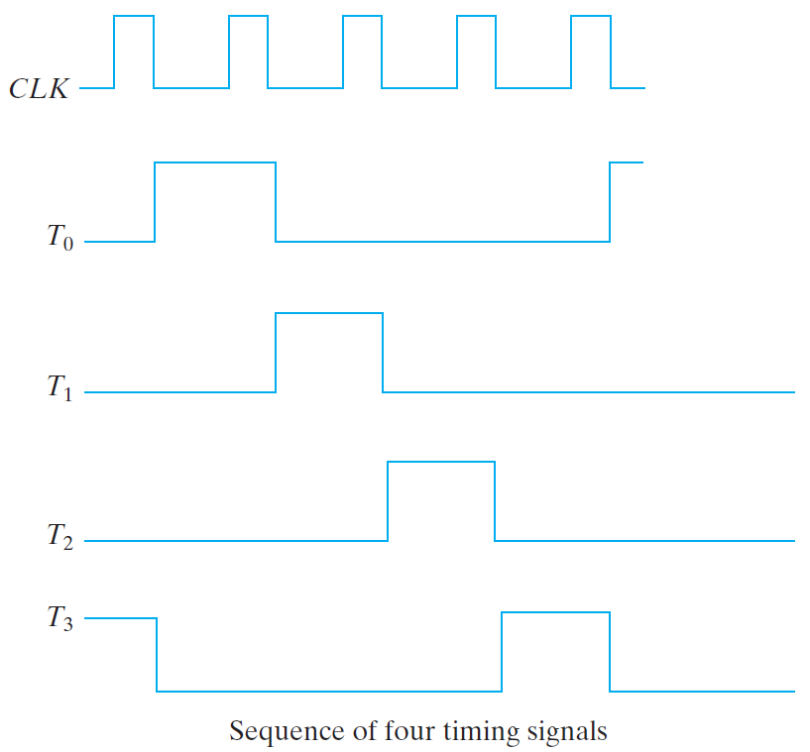
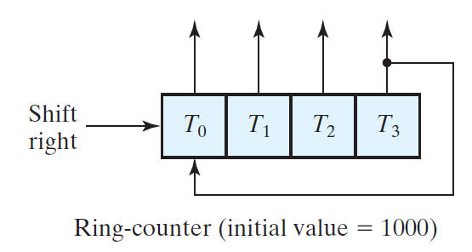
Ring Counter
A ring counter is a circular shift register with only one flip‐flop being set at any particular time (T0); all others are cleared (T1, T2, T3)
Used in Timing Signals
in computer system.

Slide 30
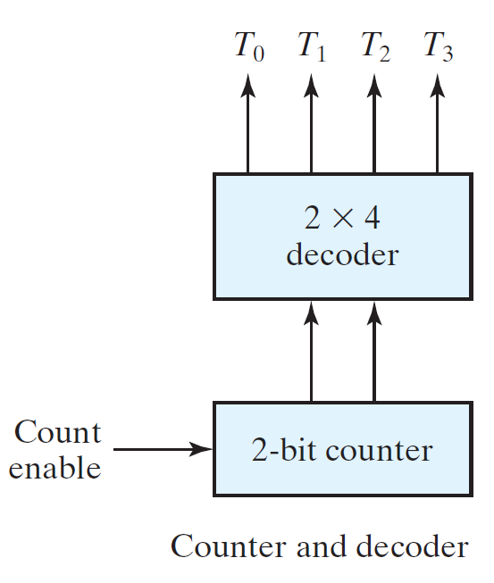
Ring Counter (Cont’d)
For an alternative design, the timing signals can be generated by a two‐bit counter that counts from 00 to 11.
The decoder shown decodes the four states of the counter and generates the required sequence of timing signals.
To generate 2^{n} timing signals, we need either a shift register with 2^{n} flip‐flops or an n ‐bit binary counter together with an n ‐to‐2^{n} ‐line decoder.

Slide 31
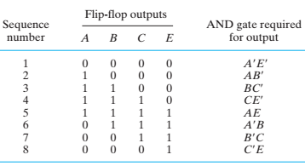
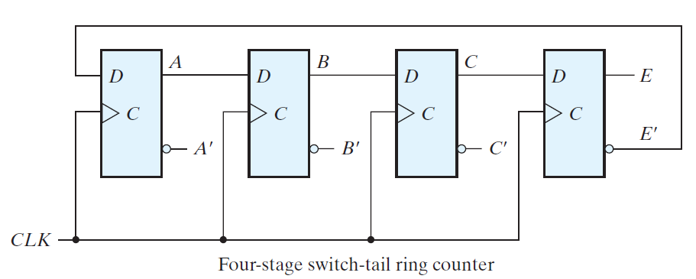
Johnson Counter
A k ‐bit ring counter circulates a single bit among the flip‐flops to provide k distinguishable states.
The number of states can be doubled (2k) if the shift register is connected as a switch‐tail ring counter.
This is called the Johnson Counter.

Slide 32
Summary
Binary counters can be ripple or synchronous
Ripple counters use flip flop outputs as triggers
Some delay before all flip flops settle on a final value
Do not require a clock signal
Synchronous counters are controlled by a clock
All flip flops change at the same time
Up/Down counters can either increment or decrement the stored binary value
Control signal determines if counter counts up or down
Counters with parallel load can be set to a certain value before counting begins

