Slide 1
COE211: Digital Logic Design
Memory Devices

Slide 2
Outline
Random Access Memory (RAM)
Read and write operations
RAM construction
RAM addressing
Types of RAM
Read Only Memory (ROM)
Types of ROM
Implementing Functions using PROM

Slide 3
Memories
A memory unit is a device to which binary information is transferred for storage and from which information is retrieved when needed for processing.
Different memory types:
Technology: magnetic, voltage, charge, fuse
Volatility: volatile, non-volatile
Access sequence: random, sequential
Speed: access time and throughput
Memory access types:
Random Access Memory (RAM)
Read Only memory (ROM)
Is memory combinational or sequential logic?
RAM: similar to register, based on FFs, but have no clock
ROM: combinational (programmable logic)

Slide 4
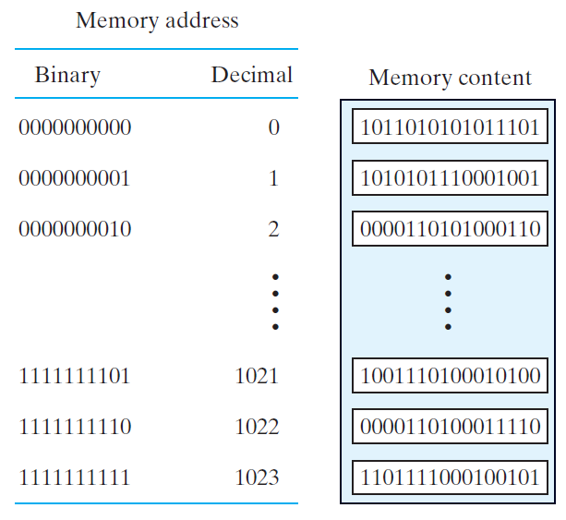
Memory Layout
Example:
1024 16-bit word storage
10 bits identify address
16 bits stored at each location
Why not make memory bit-wise addressable?
How many bits would it have?
How many address lines?
How big a decoder?
Remember:
k (Kilo) = 2¹⁰
M (Mega) = 2²⁰
G (Giga) = 2³⁰

Slide 5
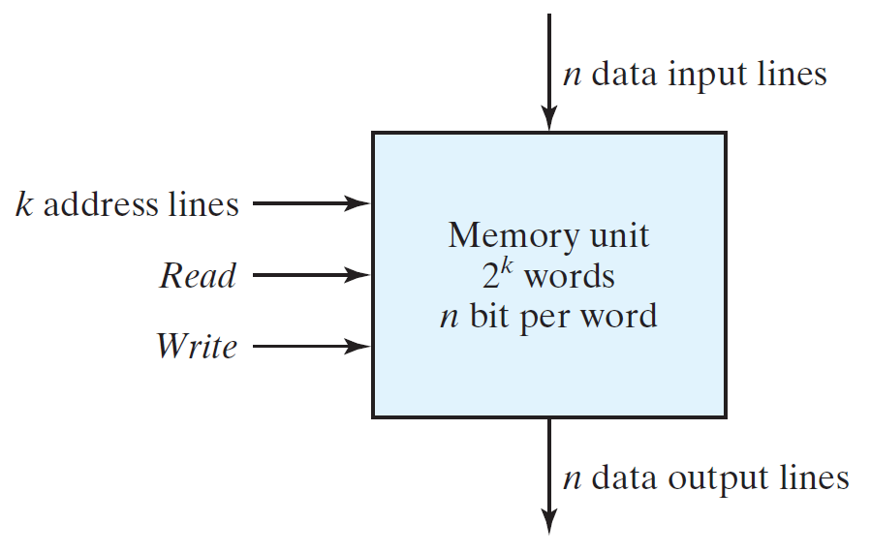
Random-access Memory (RAM)
Memory terminology:
Smallest unit is “word” (n bits wide)
Identified by “address”
Block diagram:
k address lines
At most 2^{k} words storage
n data lines (input and output)
What is the total memory size in bits?
Size = 2^{k} × n bits
Example:
1024-bit memory with 16-bit words
How many address lines?

Slide 6
RAM Read and Write Operations
Control inputs:
Address
Read
Write
Write operation
Apply address to address lines
Apply data to data input lines
Activate write input
Read operation
Apply address to address line
Activate read input
Read value from data output lines
Data to Write
Data to Read

Slide 7
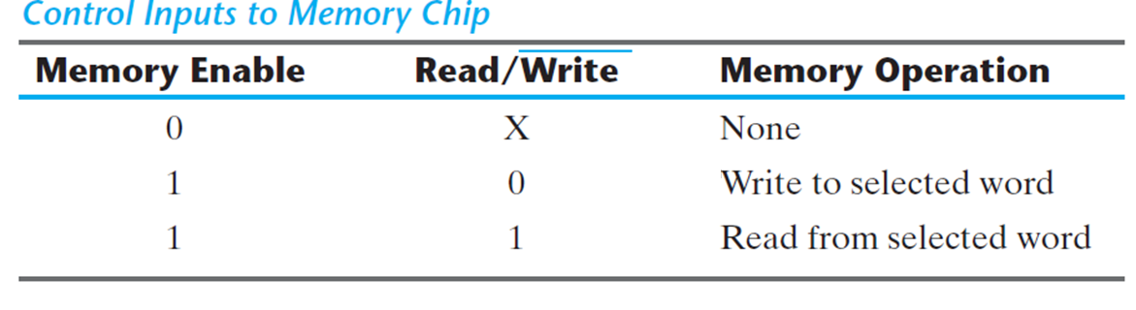
Read and Write Operations (Cont’d)
Control inputs on commercial memories
Memory enable
Read and write
What timing constraints need to be considered?
Access time: time to select a word and read it
Cycle time: time to complete a write operation
Also: setup and hold time on address lines

Slide 8
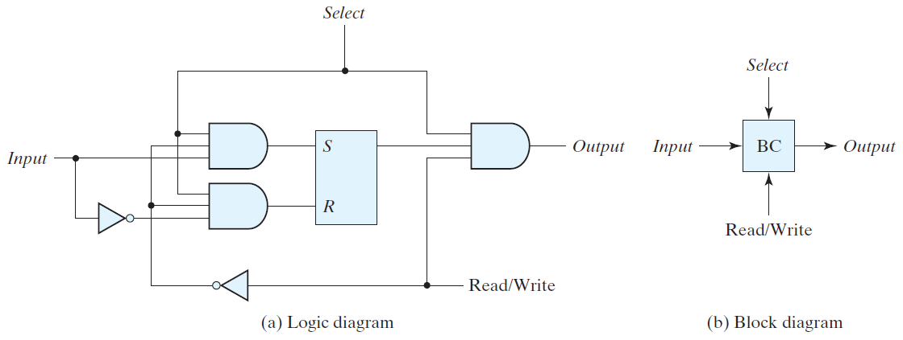
Memory Cell Design
Binary memory cell implemented with SR latch: (Note: memory is not clocked)

Slide 9
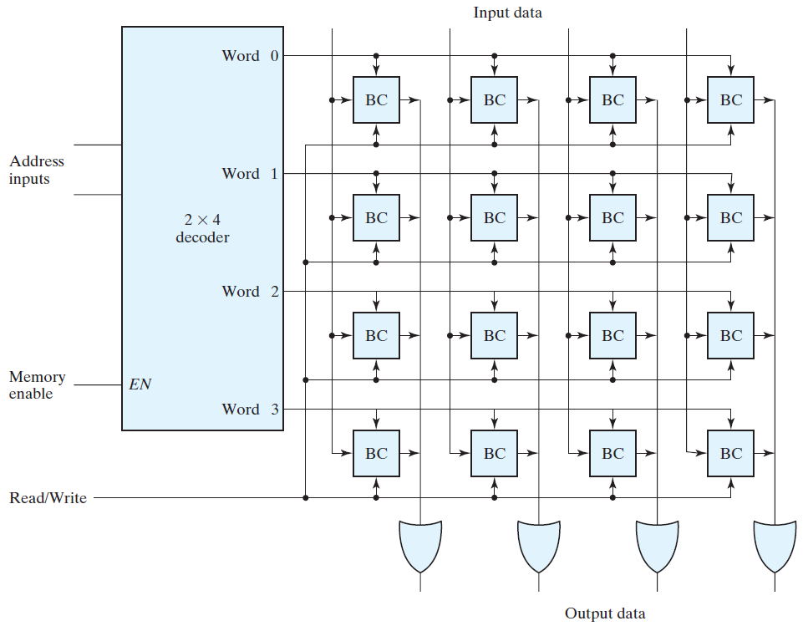
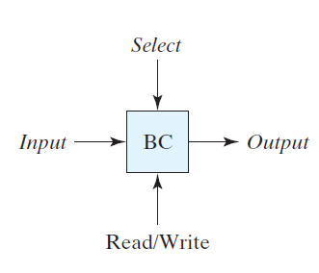
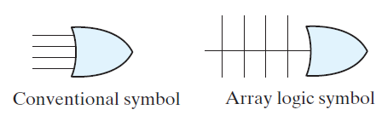
Internal RAM Construction
Internal layout of memory:
One word per “row”
Each “binary cell” stores one bit
Memory cell:
Decoder:
Selects word

Slide 10
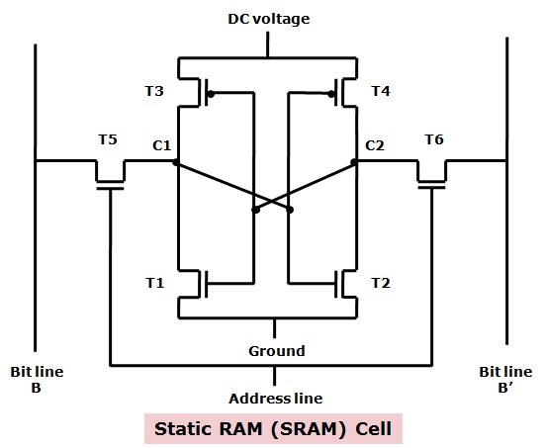
Types of RAM
Static Random Access Memory (SRAM)
Operates like a collection of latches
Once a value is written, it is guaranteed to remain in the memory as long as power is applied
Generally expensive
Used inside processors

Slide 11
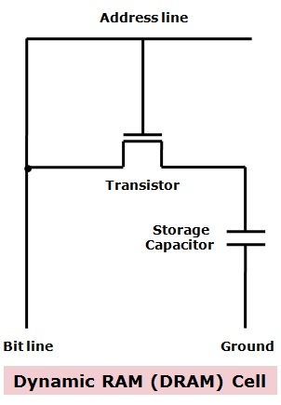
Types of RAM
Dynamic Random Access Memory (DRAM)
Generally, simpler internal design than SRAM
Requires data to be rewritten (refreshed), otherwise data is lost
Often hold larger amount of data than SRAM
Longer access times than SRAM
Used as main memory in computer
systems

Slide 12
*Example 1
The memory units that follow are specified by the number of words times the number of bits per word, How many address lines and input-output data lines are needed in each case? (a) 8K x 16 (b) 2G X 8 (c) 16M X 32 (d) 256K X 64
Solution
(a) 8 K x 16 = 2¹³ x 16 | A = 13 | D = 16
(b) 2 G x 8 = 2³¹ x 8 | A = 31 | D = 8
(c) 16 M x 32 = 2²⁴ x 32 | A = 24 | D = 32
(d) 256 K x 64 = 2¹⁸ x 64 | A = 18 | D = 64

Slide 13
*Example 2
Give the number of bytes stored in the memories listed in Example 1
(a) 2¹³ x16 = 2¹³ x 2 x 8 = 2¹⁴
(b) 2³¹ x 8 = 2³¹ x 1 x 8 = 2³¹
(c) 2²⁴ x 32 = 2²⁴ x 4 x 8 = 2²⁶
(d) 2¹⁸ x 64 = 2¹⁸ x 8 x 8 = 2²¹

Slide 14
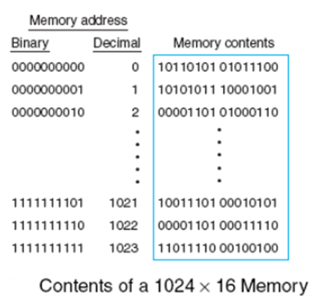
*Example 3
Word number 723 in the memory shown in figure contains the binary equivalent of 3,451. List the 10-bit address and the 16-bit memory content of the word?
723 = 512 + 128 + 64 + 16 + 2 + 1
Address: 10 1101 0011 = 2D316
3451 = 2048 + 1024 + 256
+ 64 + 32 + 16 + 8 + 2 + 1 Data: 0000 1101 0111 1011
= 0D7B16

Slide 15
*Example 4
(a) How many 32K X 8 RAM chips are needed to provide a memory capacity of 256K bytes?
(b) How many lines of the address must be used to access 256K bytes? How many of these lines are connected to the address inputs of all chips?
(c) How many lines must be decoded for the chip select inputs? Specify the size of decoder.
(a) 256 K / 32 K = 8 chips
(b) 256 K = 2¹⁸ (18 address lines for memory); 32 K = 2¹⁵ (15 address pins / chip)
(c) 18 – 15 = 3 lines ; must decode with 3 x 8 decoder

Slide 16
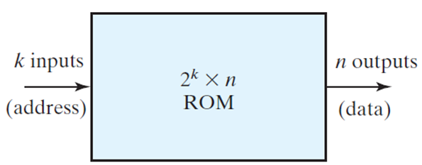
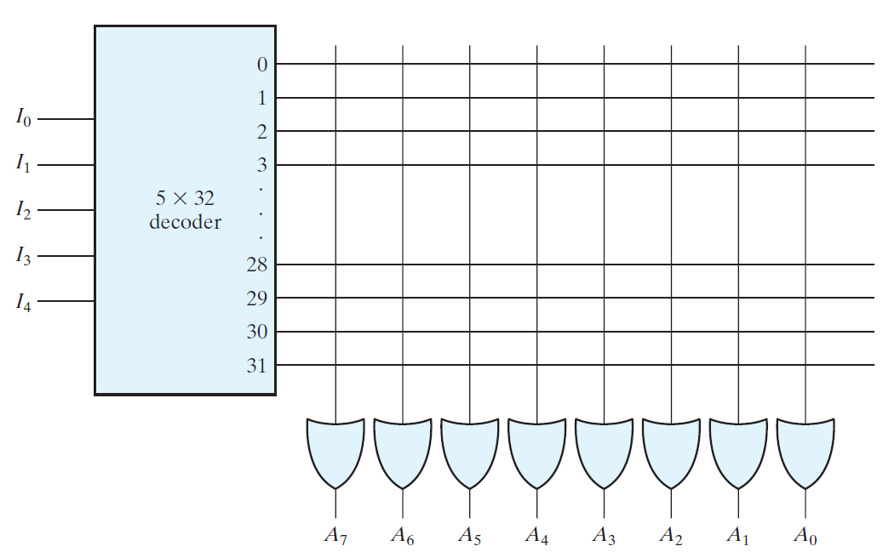
Read-Only Memory (ROM)
Storage for memory that does not need to change
Block diagram:
Address
Outputs
No data inputs
32 × 8 ROM with 256 intersections:
No connection = 0
Connection = 1

Slide 17
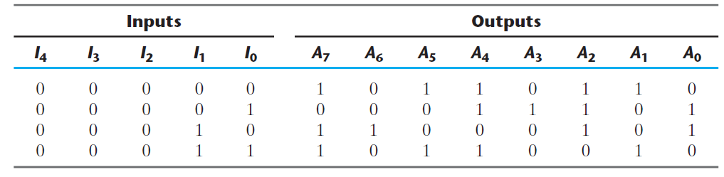
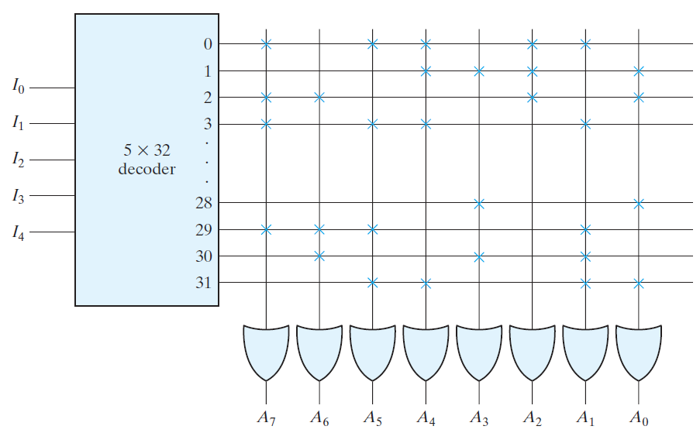
ROM Example
Example of “programmed” ROM:
“x” indicates connection
Programming of ROM
Connections implemented as “fuses” (logic 1)
Blown fuse (open) indicates 0
Higher voltage can blow fuse

Slide 18
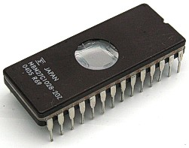
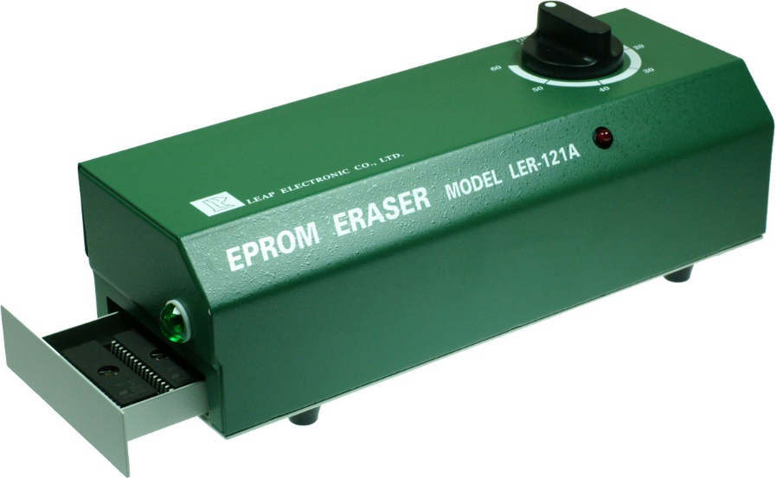
Types of ROM
Mask Programmed ROM
During fabrication of ROM
Only economical in large quantities
Programmable ROM (PROM)
ROM with all fuses intact
High-voltage pulse on special pin can irreversibly blow fuses
Note: hardware procedure despite “programmable”
Erasable PROM (EPROM)
Connections can be restored
Exposure to UV light resets EPROM
Electrically-erasable PROM (EEPROM)
Electric signal can reset connections (no UV required)

Slide 19
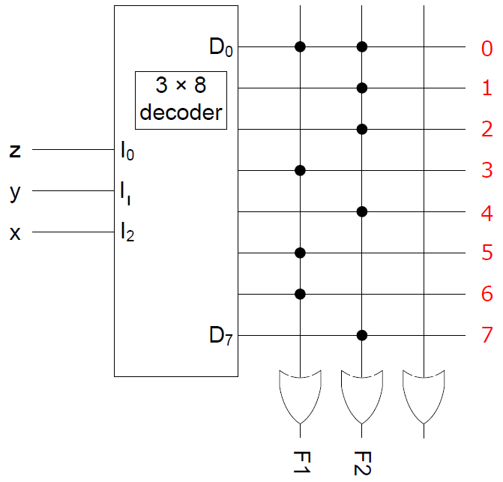
Implementing Functions using PROM
The shown PROM implements the following two Boolean functions:
F1(x,y,z)
= ∑(0,3,5,6)
= x’y’z’ + x’yz
+xy’z + xyz’
F2(x,y,z)
= ∑(0,1,2,4,7)
= x’y’z’ + x’y’z
+x’yz’ + xy’z’ + xyz

