Slide 1


Computer Networks
Taibah University
College of Computer Science and Engineering
Computer Engineering Department
Computer Networking: A Top Down Approach
6th edition
Addison-Wesley
All material copyright 1996-2012
J.F Kurose and K.W. Ross, All Rights Reserved
Ch3: Transport Layer

Slide 2
Chapter 3: Transport Layer
our goals:
understand principles behind transport layer services:
  multiplexing, demultiplexing
  reliable data transfer
  flow control
  congestion control
learn about Internet transport layer protocols:
  UDP: connectionless transport
  TCP: connection-oriented reliable transport
    TCP Flow control
    TCP congestion control

Slide 3


















*Transport services and protocols
transport protocols provide logical communication between app processes running on different hosts
transport protocols run in end systems
  sender side: breaks app messages into segments, passes to network layer
  receiver side: reassembles segments into messages, passes to app layer
more than one transport protocol available to apps
  Internet: TCP and UDP
application
transport
network
data link
physical
logical end-end transport
application
transport
network
data link
physical

Slide 4
Transport vs. network layer
network layer: logical communication between hosts
transport layer: logical communication between processes
  relies on, enhances, network layer services
household analogy:
12 kids in Ann’s house sending letters to 12 kids in Bill’s house:
hosts = houses
processes = kids
app messages = letters in envelopes
transport protocol = Ann and Bill who demux to in-house siblings
network-layer protocol = postal service

Slide 5
*Internet transport-layer protocols
TCP protocol
  reliable
  in-order delivery
  congestion control
  flow control
  connection setup
UDP protocol
  unreliable,
  unordered delivery:
  no congestion control
  no flow control
  no connection setup
services not available:
  delay guarantees
  bandwidth guarantees
application
transport
network
data link
physical
network
data link
physical
network
data link
physical
network
data link
physical
logical end-end transport
network
data link
physical
network
data link
physical
network
data link
physical
network
data link
physical
application
transport
network
data link
physical

Slide 6

Multiplexing/demultiplexing
///EA, CA14M Mon 5 oct
multiplexing at sending:
demultiplexing at receiving:
handle data from multiple
sockets, add transport header (later used for demultiplexing)
use header info to deliver
received segments to correct
socket
application
application
P1
P2
application
socket
P3
transport
P4
process
transport
network
transport
network
link
network
link
physical
link
physical
physical

Slide 7
How demultiplexing works
host receives IP datagrams
  each datagram has source IP address, destination IP address
  each datagram carries one transport-layer segment
  each segment has source, destination port number
host uses IP addresses & port numbers to direct segment to appropriate socket
32 bits
source port #
dest port #
other header fields
application
data
(payload)
TCP/UDP segment format

Slide 8
Connectionless demultiplexing
recall: when creating datagram to send into UDP socket, must specify
  destination IP address
  destination port #
recall: created socket has host-local port #:
DatagramSocket mySocket1 = new DatagramSocket(12534);
when host receives UDP segment:
  checks destination port # in segment
  directs UDP segment to socket with that port #
IP datagrams with same dest. port #, but different source IP addresses and/or source port numbers will be directed to same socket at dest

Slide 9
Connectionless demux: example
DatagramSocket serverSocket = new DatagramSocket
(6428);
DatagramSocket mySocket2 = new DatagramSocket
(9157);
DatagramSocket mySocket1 = new DatagramSocket (5775);
application
application
P1
application
P3
P4
transport
transport
network
transport
network
link
network
link
physical
link
physical
physical
source port: 6428
dest port: 9157
source port: ?
dest port: ?
source port: 9157
dest port: 6428
source port: ?
dest port: ?

Slide 10
Connection-oriented demux
TCP socket identified by 4-tuple:
  source IP address
  source port number
  dest IP address
  dest port number
demux: receiver uses all four values to direct segment to appropriate socket
server host may support many simultaneous TCP sockets:
  each socket identified by its own 4-tuple
web servers have different sockets for each connecting client
  non-persistent HTTP will have different socket for each request

Slide 11
*Connection-oriented demux: example
Port# 9157
application
Port# 5775
Port# 9157
application
P4
P5
P6
application
P3
P2
P3
transport
transport
network
transport
network
link
network
link
physical
link
physical
physical
server: IP address B
host: IP address A
source IP,port: B,80
dest IP,port: A,9157
host: IP address C
source IP,port: C,5775
dest IP,port: B,80
source IP,port: A,9157
dest IP, port: B,80
source IP,port: C,9157
dest IP,port: B,80
three segments, all destined to IP address: B,
dest port: 80 are demultiplexed to different sockets

Slide 12
Connection-oriented demux: example
threaded server
Port# 9157
application
Port# 5775
Port# 9157
application
application
P4
P3
P3
P2
transport
transport
network
transport
network
link
network
link
physical
link
physical
server: IP address B
physical
host: IP address A
source IP,port: B,80
dest IP,port: A,9157
host: IP address C
source IP,port: C,5775
dest IP,port: B,80
source IP,port: A,9157
dest IP, port: B,80
source IP,port: C,9157
dest IP,port: B,80
Notes:
A threaded web server is one that handles each request with a new thread, as opposed to handling each request with a new process.

Slide 13
UDP: User Datagram Protocol [RFC 768]
///C8 Sun 11 Oct
“bare bones” Internet transport protocol
“best effort” service, UDP segments may be:
  lost
  delivered out-of-order to app
connectionless:
  no handshaking between UDP sender, receiver
  each UDP segment handled independently of others
UDP use:
  streaming multimedia apps (loss tolerant, rate sensitive)
  DNS
  SNMP
reliable transfer over UDP:
  add reliability at application layer
  application-specific error recovery!

Slide 14
UDP: segment header
length, in bytes of UDP segment, including header
32 bits
source port #
dest port #
length
checksum
why is there a UDP?
no connection establishment (which can add delay)
simple: no connection state at sender, receiver
small header size
no congestion control: UDP can blast away as fast as desired
application
data
(payload)
UDP segment format

Slide 15
UDP checksum
Goal: detect “errors” (e.g., flipped bits) in transmitted segment
sender:
treat segment contents, including header fields, as sequence of 16-bit integers
checksum: addition (one’s complement sum) of segment contents
sender puts checksum value into UDP checksum field
receiver:
compute checksum of received segment
check if computed checksum equals checksum field value:
  NO - error detected
  YES - no error detected. But maybe errors nonetheless? More later ….

Slide 16
Internet checksum: example
example: add two 16-bit integers
1 1 1 1 0 0 1 1 0 0 1 1 0 0 1 1 0
1 1 1 0 1 0 1 0 1 0 1 0 1 0 1 0 1
1 1 0 1 1 1 0 1 1 1 0 1 1 1 0 1 1
1 1 0 1 1 1 0 1 1 1 0 1 1 1 1 0 0
1 0 1 0 0 0 1 0 0 0 1 0 0 0 0 1 1
wraparound
sum
checksum
Note: when adding numbers, a carryout from the most significant bit needs to be added to the result
Notes:
Kurose and Ross forgot to say anything about wrapping the carry and adding it to low order bit

Slide 17
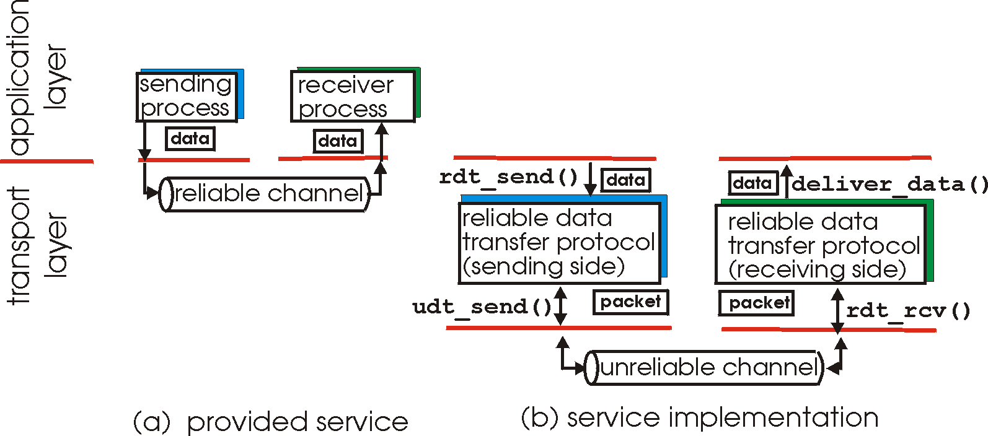
Principles of reliable data transfer
important in application, transport, link layers
  top-10 list of important networking topics!
characteristics of unreliable channel will determine complexity of reliable data transfer protocol (rdt)

Slide 18
Principles of reliable data transfer
important in application, transport, link layers
  top-10 list of important networking topics!
characteristics of unreliable channel will determine complexity of reliable data transfer protocol (rdt)

Slide 19
Principles of reliable data transfer
important in application, transport, link layers
  top-10 list of important networking topics!
characteristics of unreliable channel will determine complexity of reliable data transfer protocol (rdt)

Slide 20
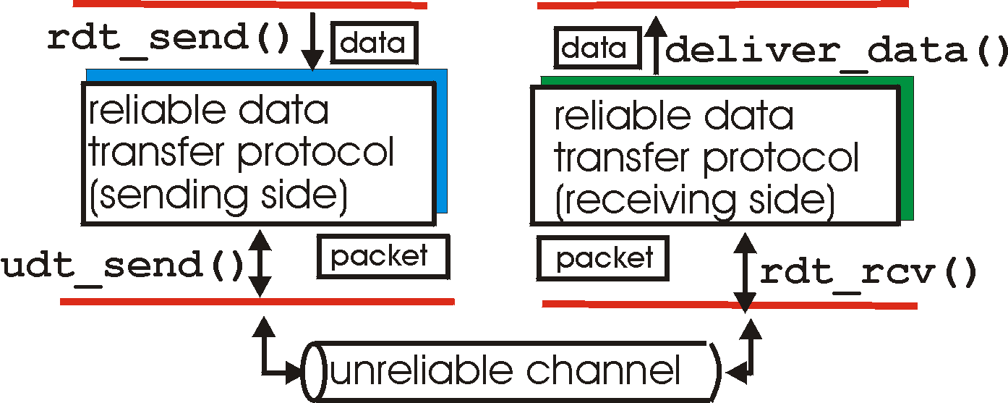
/Reliable data transfer: getting started
rdt_send(): called from above, (e.g., by app.). Passed data to
deliver to receiver upper layer
deliver_data(): called by rdt to deliver data to upper
send
side
receive
side
udt_send(): called by rdt,
to transfer packet over
unreliable channel to receiver
rdt_rcv(): called when packet arrives on rcv-side of channel

Slide 21
/Reliable data transfer: getting started
we’ll:
incrementally develop sender, receiver sides of reliable data transfer protocol (rdt)
consider only unidirectional data transfer
  but control info will flow on both directions!
use finite state machines (FSM) to specify sender, receiver
event causing state transition
actions taken on state transition
state: when in this “state” next state uniquely determined by next event
state
1
state
2
event
actions

Slide 22
/rdt1.0: reliable transfer over a reliable channel
underlying channel perfectly reliable
  no bit errors
  no loss of packets
separate FSMs for sender, receiver:
  sender sends data into underlying channel
  receiver reads data from underlying channel
Wait for call from above
rdt_send(data)
Wait for call from below
rdt_rcv(packet)
extract (packet,data)
deliver_data(data)
packet = make_pkt(data)
udt_send(packet)
sender
receiver

Slide 23
/rdt2.0: channel with bit errors
underlying channel may flip bits in packet
  checksum to detect bit errors
the question: how to recover from errors:
  acknowledgements (ACKs): receiver explicitly tells sender that pkt received OK
  negative acknowledgements (NAKs): receiver explicitly tells sender that pkt had errors
  sender retransmits pkt on receipt of NAK
new mechanisms in rdt2.0 (beyond rdt1.0):
  error detection
  receiver feedback: control msgs (ACK,NAK) rcvr->sender
How do humans recover from “errors”
during conversation?

Slide 24
/rdt2.0: channel with bit errors
underlying channel may flip bits in packet
  checksum to detect bit errors
the question: how to recover from errors:
  acknowledgements (ACKs): receiver explicitly tells sender that pkt received OK
  negative acknowledgements (NAKs): receiver explicitly tells sender that pkt had errors
  sender retransmits pkt on receipt of NAK
new mechanisms in rdt2.0 (beyond rdt1.0):
  error detection
  feedback: control msgs (ACK,NAK) from receiver to sender

Slide 25
/rdt2.0: FSM specification
///EA Wed 7 oct, C14&M??
rdt_send(data)
sndpkt = make_pkt(data, checksum)
udt_send(sndpkt)
receiver
rdt_rcv(rcvpkt) &&
isNAK(rcvpkt)
Wait for call from above
Wait for ACK or NAK
rdt_rcv(rcvpkt) &&
corrupt(rcvpkt)
udt_send(sndpkt)
udt_send(NAK)
rdt_rcv(rcvpkt) && isACK(rcvpkt)
Λ
Wait for call from below
sender
rdt_rcv(rcvpkt) &&
notcorrupt(rcvpkt)
extract(rcvpkt,data)
deliver_data(data)
udt_send(ACK)

Slide 26
/rdt2.0: operation with no errors
rdt_send(data)
snkpkt = make_pkt(data, checksum)
udt_send(sndpkt)
rdt_rcv(rcvpkt) &&
isNAK(rcvpkt)
Wait for call from above
Wait for ACK or NAK
rdt_rcv(rcvpkt) &&
corrupt(rcvpkt)
udt_send(sndpkt)
udt_send(NAK)
rdt_rcv(rcvpkt) && isACK(rcvpkt)
Wait for call from below
Λ
rdt_rcv(rcvpkt) &&
notcorrupt(rcvpkt)
extract(rcvpkt,data)
deliver_data(data)
udt_send(ACK)

Slide 27
/rdt2.0: error scenario
rdt_send(data)
snkpkt = make_pkt(data, checksum)
udt_send(sndpkt)
rdt_rcv(rcvpkt) &&
isNAK(rcvpkt)
Wait for call from above
Wait for ACK or NAK
rdt_rcv(rcvpkt) &&
corrupt(rcvpkt)
udt_send(sndpkt)
udt_send(NAK)
rdt_rcv(rcvpkt) && isACK(rcvpkt)
Wait for call from below
Λ
rdt_rcv(rcvpkt) &&
notcorrupt(rcvpkt)
extract(rcvpkt,data)
deliver_data(data)
udt_send(ACK)

Slide 28
/rdt2.0 has a fatal flaw! (flaw =weakness)
what happens if ACK/NAK corrupted?
sender doesn’t know what happened at receiver!
can’t just retransmit: possible duplicate
handling duplicates:
sender retransmits current pkt if ACK/NAK corrupted
sender adds sequence number to each pkt
receiver discards (doesn’t deliver up) duplicate pkt
stop and wait
sender sends one packet,
then waits for receiver
response

Slide 29
/rdt2.1: sender, handles garbled ACK/NAKs
rdt_send(data)
sndpkt = make_pkt(0, data, checksum)
udt_send(sndpkt)
rdt_rcv(rcvpkt) &&
( corrupt(rcvpkt) ||
isNAK(rcvpkt) )
Wait for call 0 from above
Wait for ACK or NAK 0
udt_send(sndpkt)
rdt_rcv(rcvpkt)
&& notcorrupt(rcvpkt)
&& isACK(rcvpkt)
rdt_rcv(rcvpkt)
&& notcorrupt(rcvpkt)
&& isACK(rcvpkt)
Λ
Λ
Wait for ACK or NAK 1
Wait for
call 1 from above
rdt_rcv(rcvpkt) &&
( corrupt(rcvpkt) ||
isNAK(rcvpkt) )
rdt_send(data)
udt_send(sndpkt)
sndpkt = make_pkt(1, data, checksum)
udt_send(sndpkt)

Slide 30
/ rdt2.1: receiver, handles garbled ACK/NAKs
(garbled= corrupted)
rdt_rcv(rcvpkt) && notcorrupt(rcvpkt)
&& has_seq0(rcvpkt)
extract(rcvpkt,data)
deliver_data(data)
sndpkt = make_pkt(ACK, chksum)
udt_send(sndpkt)
rdt_rcv(rcvpkt) && (corrupt(rcvpkt)
rdt_rcv(rcvpkt) && (corrupt(rcvpkt)
sndpkt = make_pkt(NAK, chksum)
udt_send(sndpkt)
sndpkt = make_pkt(NAK, chksum)
udt_send(sndpkt)
Wait for
0 from below
Wait for
1 from below
rdt_rcv(rcvpkt) &&
not corrupt(rcvpkt) &&
has_seq1(rcvpkt)
rdt_rcv(rcvpkt) &&
not corrupt(rcvpkt) &&
has_seq0(rcvpkt)
sndpkt = make_pkt(ACK, chksum)
udt_send(sndpkt)
sndpkt = make_pkt(ACK, chksum)
udt_send(sndpkt)
rdt_rcv(rcvpkt) && notcorrupt(rcvpkt)
&& has_seq1(rcvpkt)
extract(rcvpkt,data)
deliver_data(data)
sndpkt = make_pkt(ACK, chksum)
udt_send(sndpkt)

Slide 31
/ rdt2.1: discussion
sender:
seq # added to pkt
two seq. #’s (0,1) will suffice. Why?
must check if received ACK/NAK corrupted
twice as many states
  state must “remember” whether “expected” pkt should have seq # of 0 or 1
receiver:
must check if received packet is duplicate
  state indicates whether 0 or 1 is expected pkt seq #
note: receiver can not know if its last ACK/NAK received OK at sender

Slide 32
/ rdt2.2: a NAK-free protocol
same functionality as rdt2.1, using ACKs only
instead of NAK, receiver sends ACK for last pkt received OK
  receiver must explicitly include seq # of pkt being ACKed
duplicate ACK at sender results in same action as NAK: retransmit current pkt

Slide 33
*Data Communication over channels with errors and loss
assumption: underlying channel can have errors and also can lose packets (data, ACKs)
  checksum, seq. #, ACKs, retransmissions will be of help … but not enough
approach: sender sends packet(s) then waits “reasonable” amount of time for ACK
retransmits if no ACK received in this time
if pkt (or ACK) just delayed (not lost):
  retransmission will be duplicate, but seq. #’s already handles this
  receiver must specify seq # of pkt being ACKed
requires countdown timer

Slide 34

*Examples on How Data Communication Works
sender
receiver
sender
receiver
send pkt0
pkt0
send pkt0
pkt0
rcv pkt0
rcv pkt0
ack0
send ack0
ack0
send ack0
rcv ack0
rcv ack0
send pkt1
pkt1
send pkt1
pkt1
rcv pkt1
X
ack1
send ack1
loss
rcv ack1
send pkt0
pkt0
rcv pkt0
timeout
resend pkt1
ack0
send ack0
pkt1
rcv pkt1
??
ack1
send ack1
rcv ack1
send pkt0
pkt0
(a) no loss
rcv pkt0
ack0
send ack0
??
(b) packet loss

Slide 35
*Examples on How Data Communication Works
sender
receiver
sender
receiver
send pkt0
pkt0
send pkt0
pkt0
rcv pkt0
rcv pkt0
ack0
send ack0
send ack0
rcv ack0
ack0
send pkt1
pkt1
rcv ack0
rcv pkt1
send pkt1
pkt1
send ack1
rcv pkt1
ack1
send ack1
ack1
X
loss
timeout
resend pkt1
pkt1
rcv pkt1
timeout
resend pkt1
rcv ack1
pkt1
rcv pkt1
pkt0
(detect duplicate)
send pkt0
send ack1
ack1
(detect duplicate)
ack1
rcv pkt0
rcv ack1
send ack1
rcv ack1
ack0
send ack0
pkt0
send pkt0
pkt0
send pkt0
rcv pkt0
rcv pkt0
ack0
(detect duplicate)
ack0
send ack0
send ack0
??
??
(c) ACK loss
(d) premature timeout/ delayed ACK

Slide 36
*stop-and-wait operation*
sender
receiver
first packet bit transmitted, t = 0
last packet bit transmitted, t = L / R
first packet bit arrives
RTT
last packet bit arrives, send ACK
ACK arrives, send next
packet, t = RTT + L / R
Usender: Utilization of sender.
Assumptions: t=.008 ms, RTT (Round Trip Time)= 30ms
0.00027= 27/100,000

Slide 37
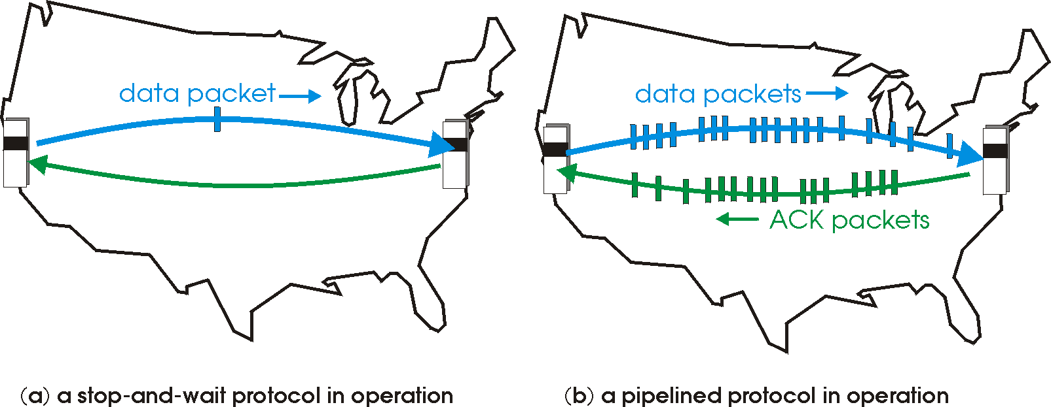

Pipelined protocols ///C8A Tue 13 Oct
pipelining: sender allows multiple, “in-flight”, yet-to-be-acknowledged pkts
  range of sequence numbers must be increased
  buffering at sender and/or receiver
two generic forms of pipelined protocols: go-Back-N, selective repeat

Slide 38
Pipelined protocols: overview
Go-back-N:
sender can have up to N unacked packets in pipeline
receiver only sends a cumulative ack
  doesn’t ack packet if there’s a gap
sender has timer for oldest unacked packet
  when timer expires, retransmit all unacked packets
Selective Repeat:
sender can have up to N unacked packets in pipeline
rcvr sends individual ack for each packet
sender maintains timer for each unacked packet
  when timer expires, retransmit only that unacked packet

Slide 39
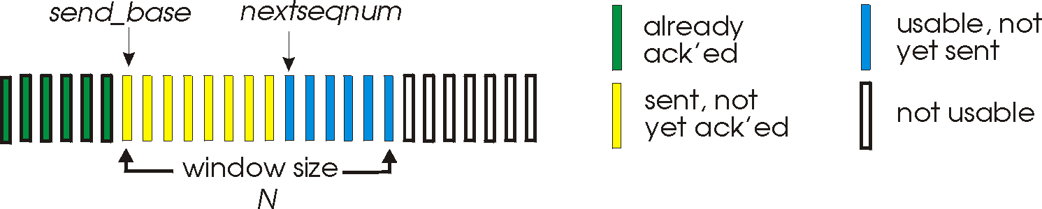
Go-Back-N: sender
k-bit seq # in pkt header
“window” of up to N, consecutive unacked pkts allowed
ACK(n): ACKs all pkts up to, including seq # n - “cumulative ACK”
  may receive duplicate ACKs (see receiver)
timer for oldest in-flight pkt
timeout(n): retransmit packet n and all higher seq # pkts in window

Slide 40
*GBN in action
Seq#: 0-8, just an example
sender window size (N=4)
sender
receiver
0 1 2 3 4 5 6 7 8
send pkt0
send pkt1
send pkt2
send pkt3
(wait)
0 1 2 3 4 5 6 7 8
receive pkt0, send ack0
receive pkt1, send ack1
receive pkt3, discard,
(re)send ack1
0 1 2 3 4 5 6 7 8
X
0 1 2 3 4 5 6 7 8
loss
0 1 2 3 4 5 6 7 8
rcv ack0, send pkt4
rcv ack1, send pkt5
0 1 2 3 4 5 6 7 8
receive pkt4, discard,
(re)send ack1
ignore duplicate ACK
receive pkt5, discard,
(re)send ack1
pkt 2 timeout
0 1 2 3 4 5 6 7 8
(re)send pkt 2
(re)send pkt 3
(re)send pkt 4
(re)send pkt 5
0 1 2 3 4 5 6 7 8
0 1 2 3 4 5 6 7 8
0 1 2 3 4 5 6 7 8

Slide 41
Selective repeat
receiver individually acknowledges all correctly received pkts
  buffers pkts, as needed, for eventual in-order delivery to upper layer
sender only resends pkts for which ACK not received
  sender timer for each unACKed pkt
sender window
  N consecutive seq #’s
  limits seq #s of sent, unACKed pkts

Slide 42
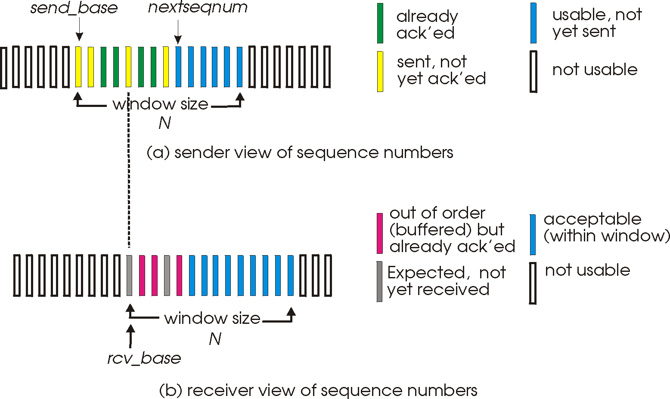
Selective repeat: sender, receiver windows

Slide 43
Selective repeat
sender
receiver
data from above:
if next available seq # in window, send pkt
timeout(n):
resend pkt n, restart timer
ACK(n) in [sendbase,sendbase+N]:
mark pkt n as received
if n smallest unACKed pkt, advance window base to next unACKed seq #
pkt n in [rcvbase, rcvbase+N-1]
send ACK(n)
out-of-order: buffer
in-order: deliver (also deliver buffered, in-order pkts), advance window to next not-yet-received pkt
pkt n in [rcvbase-N,rcvbase-1]
ACK(n)
otherwise:
ignore

Slide 44
*Selective repeat in action
sender window (N=4)
sender
receiver
0 1 2 3 4 5 6 7 8
send pkt0
send pkt1
send pkt2
send pkt3
(wait)
0 1 2 3 4 5 6 7 8
receive pkt0, send ack0
receive pkt1, send ack1
receive pkt3, buffer,
send ack3
0 1 2 3 4 5 6 7 8
X
0 1 2 3 4 5 6 7 8
loss
0 1 2 3 4 5 6 7 8
rcv ack0, send pkt4
rcv ack1, send pkt5
0 1 2 3 4 5 6 7 8
receive pkt4, buffer,
send ack4
record ack3 arrived
receive pkt5, buffer,
send ack5
pkt 2 timeout
0 1 2 3 4 5 6 7 8
resend pkt2
0 1 2 3 4 5 6 7 8
record ack4 arrived
0 1 2 3 4 5 6 7 8
rcv pkt2; deliver pkt2,
pkt3, pkt4, pkt5; send ack2
record ack5 arrived
0 1 2 3 4 5 6 7 8
Q: what happens when ack2 arrives?

Slide 45

/Selective repeat: dilemma
///EA, C14&M Mon 12 Oct
receiver window
(after receipt)
sender window
(after receipt)
0 1 2 3 0 1 2
pkt0
0 1 2 3 0 1 2
pkt1
0 1 2 3 0 1 2
example:
seq #’s: 0, 1, 2, 3
window size=3
0 1 2 3 0 1 2
pkt2
0 1 2 3 0 1 2
0 1 2 3 0 1 2
0 1 2 3 0 1 2
pkt3
X
0 1 2 3 0 1 2
pkt0
will accept packet
with seq number 0
receiver sees no difference in two scenarios!
duplicate data accepted as new in (b)
Q: what relationship between seq # size and window size to avoid problem in (b)?
(a) no problem
receiver can’t see sender side.
receiver behavior identical in both cases!
something’s (very) wrong!
0 1 2 3 0 1 2
pkt0
0 1 2 3 0 1 2
pkt1
0 1 2 3 0 1 2
0 1 2 3 0 1 2
pkt2
0 1 2 3 0 1 2
X
0 1 2 3 0 1 2
X
timeout
retransmit pkt0
X
0 1 2 3 0 1 2
pkt0
will accept packet
with seq number 0
(b) oops!

Slide 46
TCP: Overview RFCs: 793,1122,1323, 2018, 2581
point-to-point:
  one sender, one receiver
reliable, in-order byte steam:
  no “message boundaries”
pipelined:
  TCP congestion and flow control set window size
full duplex data:
  bi-directional data flow in same connection
  MSS: maximum segment size
connection-oriented:
  handshaking (exchange of control msgs) inits sender, receiver state before data exchange
flow controlled:
  sender will not overwhelm receiver

Slide 47
TCP segment structure
32 bits
URG: urgent data
(generally not used)
counting
by bytes
of data
(not segments!)
source port #
dest port #
sequence number
ACK: ACK #
valid
acknowledgement number
head
len
not
used
U
receive window
A
PSH: push data now
(generally not used)
P
R
S
F
# bytes
rcvr willing
to accept
checksum
Urg data pointer
RST, SYN, FIN:
connection estab
(setup, teardown
commands)
options (variable length)
application
data
(variable length)
Internet
checksum
(as in UDP)

Slide 48
TCP seq. numbers, ACKs
outgoing segment from sender
sequence numbers:
  byte stream “number” of first byte in segment’s data
acknowledgements:
  seq # of next byte expected from other side
  cumulative ACK
Q: how receiver handles out-of-order segments
  A: TCP spec doesn’t say, - up to implementor
source port #
dest port #
sequence number
acknowledgement number
rwnd
checksum
urg pointer
window size
N
  sender sequence number space
sent
ACKed
sent, not-yet ACKed
(“in-flight”)
usable
but not
yet sent
not
usable
incoming segment to sender
source port #
dest port #
sequence number
acknowledgement number
A
rwnd
checksum
urg pointer

Slide 49
TCP seq. numbers, ACKs*
Host A
Host B
User
types
‘C’
Seq=42*, ACK=79*, data = ‘C’
host ACKs
receipt of
‘C’, echoes
back ‘C’
Seq=79, ACK=43, data = ‘C’
host ACKs
receipt
of echoed
‘C’
Seq=43, ACK=80
simple telnet scenario (Fig 3.31 p238)
* 42 and 79 are assumed to be the starting Seq numbers for Host-A and Host-B respectively. See P237-238

Slide 50
TCP round trip time (RTT), timeout
///C8A Sun 18 Oct
Q: how to set TCP timeout value?
longer than RTT
  but RTT varies
too short: premature timeout, unnecessary retransmissions
too long: slow reaction to segment loss
Q: how to estimate RTT?
SampleRTT: measured time from segment transmission until ACK receipt
  ignore retransmissions
SampleRTT will vary, want estimated RTT “smoother”
  average several recent measurements, not just current SampleRTT

Slide 51
TCP round trip time, timeout
EstimatedRTT = (1- α)*EstimatedRTT + α*SampleRTT
exponential weighted moving average
influence of past sample decreases exponentially fast
typical value: α = 0.125
RTT: gaia.cs.umass.edu to fantasia.eurecom.fr
RTT (milliseconds)
sampleRTT
EstimatedRTT
time (seconds)

Slide 52

TCP round trip time, timeout
timeout interval: EstimatedRTT plus “safety margin”
  large variation in EstimatedRTT -> larger safety margin
estimate SampleRTT deviation from EstimatedRTT:
DevRTT = (1-β)*DevRTT +
β*|SampleRTT-EstimatedRTT|
(typically, β = 0.25)
TimeoutInterval = EstimatedRTT + 4*DevRTT
estimated RTT
“safety margin”

Slide 53
*TCP reliable data transfer (rdt)
///CA14&M Wed 14 Oct
TCP creates reliable data transfer (rdt) service on top of IP’s unreliable service at network layer
  pipelined segments
  cumulative acks
  single retransmission timer
retransmissions triggered by:
  timeout events
  duplicate acks
let’s initially consider simplified TCP sender:
  ignore duplicate acks
  ignore flow control, congestion control

Slide 54
TCP sender events:
data rcvd from app:
create segment with seq #
seq # is byte-stream number of first data byte in segment
start timer if not already running
  think of timer as for oldest unacked segment
  expiration interval: TimeOutInterval
timeout:
retransmit segment that caused timeout
restart timer
ack rcvd:
if ack acknowledges previously unacked segments
  update what is known to be ACKed
  start timer if there are still unacked segments

Slide 55
*TCP: retransmission scenarios
///EA Wed 14 Oct
Host A
Host B
Host A
Host B
SendBase=92
Seq=92*, 8 bytes of data
Seq=92, 8 bytes of data
timeout
timeout
Seq=100, 20 bytes of data
ACK=100
X
ACK=100
ACK=120, rwnd=10 B
Seq=92, 8 bytes of data
Seq=92, 8
bytes of data
SendBase=100
SendBase=120
ACK=100, rwnd= 15B
ACK=120, rwnd=10 B
SendBase=120
Seq=100, 15 bytes of data
Seq=120, 10 bytes of data
lost ACK scenario
premature timeout
*Seq=92: Assumed Number

Slide 56
TCP: retransmission scenarios
Host A
Host B
Seq=92, 8 bytes of data
Seq=100, 20 bytes of data
timeout
ACK=100
X
ACK=120, rwnd=15 B
Seq=120, 15 bytes of data
ACK=?, rwnd=? B
*cumulative ACK 120 avoids retransmission of the first segment (Seq=92, 8 bytes of data)
cumulative ACK*

Slide 57
/TCP ACK generation* [RFC 1122, RFC 2581]
event at receiver
arrival of in-order segment with
expected seq #. All data up to
expected seq # already ACKed
e.g: Seq 92, 8Bytes data arrived
arrival of in-order segment with
expected seq #. One other
segment has ACK pending
e.g: Seq 92, 8B arrived then 100, 20B
&& ACK 100 not sent yet
arrival of out-of-order segment
higher-than-expect seq. # .
Gap detected.
e.g: Seq 100, 20B arrived but 92, 8B not
arrival of segment that
partially or completely fills gap
TCP receiver action
delayed ACK. Wait up to 500ms
for next segment. If no next segment,
send ACK
Wait 500ms then Send Ack 100
immediately send single cumulative
ACK, ACKing both in-order segments
Send Ack 120
immediately send duplicate ACK,
indicating seq. # of next expected byte
ACK=92, ACK=92
immediate send ACK, provided that
segment starts at lower end of gap

Slide 58
TCP fast retransmit
time-out period often relatively long:
  ➔long delay before resending lost packet
detect lost segments via duplicate ACKs.
  sender often sends many segments back-to-back
  if segment is lost, there will likely be many duplicate ACKs.
TCP fast retransmit
if sender receives 3 ACKs for same data
(“triple duplicate ACKs”), resend unacked segment with smallest seq #
  likely that unacked segment lost, so don’t wait for timeout

Slide 59
*TCP fast retransmit
Host A
Host B
Seq=92, 8 bytes of data
Seq=100, 20 bytes of data
X
ACK=100
timeout
ACK=100
ACK=100
ACK=100
Seq=100, 20 bytes of data
ACK=?, rwnd=?
fast retransmit after sender
receipt of triple duplicate ACK

Slide 60
TCP flow control
application
process
application may
remove data from
TCP socket buffers ….
application
TCP socket
receiver buffers
OS
… slower than TCP
receiver is delivering
(sender is sending)
TCP
code
flow control
IP
code
receiver controls sender, so sender won’t overflow receiver’s buffer by transmitting too much, too fast
from sender
receiver protocol stack

Slide 61
TCP flow control
receiver “advertises” free buffer space by including rwnd value in TCP header of receiver-to-sender segments
  RcvBuffer size set via socket options (typical default is 4096 bytes)
  many operating systems autoadjust RcvBuffer
sender limits amount of unacked (“in-flight”) data to receiver’s rwnd value
guarantees receive buffer will not overflow
to application process
RcvBuffer
buffered data
rwnd
free buffer space
TCP segment payloads
receiver-side buffering

Slide 62
Connection Management
before exchanging data, sender/receiver “handshake”:
agree to establish connection (each knowing the other willing to establish connection)
agree on connection parameters
application
application
connection state: ESTAB
connection variables:
  seq # client-to-server
  server-to-client
  rcvBuffer size
  at server,client
connection state: ESTAB
connection Variables:
  seq # client-to-server
  server-to-client
  rcvBuffer size
  at server,client
network
network
Socket clientSocket =
newSocket("hostname","port number");
Socket connectionSocket = welcomeSocket.accept();

Slide 63



/Agreeing to establish a connection
2-way handshake:
Q: will 2-way handshake always work in network?
variable delays
retransmitted messages (e.g. req_conn(x)) due to message loss
message reordering
can’t “see” other side
Let’s talk
ESTAB
OK
ESTAB
choose x
req_conn(x)
ESTAB
acc_conn(x)
ESTAB

Slide 64
/Agreeing to establish a connection
2-way handshake failure scenarios:
choose x
choose x
req_conn(x)
req_conn(x)
ESTAB
ESTAB
retransmit
req_conn(x)
acc_conn(x)
retransmit
req_conn(x)
acc_conn(x)
ESTAB
ESTAB
data(x+1)
accept
data(x+1)
req_conn(x)
retransmit
data(x+1)
connection
x completes
connection
x completes
client terminates
server
forgets x
client terminates
server
forgets x
req_conn(x)
ESTAB
data(x+1)
ESTAB
half open connection!
(no client!)
accept
data(x+1)

Slide 65
TCP 3-way handshake
client state
server state
LISTEN
LISTEN
choose init seq num, x
send TCP SYN msg
SYNSENT
SYNbit=1, Seq=x
choose init seq num, y
send TCP SYNACK
msg, acking SYN
SYN RCVD
SYNbit=1, Seq=y
ACKbit=1; ACKnum=x+1
received SYNACK(x)
indicates server is live;
send ACK for SYNACK;
this segment may contain
client-to-server data
ESTAB
ACKbit=1, ACKnum=y+1
received ACK(y)
indicates client is live
ESTAB

Slide 66
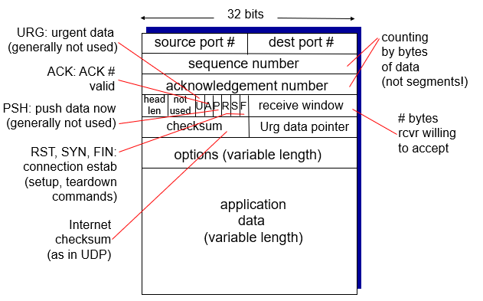
*TCP: closing a connection
client, server each close their side of connection
  send TCP segment with FIN bit = 1
respond to received FIN with ACK
  on receiving FIN, ACK can be combined with own FIN
simultaneous FIN exchanges can be handled
Remember (from Slide 47):

Slide 67
TCP: closing a connection
client state
server state
ESTAB
ESTAB
clientSocket.close()
FIN_WAIT_1
can no longer
send but can
receive data
FINbit=1, seq=x
CLOSE_WAIT
ACKbit=1; ACKnum=x+1
can still
send data
FIN_WAIT_2
wait for server
close
LAST_ACK
FINbit=1, seq=y
TIMED_WAIT
can no longer
send data
ACKbit=1; ACKnum=y+1
timed wait
for 2*max
segment lifetime
CLOSED
CLOSED

Slide 68
*Principles of congestion control
congestion:
informally: “too many sources sending too much data too fast for network to handle”
different from flow control!
Manifestations (Indicators):
  lost packets (buffer overflow at routers)
  long delays (queueing in router buffers)
a top-10 problem!

Slide 69

/Causes/costs of congestion: scenario 1
original data: λ_{in}
throughput: λ_{out}
two senders, two receivers
one router, infinite buffers
output link capacity: R
no retransmission
Host A
unlimited shared output link buffers
Host B
R/2
λ_{out}
delay
λ_{in}
R/2
λ_{in}
R/2
maximum per-connection throughput: R/2
large delays as arrival rate, λ_{in}, approaches capacity

Slide 70
/Causes/costs of congestion: scenario 2
one router, finite buffers
sender retransmission of timed-out packet
  application-layer input = application-layer output: λ_{in} = λ_{out}
  transport-layer input includes retransmissions : λ_{in} λ_{in}
‘
λ_{in} : original data
λ'_{in}: original data, plus retransmitted data
λ_{out}
Host A
finite shared output link buffers
Host B

Slide 71
/Causes/costs of congestion: scenario 2
R/2
idealization: perfect knowledge
sender sends only when router buffers available
λ_{out}
λ_{in}
R/2
λ_{in} : original data
copy
λ'_{in}: original data, plus retransmitted data
λ_{out}
A
free buffer space!
finite shared output link buffers
Host B

Slide 72

/Causes/costs of congestion: scenario 2
Idealization: known loss packets can be lost, dropped at router due to full buffers
sender only resends if packet known to be lost
λ_{in} : original data
copy
λ'_{in}: original data, plus retransmitted data
λ_{out}
A
no buffer space!
Host B

Slide 73
/Causes/costs of congestion: scenario 2
Idealization: known loss packets can be lost, dropped at router due to full buffers
sender only resends if packet known to be lost
R/2
when sending at R/2, some packets are retransmissions but asymptotic goodput is still R/2 (why?)
λ_{out}
λ_{in}
R/2
λ_{in} : original data
λ'_{in}: original data, plus retransmitted data
λ_{out}
A
free buffer space!
Host B

Slide 74


/Causes/costs of congestion: scenario 2
Realistic: duplicates
packets can be lost, dropped at router due to full buffers
sender times out prematurely, sending two copies, both of which are delivered
R/2
when sending at R/2, some packets are retransmissions including duplicated that are delivered!
λ_{out}
λ_{in}
R/2
λ_{in}
copy
λ'_{in}
λ_{out}
timeout
A
free buffer space!
Host B

Slide 75
/Causes/costs of congestion: scenario 2
Realistic: duplicates
packets can be lost, dropped at router due to full buffers
sender times out prematurely, sending two copies, both of which are delivered
R/2
when sending at R/2, some packets are retransmissions including duplicated that are delivered!
λ_{out}
λ_{in}
R/2
“costs” of congestion:
more work (retrans) for given “goodput”
unneeded retransmissions: link carries multiple copies of pkt
  decreasing goodput

Slide 76
/Causes/costs of congestion: scenario 3
Q: what happens as λ_{in} and λ_{in}’ increase ?
four senders
multihop paths
timeout/retransmit
A: as red λ_{in}’ increases, all arriving blue pkts at upper queue are dropped, blue throughput g 0
Host A
λ_{in} : original data
λ_{out}
Host B
λ'_{in}: original data, plus retransmitted data
finite shared output link buffers
Host D
Host C

Slide 77
/Causes/costs of congestion: scenario 3
C/2
λ_{out}
λ_{in}’
C/2
another “cost” of congestion:
when packet dropped, any “upstream transmission capacity used for that packet was wasted!

Slide 78
Approaches towards congestion control
///EA, CA14&M Mon 19 Oct, C8A Tue 20 Oct
///CA14&M on Wed 21 Oct not delivered
two broad approaches towards congestion control:
end-end congestion control:
no explicit feedback from network
congestion inferred from end-system observed loss, delay
approach taken by TCP
network-assisted congestion control:
routers provide feedback to end systems
  single bit indicating congestion (SNA, DECbit, TCP/IP ECN, ATM)
  explicit rate for sender to send at

Slide 79
TCP congestion control: additive increase multiplicative decrease
approach: sender increases transmission rate (window size), probing for usable bandwidth, until loss occurs
  additive increase: increase cwnd by 1 MSS every RTT until loss detected
  multiplicative decrease: cut cwnd in half after loss
additively increase window size …
…. until loss occurs (then cut window in half)
AIMD saw tooth
behavior: probing
for bandwidth
cwnd: TCP sender
congestion window size
time

Slide 80
/TCP Congestion Control: details
sender sequence number space
TCP sending rate:
roughly: send cwnd bytes, wait RTT for ACKS, then send more bytes
cwnd
last byte
ACKed
last byte sent
sent, not-yet ACKed
(“in-flight”)
rate
cwnd
sender limits transmission:
cwnd is dynamic, function of perceived network congestion
~
bytes/sec
~
RTT
LastByteSent-
LastByteAcked
cwnd
<

Slide 81
TCP Slow Start
Host A
Host B
when connection begins, increase rate exponentially until first loss event:
  initially cwnd = 1 MSS
  double cwnd every RTT
  done by incrementing cwnd for every ACK received
summary: initial rate is slow but ramps up exponentially fast
one segment
RTT
two segments
four segments
time

Slide 82
TCP: detecting, reacting to loss*
loss indicated by timeout:
  cwnd set to 1 MSS;
  window then grows exponentially (as in slow start) to threshold, then grows linearly
loss indicated by 3 duplicate ACKs:
TCP RENO*
  dup ACKs indicate network capable of delivering some segments
  cwnd is cut in half window then grows linearly
TCP Tahoe* always sets cwnd to 1 (timeout or 3 duplicate acks)
* Reno : The newer version of TCP. Tahoe: An early version of TCP (++)
Notes:
*It is interesting that an early version of TCP, known as TCP Tahoe, unconditionally cut its congestion window to 1 MSS and entered the slow-start phase after either a timeout-indicated or triple-duplicate-ACK-indicated loss event. The newer version of TCP, TCP Reno, incorporated fast recovery. p276

Slide 83
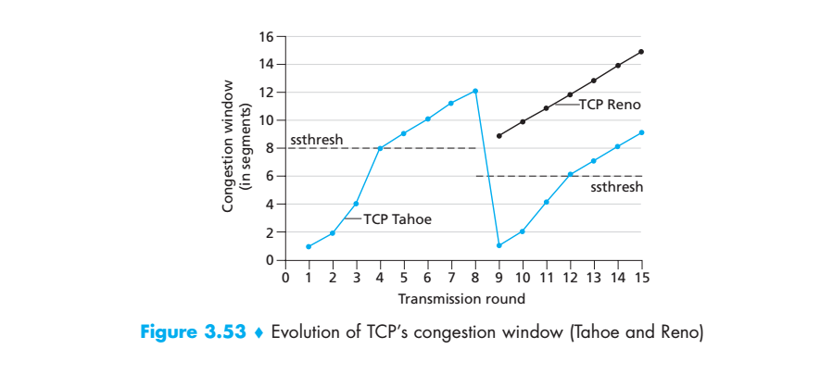
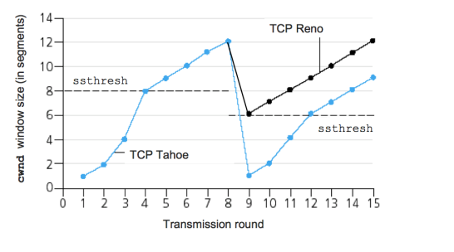
**TCP: detecting, reacting to loss*
Tahoe / Reno Congestion Control
Loss
ssthresh: slow start threshold. MSS: Maximum Segment Size
For Transmission. Rounds 1-8, Tahoe and Reno are identical till loss happens. Then:
  ssthresh2= 0.5 Last_Max_cwnd= (in the figure = 0.5*12= 6 MSS),
  Tahoe_cwnd cut to 1MSS always, then increases exponentially to ssthresh2, then Linearly till loss happens .
  Reno_cwnd cut to = 0.5 Last_Max_cwnd= (in the figure = 6 MSS), then increases Linearly till loss happens .
https://gkf168.files.wordpress.com/2012/05/tahoe-reno.png?w=546&h=304

Slide 84
Chapter 3: summary
principles behind transport layer services:
  multiplexing, demultiplexing
  reliable data transfer
  flow control
  congestion control
instantiation, implementation in the Internet
  UDP
  TCP
next:
leaving the network “edge” (application, transport layers)
into the network “core”

