Slide 1
Microprocessor and Microcontroller (802681-3)
Lecture 1
Embedded Systems Basics
Dr Syed Misbahuddin
ssmisbahuddin@uqu.edu.sa

Slide 2
Objectives
Define a microprocessor, a microcomputer, and a microcontroller
  Describe the basic components of a microcontroller
Define an embedded system
  Describe the basic components of an embedded system
  List some major applications of embedded systems

Slide 3
What is a Microprocessor?
A microprocessor is a very small silicon chip in which millions of MOSFETs are integrated
  Also known as an Integrated Circuit or I. C.
The silicon chip contains a central processing unit (CPU)
  Fetches, decodes, and executes program instructions from memory and executes them
A microprocessor mainly features data pins, address pins, and a couple of control pins to communicate with external devices via a group of wires

Slide 4
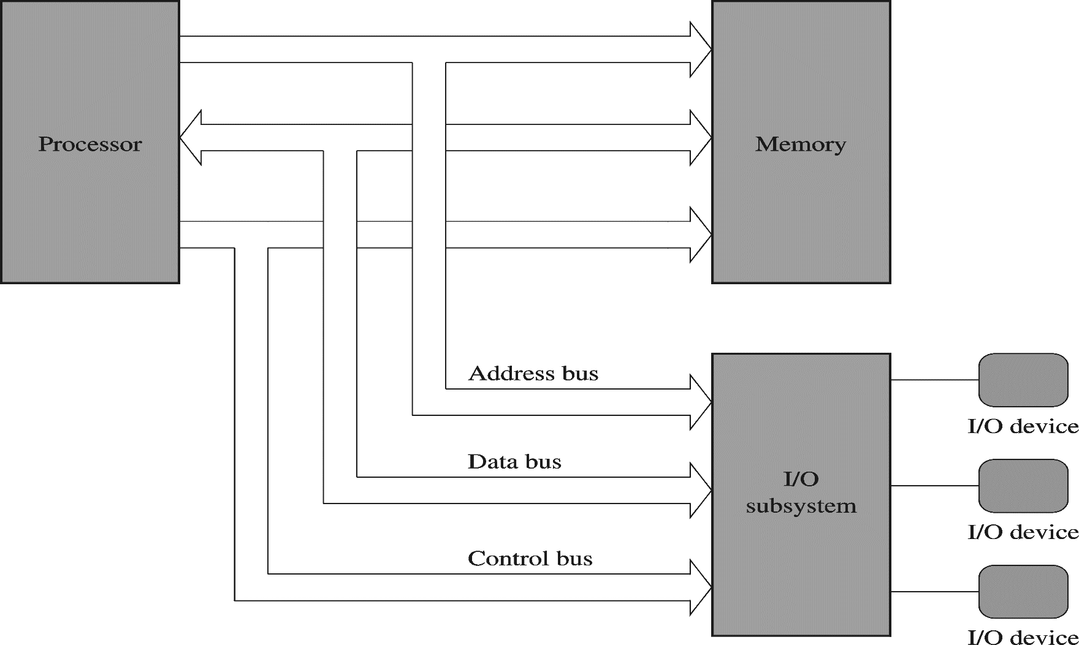
Fetch step: Place address of instruction on address bus, issue read signal
Decode step: Understanding the instruction
Execute: Completing the task
00000000=ADD
00000001=SUB
11111111=DIV
Instruction set
Parallel connection 8255
Serial connection 8251

Slide 5
ASCII=American Standard Code for Information Inerchange
Each printable character has 7 bit code A=65

Slide 6
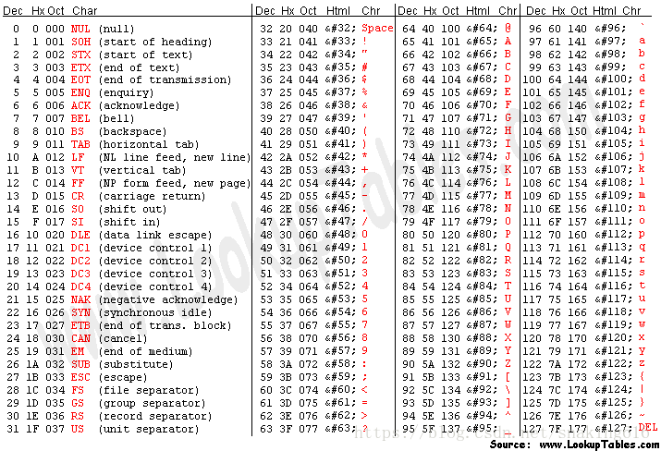
A=100 0001B

Slide 7
What is a Microprocessor?
A microprocessor cannot be operated stand-alone
  At the very least it requires some memory and an output device to be useful
The memory required by the microprocessor is external to the microprocessor chip
  It is put on the circuit board by the hardware engineer designing the system

Slide 8
What is a Microcomputer?
A microcomputer is a combination of the following minimal set of three basic components packaged in multiple chips required to establish a computing system
  A micro processor (called the processor core) or the central processing unit (CPU) to interpret and execute programs
  A memory to store both data and program instructions
  Input-output (I/O) ports working as an interface to provide communications between the microcomputer and the outside world

Slide 9
What is a Microcomputer?
Except for the three fundamental components, a microcomputer contains the following
  Groups of wires or buses to connect CPU, memory, and I/O ports
  Some internal devices or peripheral devices to provide necessary power and timing synchronization for system operation

Slide 10
I/O Subsystems
All the I/O ports and devices/peripherals, excluding the CPU and memory, that are connected to the buses make the I/O subsystems
  The peripherals could serve either as input, output or both
    CPU is used as the reference to designate a device/peripheral as either input or output
  I/O subsystems also include special registers or devices used to manage the system operation without external signals

Slide 11
V_{DD}
Power and Timing Support
f_{CLK}
CPU
RESET
System Memory
System Buses
I/O
Subsystems
Data
(RAM)
Program
(ROM)
V_{DD}
Figure 1-1: Basic building blocks of a Microcomputer
Power and Timing Support
f_{CLK}
CPU
RESET
System Memory
I/O
Subsystems
Data
(RAM)
Program
(ROM)
System Buses

Slide 12
What is a Microcontroller?
A microcontroller unit (MCU) is a small microcomputer that contains all the components of a microcomputer integrated into a single silicon chip and is used to control electronic devices
Due to the assortment of components inside a single chip, the MCUs are also known as computers-on-a-chip (CoC)
An MCU allows for implementing complete applications requiring only a minimal number of external components

Slide 13
V_{DD}
Power and Timing Support
f_{CLK}
CPU
RESET
System Memory
System Buses
I/O
Subsystems
Data
(RAM)
Program
(ROM)
Figure 1-2: Basic building blocks of an MCU

Slide 14
MCU Characteristics
Designated for monitoring and/or controlling tasks
Can operate stand-alone
Contains the processor, memory, various interface controllers, one or more timers, an interrupt controller, and general purpose I/O pins which allow it to directly interface to its environment
Also include bit operations which allow to change one bit within a byte without touching the other bits
Bit control instructions

Slide 15
I/O Subsystems of MCU
I/O Ports (Parallel Interfaces)
  Connects the I/O devices (peripherals) with the CPU via system buses
  The communications between CPU and I/O devices via I/O ports are parallel (several data lines to send more than one bit at a time) and viable for shorter distances up to several meters

Slide 16
I/O Subsystems of MCU
Serial Interfaces
  Connects MCU with external peripheral devices
  The communications between MCU and external peripheral devices via serial interfaces are serial (one data line to send one bit at a time) and useful for longer distances
Analog-to-digital (A/D) Converter or ADC
  Converts external analog input signals into discrete digital numbers and forwards to the CPU for further processing

Slide 17
I/O Subsystems of MCU
Digital-to-analog (D/A) Converter or DAC
  Converts digital command of CPU into analog signals understood by external electromechanical systems
Timer
  Measures time intervals between two events
  Generate events at specified time intervals
  Generate signals at a specified frequency

Slide 18
I/O Subsystems of MCU
Counter
  A counter is a timer that supplies pulses into the MCU input pins for the purpose of counting events
  Pulses to be counted come through the ports and their duration is mostly not defined
Watchdog Timer
  Resets the computer in case of software crashes

Slide 19
Other MCU Components
Interrupt Controller
  Interrupts normal program flow in case of important external or internal events
Phase-Locked Loop (PLL)
  Multiplies a low-frequency external clock to a higher internal frequency, increasing the speed of microcontroller operation
Direct Memory Access (DMA) controller
  Improves data transfer between internal memory and peripheral devices

Slide 20














Interrupt Service Routine (ISR)

Slide 21
Other MCU Components
Debugging Unit
  Support device testing and programming
Reset Controller
  Provides power-on reset and brown-out (i.e. power drops below the minimum specified supply voltage) detection
  Drives the reset pin to reset external devices
Power Management Controller
  Controls the clocks to various peripheral devices

Slide 22
What is an Embedded System?
An embedded system is an electronic circuit board/device
  Contains a microprocessor or MCU and other electronic parts
  Runs a software program
  Used for a specific purpose rather than a general purpose
  Packaged up as a complete system
Embedded systems are a major application area for microcontroller
  The control unit is integrated into the system

Slide 23
What is an Embedded System?
Any electrical, mechanical, or chemical system that involves inputs, decisions, calculations, analyses, and outputs can be implemented as an embedded system
  Also known as a Cyber-Physical System

Slide 24
Embedded System
Microcontroller
Power and
Timing
Support
CPU
Electrical, Mechanical, Chemical, or Optical Devices
External
Analog
World
System Memory
I/O
Ports
System Buses
RAM
ROM
Figure 1-3: Basic building blocks of an Embedded System

Slide 25
Embedded Systems Characteristics
Intended to perform a single function
Form part of a larger system
  Not intended to be independently programmable by the user
Expected to work with minimal or no human interaction
Respond in real-time to process inputs to ensure proper operation
Constrained by limited memory, computing power, and power supply

Slide 26
Embedded Systems Components
Microcontroller
  All the components of an MCU as described in slides 5-6 and slides 12-17
User Interfaces
  Facilitates human-machine interaction
  Examples: keypads, switches, buzzers and audio, LEDs, and displays (numeric, alphanumeric, and graphic)

Slide 27
Embedded Systems Components
Sensors
  Provides ADC with analog inputs related to physical parameters such as temperature, pressure, displacement, acceleration, rotation, etc.
Actuators
  Receives digital outputs from the system I/O ports (DAC)
  Examples: motor speed controllers, stepper motor controllers, relays, and power drivers

Slide 28
Embedded Systems Applications
Consumer
  Washing machines, exercise equipment, remote controls, clocks and watches, games and toys, audio/video devices, thermostats
Communication
  Answering machines, telephone systems, cellular phones, satellites

Slide 29
Embedded Systems Applications
Automotive
  Automatic braking, noise cancellation, theft deterrent devices, electronic ignition, windows and seats, instrumentation
Military
  Smart weapons, missile guidance, global positioning, surveillance
Industrial
  Point-of-sale systems, temperature control, robot systems, inventory systems, automatic sprinklers

Slide 30
Embedded Systems Applications
Medical
  Infant apnea monitors, cardiac monitors, cancer treatments, prosthetic devices, medical records
Computer components
  Mouse, USB flash drive, keyboard

Slide 31
References
Yiu, J. (2014). The Definite Guide to ARM Cortex-M3 and Cortex-M4 Processors (3rd Edition). Elsevier Inc. ISBN: 978-0-12-408082-9
Valvano, Jonathan W. (2015). Introduction to ARM Cortex-M Microcontrollers (5th Edition). Jonathan W. Valvano. ISBN: 978-1-477-50899-2

