Slide 1
UNIT 2
THE PREDICATE CALCULUS

Slide 2
Knowledge
Knowledge is a theoretical or practical understanding of a subject or a domain. Knowledge is also the sum of what is currently known, and apparently knowledge is power. Those who possess knowledge are called experts.
Knowledge representation is a science of translating actual knowledge into a format that can be used by the computer.

Slide 3
THE PROPOSITIONAL CALCULUS
The propositional calculus and the predicate calculus are representation languages for artificial intelligence.
Using their words, phrases, and sentences, we can represent and reason about properties and relationships in the world.
The first step in describing a language is to introduce the pieces that make it up: its set of symbols.

Slide 4
Syntax vs. Semantic
Syntax: is the study of the principles and rules for constructing phrases and sentences in natural languages
The syntax of the logic system defined by a set of rules for producing legal sentences.
Semantics: is the study of meaning of legal sentences.

Slide 5
PROPOSITIONAL CALCULUS SYMBOLS
The symbols of propositional calculus are:
  The propositional symbols (that denote propositions): P, Q, R, S, …
  The truth symbols: True and False
  The connectives:
      ∧ : the conjunction (and)
      ∨ : the disjunction (or)
      ￢ : the negation
      → : the implication (conditional statement)
      ≡ : the equivalence

Slide 6
Propositional Calculus sentences (i)
Sentences in the propositional calculus are formed from these atomic symbols according to the following rules:
  Every propositional symbol and truth symbol is a sentence.
  For example: true, P, Q, and R are sentences.
  The negation of a sentence is a sentence:
  For example: ￢ P and ￢ false are sentences.
  The conjunction (and) of two sentences is a sentence.
  For example: P ∧ Q is a sentence (P and Q are called the conjuncts).
  The disjunction (or) of two sentences is a sentence.
  For example: P ∨ Q is a sentence (P and Q are referred to as disjuncts).
  The implication of one sentence from another is a sentence.
  For example: P → Q is a sentence (P is called the premise or antecedent and Q is called the conclusion or consequent.)
  The equivalence of two sentences is a sentence.
  For example: P ∨ Q ≡ R is a sentence.

Slide 7
Propositional Calculus sentences (ii)
Legal sentences are also called well-formed formulas or WFFs.
In the sentences of propositional calculus, the symbols ( ) and [ ] are used to group symbols into sub expressions and so to control their order of evaluation and meaning.
For example, (P ∨ Q) ≡ R is quite different from P ∨ (Q ≡R)
An expression is considered a sentence (or well-formed formula) if and only if it can be formed of legal symbols through some sequence of the above rules.

Slide 8
Example
Is the following expression a well-formed sentence in the propositional calculus?
((P ∧ Q) → R) ≡ ￢ P ∨ ￢Q ∨ R
Answer
Yes, it is a well-formed sentence in the propositional calculus because it has been constructed (through a series of applications of legal rules and is therefore “well formed) as follows:
P, Q, and R are propositions and thus sentences.
P ∧ Q, the conjunction of two sentences, is a sentence.
(P ∧ Q) → R, the implication of a sentence for another, is a sentence.
￢ P and ￢ Q, the negations of sentences, are sentences.
￢ P ∨ ￢ Q, the disjunction of two sentences, is a sentence.
￢ P ∨ ￢ Q ∨ R, the disjunction of two sentences, is a sentence.
((P ∧ Q) → R) ≡ ￢ P ∨ ￢ Q ∨ R, the equivalence of two sentences, is a sentence.

Slide 9
The Semantics of the Propositional Calculus
Interpretation is the truth value assignment to propositional sentences.
Formally, an interpretation is a mapping from the propositional symbols into the set {T, F}.
Because AI programs must reason with their representational structures, it is important to demonstrate that the truth of their conclusions depends only on the truth of their initial knowledge or premises.
As mentioned earlier, the symbols true and false are part of the set of well-formed sentences of the propositional calculus; i.e., they are distinct from the truth value assigned to a sentence.
To enforce this distinction, the symbols T and F are used for truth value assignment.
Notes:
ترجمة

Slide 10
The interpretation for sentences in the Propositional Calculus
The truth assignment of negation (￢ P), where P is any propositional symbol, is F if the assignment to P is T, and T if the assignment to P is F.
The truth assignment of conjunction (∧) is T only when both conjuncts have truth value T; otherwise it is F.
The truth assignment of disjunction (∨) is F only when both disjuncts have truth value F; otherwise it is T.
The truth assignment of implication (→) is F only when the premise (symbol before the implication) is T and the truth value of the consequent (symbol after the implication) is F; otherwise it is T.
The truth assignment of equivalence (≡) is T only when both expressions have the same truth assignment for all possible interpretations; otherwise it is F.

Slide 11
Propositional Calculus Laws
P, Q, and R are propositional expressions
The double negation law | ￢(￢P) ≡ P
The definition of implication | (P → Q) ≡ (￢P ∨ Q)
The contrapositive law | (P → Q) ≡ (￢Q → ￢P)
De Morgan’s laws | ￢(P ∨ Q) ≡ (￢P ∧ ￢Q) ￢(P ∧ Q) ≡ (￢P ∨￢ Q)
The commutative laws | (P ∧ Q) ≡ (Q ∧ P) (P ∨ Q) ≡ (Q ∨ P)
The associative laws | ((P ∧ Q) ∧ R) ≡ (P ∧ (Q ∧ R)) ((P ∨ Q) ∨ R) ≡ (P ∨ (Q ∨ R))
The distributive laws | P ∨ (Q ∧ R) ≡ (P ∨ Q) ∧ (P ∨ R) P ∧ (Q ∨ R) ≡ (P ∧ Q) ∨ (P ∧ R)

Slide 12
Truth Tables
Two expressions in the propositional calculus are equivalent if they have the same value under all truth value assignments.
This equivalence may be demonstrated using truth tables.

Slide 13
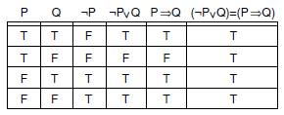
Example
Using a truth table, show that the expressions
(P → Q) and (￢P ∨ Q) are equivalent (P → Q ≡ ￢P ∨ Q)

Slide 14
The Predicate Calculus: introduction (i)
In propositional calculus, each atomic symbol (P, Q, etc.) denotes a single proposition. Therefore, there is no way to access the components of an individual assertion. For instance, P is a proposition such that
P: “it rained on Tuesday”
On the contrary, predicate calculus provides this ability. For instance, we can create a predicate weather that describes a relationship between a day and the weather:
weather (Tuesday, rain)
Through inference rules we can manipulate predicate calculus expressions, accessing their individual components and inferring new sentences.

Slide 15
The Predicate Calculus: introduction (ii)
Predicate calculus also allows expressions to contain variables.
Variables let us create general assertions about classes of entities. For example, we could state that:
for all values of X, where X is a day of the week,
the statement weather(X, rain) is true;
i.e., it rains every day.

Slide 16
Predicate Calculus Symbols (i)
The alphabet that makes up the symbols of the predicate calculus consists of:
The set of both upper and lowercase letters of the English alphabet
The set of decimal digits (0, 1, 2, … , 9)
The underscore ( _ )
Symbols in the predicate calculus begin with a letter and are followed by any sequence of the above legal characters.

Slide 17
Example
Is the following a legitimate character in the alphabet of predicate calculus symbols?
A
Yes
d
Yes
#
No
/
No
6
Yes
_
Yes
&
No

Slide 18
Example
Is the following a legitimate predicate calculus symbol?
George
YES
Fire3
YES
science!!!
No
ahmd_and_salem
YES
3jack
No
bill
YES
XXXX
YES
Cheating not allowed
No
friends_of
YES
ab%cd
No

Slide 19
Predicate Calculus Symbols (ii)
Parentheses “( )”, commas “,”, and periods “.” are used solely to construct well-formed expressions and do not denote objects or relations in the world. These are called improper symbols.
Predicate calculus symbols may represent either variables, constants, functions, or predicates.
Notes:
تستخدم فقط لبناء تعبيرات شكلت بشكل جيد ولا تشير إلى الأشياء أو العلاقات في العالم. وتسمى هذه الرموز غير صحيح

Slide 20
Predicate Calculus Symbols (iii)
Predicate calculus symbols include:
  Truth symbols: true and false (these are reserved symbols).
  Constant symbols: symbol expressions having the first character lowercase.
  Variable symbols: symbol expressions beginning with an uppercase character.
  Function symbols: symbol expressions having the first character lowercase.
Every function symbol has an associated arity, indicating the number of elements in the domain mapped onto each element of the range.
A function expression is a function symbol followed by its arguments. i.e., it consists of a function constant of arity n, followed by n terms (t₁, t₂ ,…, t_{n}) enclosed in parentheses and separated by commas.

Slide 21
Predicate Calculus Terms
A predicate calculus term is either a constant, variable, or function expression. It may be used to denote objects and properties in a problem domain.
Examples of terms are:
  cat
  times(2,3)
  X
  Blue
  mother(sarah)
  kate

Slide 22
Predicates
Symbols in predicate calculus may also represent predicates.
Predicate symbols, like constants and function names, begin with a lowercase letter.
A predicate names a relationship between zero or more objects in the world.
The number of objects so related is the arity of the predicate.
Predicates with the same name but different arities are considered distinct.
Examples of predicates are:
  likes
  equals
  on
  near
  part_of
Notes:
الرموز

Slide 23
Atomic Sentences
Atomic sentence
  Is the most primitive unit of the predicate calculus language.
  It is a predicate of arity n followed by n terms enclosed in parentheses and separated by commas.
  The truth values, true and false, are also atomic sentences
  Atomic sentences are also called atomic expressions, atoms, or propositions
  We may combine atomic sentences using logical operators to form sentences in the predicate calculus. These are the same logical connectives used in propositional calculus (∧, ∨, ￢, →, and ≡)

Slide 24
Examples of Atomic Sentences
Examples of atomic sentences are:
  likes(george,kate)
  likes(george,susie)
  likes(X,george)
  likes(X,X)
  likes(george,sarah,tuesday)
  friends(bill,richard)
  friends(bill,george)
  friends(father_of(david),father_of(andrew))
  helps(bill,george)
  helps(richard,bill)

Slide 25
Universal and Existential Quantiﬁers
The universal quantiﬁer,∀, indicates that the sentence is true for all values of the variable.
  In the example, ∀X likes(X, ice_cream) is true for all values in the domain of the deﬁnition of X.
The existential quantiﬁer,∃, indicates that the sentence is true for at least one value in the domain.
  For examle ∃ Y friends(Y, peter) is true if there is at least one object, indicated by Y that is a friend of peter.

Slide 26
Syntax of First Order Logic: Quantifiers
For the universal quantifier
For the existential quantifier
⇒ is the main connective with (∀).
E.g.: ∀x At(x,KSA) ⇒ Smart(x)
    means:
    “everyone that is at KSA is smart”
∧ is the main connective with (∃)
E.g. ∃xAt(x,KSA) ∧ Smart(x) means “there are students at KSA that are smart”

Slide 27
PREDICATE CALCULUS SENTENCES (WFFs)
Every atomic sentence is a sentence.
If s is a sentence, then so is its negation, ￢ s.
If s1 and s2 are sentences, then so is their conjunction, s1 ∧ s2.
If s1 and s2 are sentences, then so is their disjunction, s1 ∨ s2.
If s1 and s2 are sentences, then so is their implication, s1 → s2.
If s1 and s2 are sentences, then so is their equivalence, s1 ≡ s2.
If X is a variable and s a sentence, then ∀ X s is a sentence.
If X is a variable and s a sentence, then ∃ X s is a sentence.

Slide 28
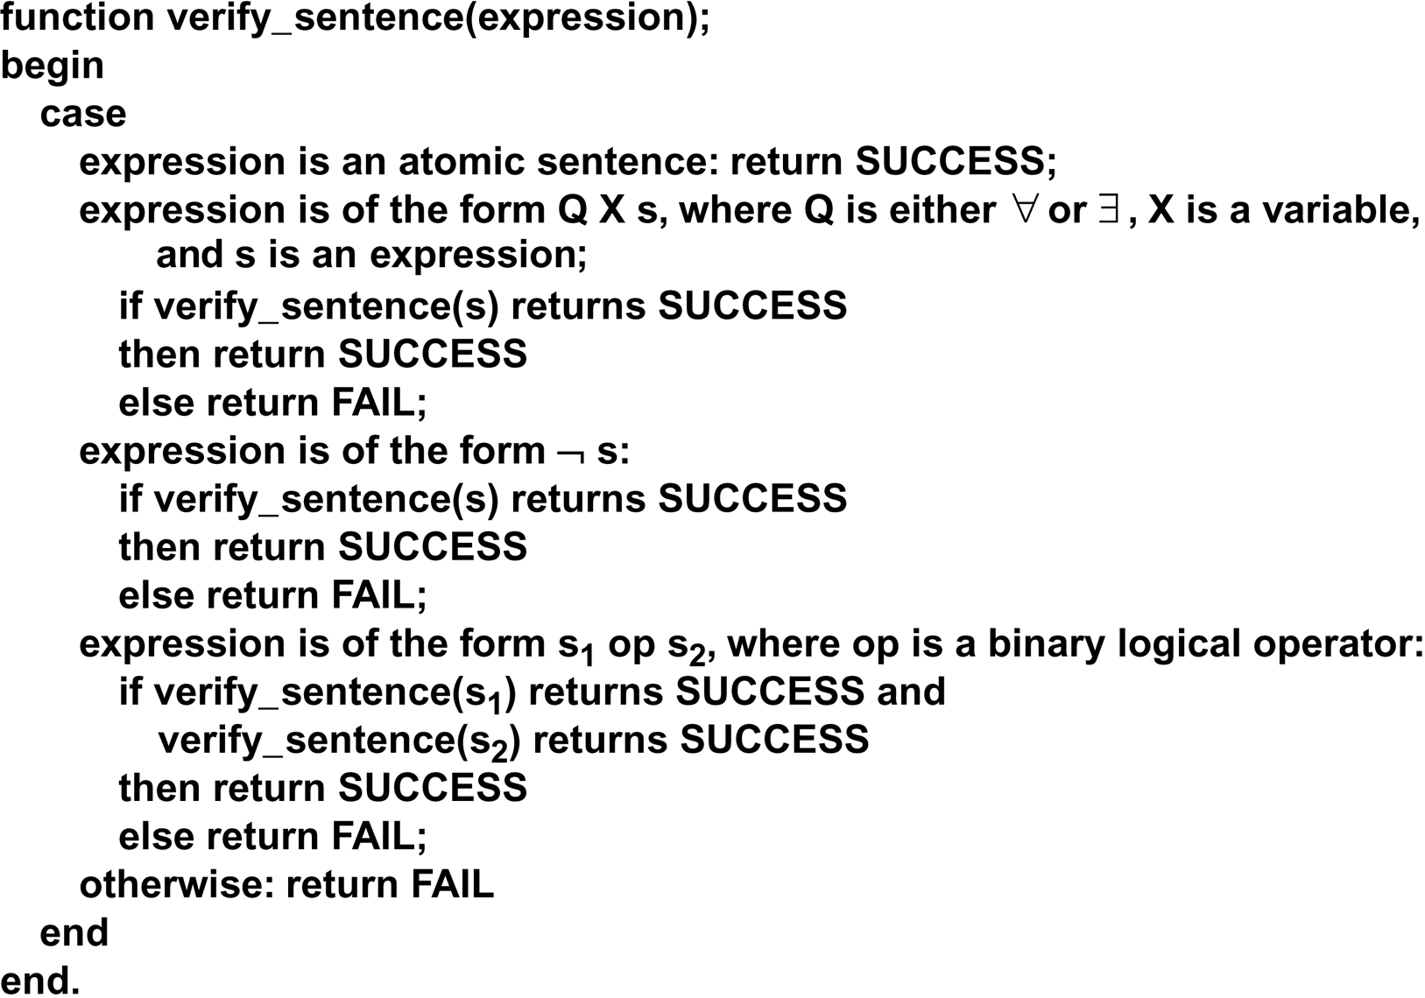
Verify _ Sentence Algorithm

Slide 29
A Family Relationships
An Example of the use of predicate calculus to describe a simple world. The domain of discourse is a set of family relationships in a biblical genealogy:
  mother(eve, abel)
  mother(eve , cain)
  father(adam , abel)
  father(adam , cain)
∀ X ∀ Y father(X, Y) ∨ mother(X, Y) → parent(X, Y)
∀ X ∀ Y ∀ Z parent(X, Y) ∧ parent(X, Z) → sibling (Y, Z)

Slide 30
A Semantics for the Predicate Calculus
Given an interpretation, the meaning of an expression is a truth value assignment over the interpretation.
The value of an atomic sentence is either T or F as determined by the interpretation I

Slide 31
FIRST-ORDER PREDICATE CALCULUS (i)
First-order predicate calculus allows quantified variables to refer to objects in the domain of discourse and not to predicates or functions.
For example, ∀(Likes) Likes(george,kate)
is not a well-formed expression in the ﬁrst-order predicate calculus.
There are higher-order predicate calculi where such expressions are meaningful.

Slide 32
FIRST-ORDER PREDICATE CALCULUS (ii)
Examples of English sentences represented in predicate calculus are:
  If it doesn’t rain on Monday, Tom will go to the mountains.
￢ weather(rain, monday)→go(tom, mountains)
  Emma is a Doberman pinscher and a good dog.
gooddog(emma) ∧ isa(emma, doberman)
  All basketball players are tall.
∀ X (basketball_player(X)→tall(X))
  Some people like anchovies.
∃ X (person(X) ∧ likes(X, anchovies))
  If wishes were horses, beggars would ride.
equal(wishes, horses)→ride(beggars)
  Nobody likes taxes.
￢ ∃ X likes(X, taxes)
Notes:
المتسولين

Slide 33
Example (i)
Everybody likes some food.
∀X ∃F food(F) ∧ likes (X,F)
There is a food that everyone likes.
∃F ∀X food(F) ∧ likes (X,F)
Whenever someone eats a spicy dish, they’re happy.
∀X ∃F food(F) ∧ spicy(F) ∧ eats (X,F) → happy(X)
John’s meals are spicy.
∀X meal-of(John,X) → spicy(X)
Every city has a dogcatcher who has been bitten by every dog in town.
∀x City(x) ⇒ [∃y DogCatcher(y)∧[∀z Dog(z)∧LivesIn(z, x) ⇒ BittenBy(y, z)]]

Slide 34
Example (ii)
From the following axioms and facts, can you deduce who is the prize winner and if he is happy or not?
∀x Won_Prize(x) ⇒Happy(x)
∀y Play_Game(y) ^ Lucky(y) ⇒ Won_Prize(y)
Play_Game(Ali)
Play_Game(Mona)
Lucky(Ali)
Happy(Mona)
Notes:
Ali

Slide 35
Example (iii)
Consider the following axioms:
All hounds howl at night.
Anyone who has any cats will not have any mice.
Light sleepers do not have anything which howls at night.
Ali has either a cat or a hound.
Using FOL translate each of the above axioms into a well formed formula (WFF).
Given the fact that Ali is a light sleeper, Does Ali have mice? Explain.
Notes:
-All hounds howl at night.
∀x X (hound(X) -> howl(X))
-Anyone who has any cats will not have any mice.
∀X ∀Y (have(X,Y) ^ cat(Y) -> (￢(∃ Z (have(X,Z) ^ mouse(Z)))))
Light sleepers do not have anything which howls at night.
∀ X (ls(X) -> (￢(∃ Y (have(X,Y) ^ howl(Y)))))
John has either a cat or a hound.
X (have(john,X) ^ (cat(X) ∨ hound(X)))
Conclusion: if John is a light sleeper, then John does not have any mice.

Slide 36
Answer
1. ∀x(Hound(x) → Howl(x))
2. ∀x∀y(Have(x, y) ∧ Cat(y) → ¬∃z(Have(x, z) ∧ Mouse(z)))
3. ∀x(LS(x) → ¬∃y(Have(x, y) ∧ Howl(y)))
4. ∃x(Have(Ali , x) ∧ (Cat(x) ∨ Hound(x)))
5. LS(Ali ) → ¬∃z(Have(Ali , z) ∧ Mouse(z))

Slide 37
Fundamental concepts of logical representation: the inference rules
The semantics of the predicate calculus provides a basis for a formal theory of logical inference.
The ability to infer new correct expressions from a set of true assertions is an important feature of the predicate calculus.
These new expressions are correct in that they are consistent with all previous interpretations of the original set of expressions.

Slide 38
Fundamental concepts of logical representation: the proof procedure
Proof procedure is a combination of an inference rule and an algorithm for applying that rule to a set of logical expressions to generate new sentences.

Slide 39
Fundamental concepts of logical representation: Satisfy, model, valid, inconsistent
For a predicate calculus expression X and an interpretation I:
  If X has a value of T under I and a particular variable assignment, then I is said to satisfy X.
  If I satisfies X for all variable assignments, then I is a model of X.
  X is satisfiable if there is an interpretation and variable assignment that satisfy it; otherwise it is unsatisfiable.
  A set of expressions is satisfiable if there is an interpretation and variable assignment that satisfy every element.
  If a set of expressions is not satisfiable, it is said to be inconsistent.
  If X has a value T for all possible interpretations, X is said to be valid.

Slide 40
Fundamental concepts of logical representation: Logically follows, sound, and complete
A predicate calculus expression X logically follows from a set S of predicate calculus expressions if every interpretation and variable assignment that satisfies S also satisfies X.
An inference rule is sound if every predicate calculus expression produced by the rule from a set S of predicate calculus expressions also logically follows from S. derivations produce only entailed sentences
An inference rule is complete if, given a set S of predicate calculus expressions, the rule can infer every expression that logically follows from S. derivations can produce all entailed sentences.

Slide 41
Rules of inference
Modus ponens | p p → q ∴ q
Modus tollens | ¬ Q p → q ∴ ¬ p
Elimination | p ∧ q ∴ p ∴ Q
Introduction | p q ∴ p ∧ q
Universal instantiation | ∀ X p(X) ∴ p(a), where a is from the domain of x

Slide 42
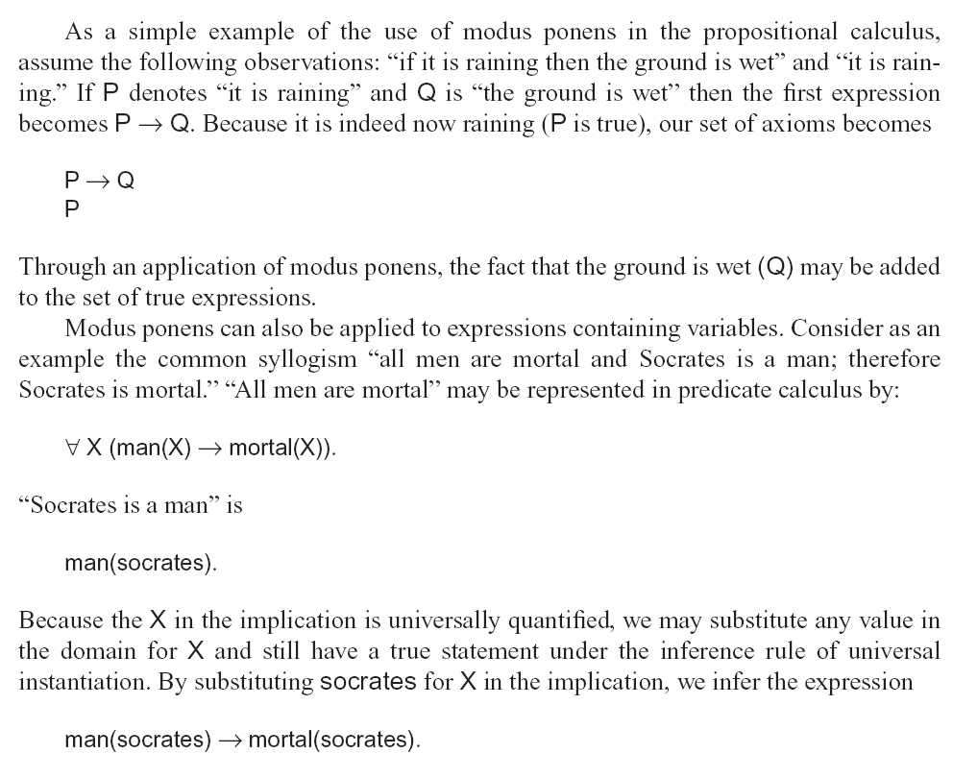
Examples

Slide 43
Unification
Uniﬁcation is an algorithm for determining the substitutions needed to make two predicate calculus expressions match.
Unification specifies conditions under which two (or more) predicate calculus expressions may be said to be equivalent.
Because p(X) and p(Y) are equivalent, Y may be substituted for X to make the sentences match.
Unification and inference rules such as modus ponens allow us to make inferences on a set of logical assertions.
Unification is complicated by the fact that a variable may be replaced by any term, including other variables and function expressions of arbitrary complexity. These expressions may themselves contain variables.

Slide 44
Examples
Unify p(a,X) and p(a,b)
answer: b/X p(a,b)
Unify p(a,X) and p(Y,b)
answer: a/Y, b/X p(a,b)
Unify p(a,X) and p(Y, f(Y))
answer: a/Y, f(a)/X p(a,f(a))
Unify p(a,X) and p(X,b)
Failure
Unify p(a,X) and p(Y,b)
answer: a/Y, b/X p(a,b)
Unify p(a,b) and p(X,X)
Failure
Unify p(X, f(Y), b) and P(X, f(b), b)
answer: b/Y

